Slide 1



Scaling-up of Quality and Patient Safety

Slide 2
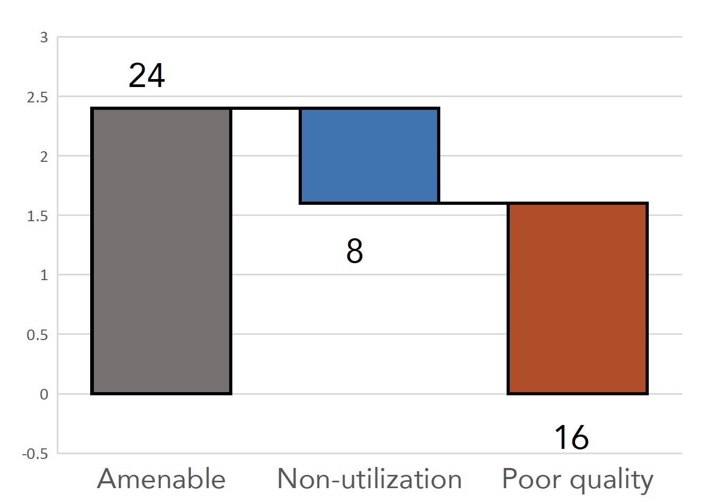
Why ‘Quality of Care’ is Important?
High-quality health systems could save over 86 Lakhs lives each year in LMICs*
Over 24 lakh deaths in India from treatable conditions
In India, 15.99 lakh deaths per year on account of poor quality of care**
16
* The Lancet Global Health Commission on High Quality Health Systems in the SDG era
**Kruk ME, Gage AD, Joseph NT, Danaei G, García-Saisó S, Salomon JA. Mortality due to low-quality health systems in the universal health coverage era: a systematic analysis of amenable deaths in 137 countries. The Lancet. 2018 Sep 5.

Slide 3
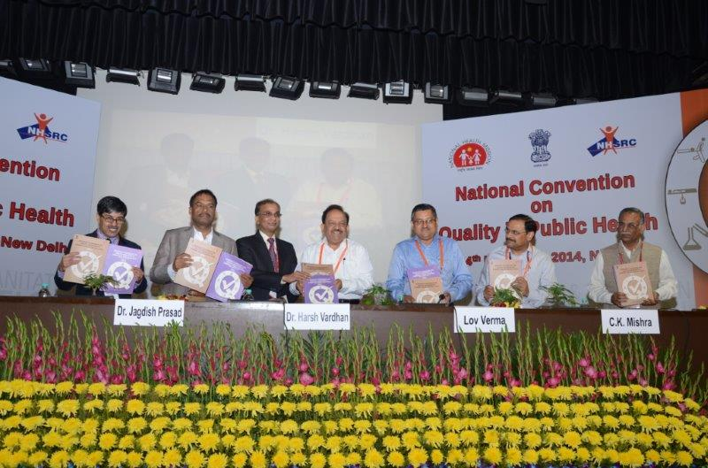
National Quality Assurance Standards (NQAS)
Standards and Assessors Guidebook for Community Health Centers (CHCs) and Primary Health Centers (PHCs) were launched in November 2014, and Urban Primary Health Centers(UPHC) in January 2016 & HWC-SC in 2020

Slide 4

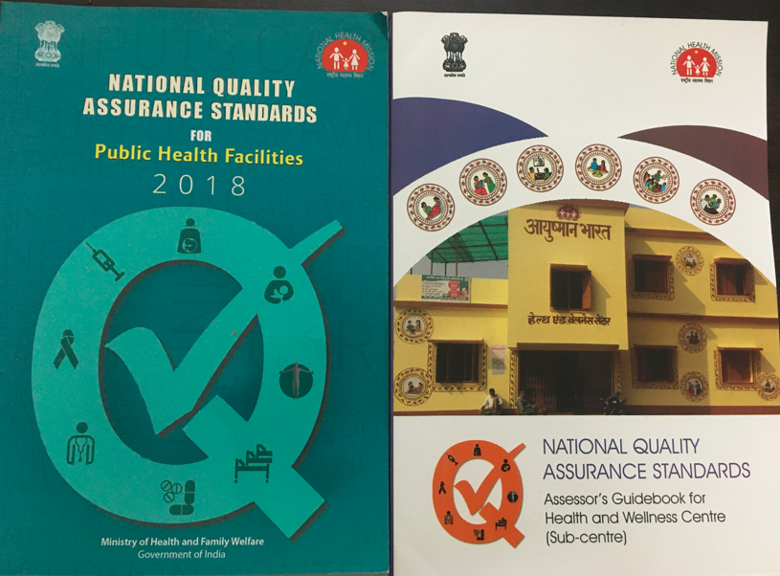


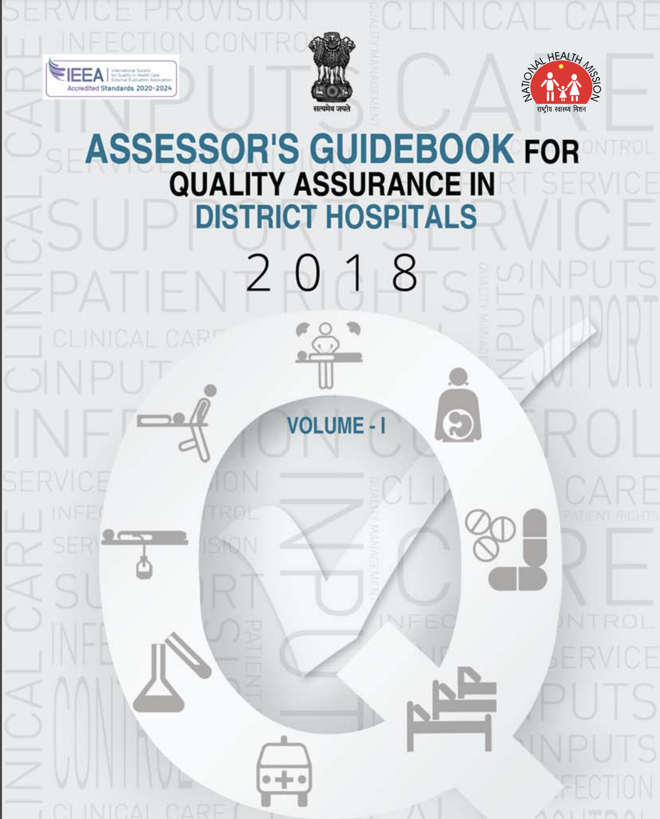
Overarching umbrella under NQAS
National Quality Assurance Standards
NQAS for Primary Care
NQAS for Secondary Care
MusQan initiative to ensure quality and safe services for child in OPD, PW, SNCU, NRC
Improvement of Quality of care around birth in LR and MOT
Health and Wellness Centre
Primary Health Centre
Urban Primary Health Centre
Community Health Centre
DH/SDH
Ensuring Quality of Care across the public health system

Slide 5


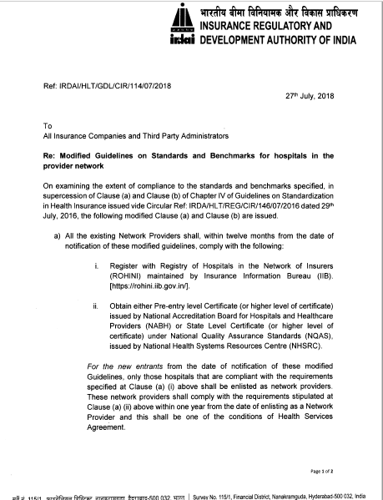
NQAS –International & National standards
NQAS model is presently well-established
and meeting national and international
benchmarks like the Insurance Regulatory
and Development Authority (IRDA as
International Society for Quality in
Healthcare (ISQUA), respectively.
National Health Authority (NHA) has provided
15% incentive over above existing health benefit
packages rate for NQAS
National level certified public hospitals.

Slide 6

Organizational Structure under Quality Assurance Programmes
National Level
Central Quality Supervisory Committee
State Level
State Quality
Assurance Committee
State Quality
Assurance Unit
District Level
District Quality
Assurance Committee
District Quality
Assurance Unit
Facility Level
Quality Improvement Team/Quality Circle

Slide 7
Continuous Assessment & Feedback
NATIONAL
National
Certification
NHSRC
STATE
Periodic Assessment & certification by SQAU
HOSPITAL
Continuous Internal
Assessment
Quarterly Assessment by DQAU
DISTRICT

Slide 8
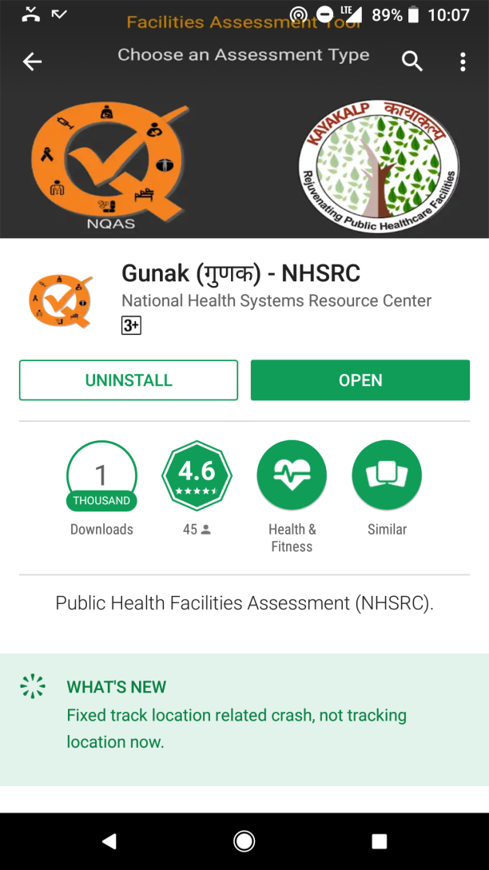
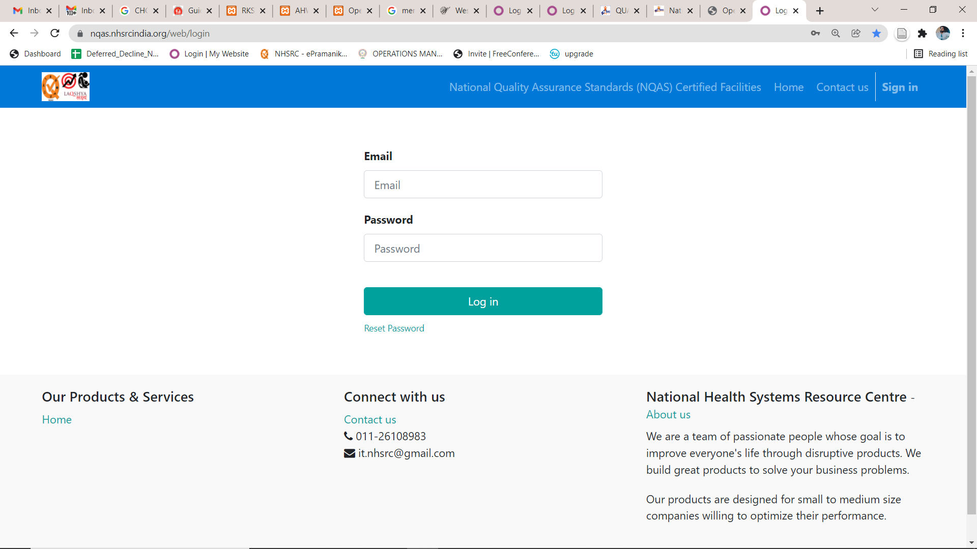



IT Solution For management of Certification Process and Quality Dashboard
GUNAK App : NQAS, KK & LaQshya Assessments
Interim IT Solution for certification Process
IT solution for Assessment, certification & Reporting-CDAC

Slide 9
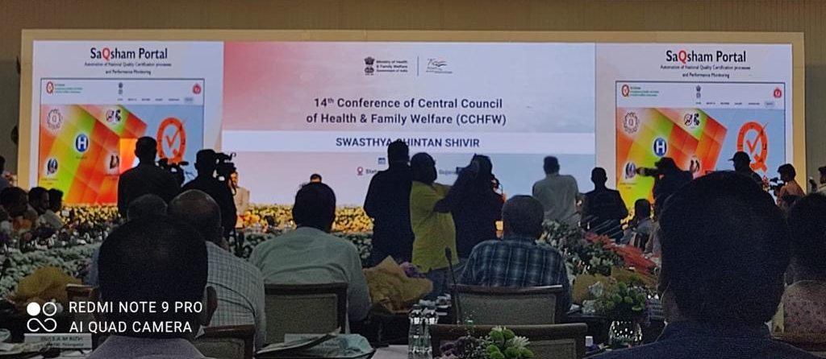
SaQsham Portal
Automation of National Quality Certification processes and Performance Monitoring
Notes:
We will provide

Slide 10
Percentage of NQAS national certified facilities against total* no. of facilities
Progress till 31st March 2022
*as per RHS 2019-20

Slide 11
Progress of NQAS National Certification
Progress in Ist Quarter of FY 2022-23 (April-June 2022)
 | DH | SDH | CHC | PHC | UPHC | HWC
India | 8 | 9 | 4 | 89 | 26 | 0
Arunachal Pradesh
Assam
Manipur
Meghalaya
Mizoram
Nagaland |  |  |  | 1 | 2
Sikkim |  |  |  | 1
Tripura
Odisha
West Bengal

Slide 12
Pool of assessors
S. No | State | Total External Assessors | Total Internal Assessors
1 | Arunachal Pradesh | 7 | 61
2 | Assam | 14 | 266
3 | Manipur | 11 | 149
4 | Meghalaya | 12 | 125
5 | Mizoram | 8 | 56
6 | Nagaland | 7 | 104
7 | Sikkim | 4 | 60
8 | Tripura | 16 | 71
9 | Odisha | 10 | 97
10 | West Bengal | 10 | 123
11 | India | 756 | 4959

Slide 13
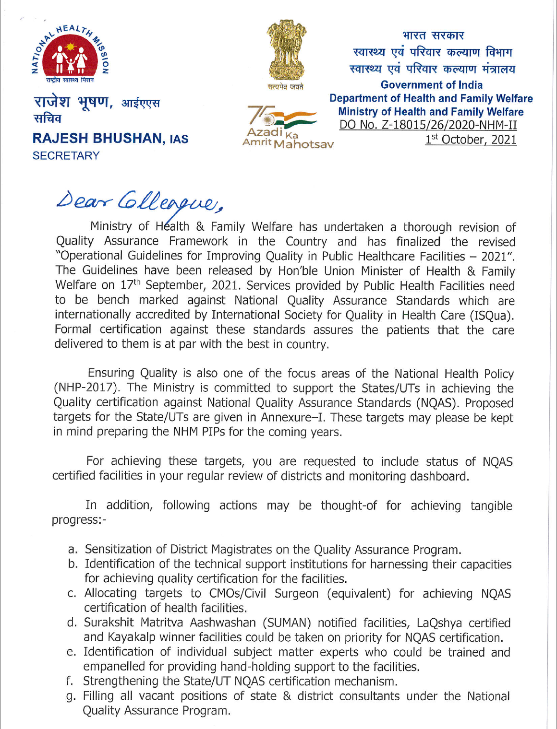
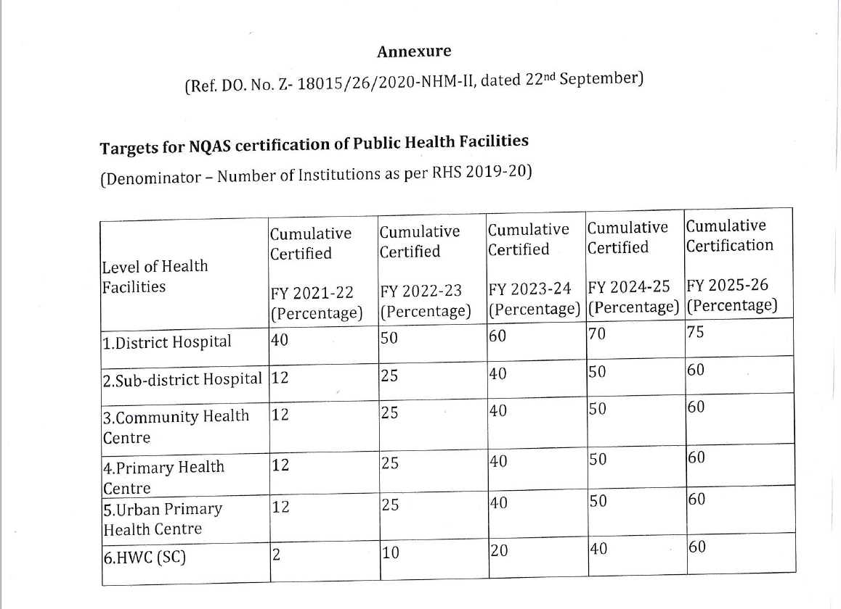
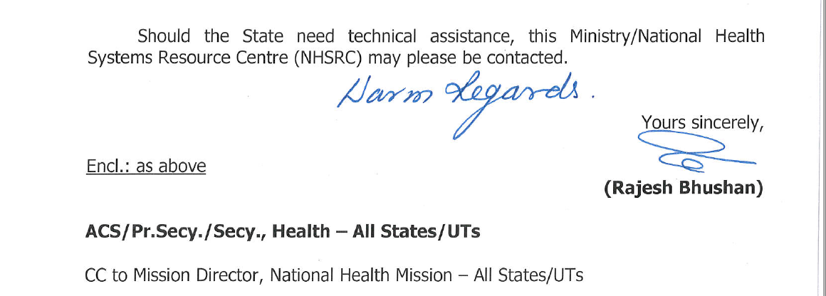
NHM-II targets for NQAS

Slide 14
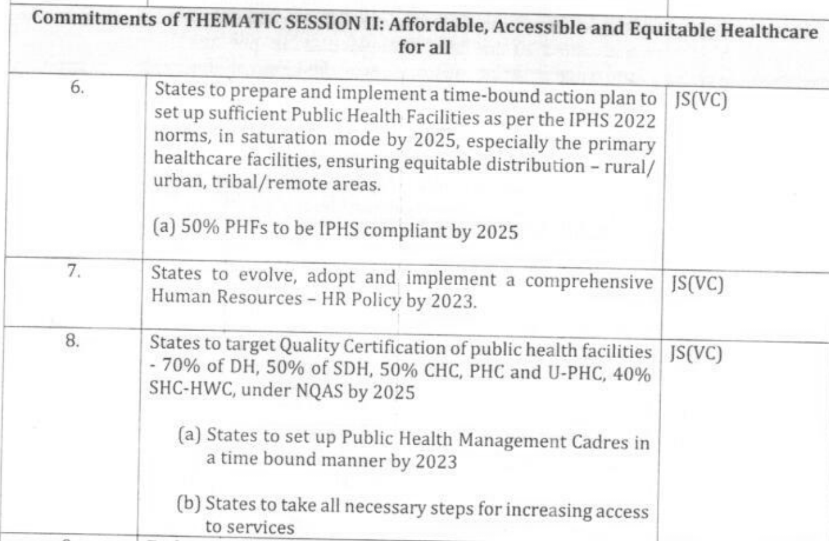
14th CCHFW Resolution
(5th – 7th May 2022)

Slide 15
NITI’s indicators on Quality for ranking of States
The Health Index score – List of indicators
3.1.3 (b) Proportion of public health facilities with Kayakalp score >70% against total number of public health facilities
3.1.8 (a) Proportion of public health facilities with accreditation certificates by a standard quality assurance program (NQAS/NABH)
3.1.8.b Proportion of District Hospitals and CHCs certified under LaQshya (separately for Labour Room and Maternal OT)

Slide 16
NITI’s indicators on Ranking of DHs
Tracking the performance of District Hospitals
Indicator: Quality score of Health Facility [NQAS score (%) obtained after state assessment for the FY ]
Indicator: Kayakalp score of Health Facility [Kayakalp score (%) obtained after peer assessment for the FY]
Indicator: Mera Aspataal Score [Percentage of very satisfied and satisfied patients for the FY]

Slide 17
NQAS as in-built component under XV-FC & PM-ABHIM
*Support for Diagnostics Infrastructure to the primary healthcare facilities- Sub-centres, PHCs and Urban PHCs
“To ensure reliable and accurate testing, it is important to adhere to quality procedures and protocols. The process of quality assurance would be in accordance with the NQAS program of GoI.”
**District Integrated Public Health Laboratories
“Under the overall ambit of the Quality Assurance Programme of Government of India, the quality initiatives and accreditations shall be undertaken to define the mechanism of NQAS and EQAS.”
*Implementation of 15th Finance Commission (FC-XV)- Health Grants through Local Governments
**Operational Guidelines for PM Ayushman Bharat Health Infrastructure Mission (PM-ABHIM)

Slide 18
Ensuring Quality in Laboratories
INTERNAL ASSESSMENT
STATE ASSESSMENT
NATIONAL ASSESSMENT
As per NQAS checklist for Laboratory
Gap analysis
SOPs and Work instructions
Calibration of Equipment
Controls
Periodic Ext. Validation
EQAS
Reporting of Quality Indicators
Score validation at State Level
Internal and External Quality Assurance
Through a team of empanelled External Assessors
As per NQAS certification criteria
ISO 15189 (NABL accreditation)
* As per Guidelines on Integrated Public Health Laboratories 2021, under Chapter 7 (Quality Assurance)

Slide 19
External Quality Assurance Scheme (EQAS) for Laboratories (1/2)
A. CMC Vellore: External Quality Assurance Programme
For Biochemistry, Thyroid & Cortisol, HbA1c, Reproductive Hormones, Urine Chemistry, Tumor & Cardiac Marker, Trace Metal
Online registration at http://home.cmcvellore.ac.in/clinqc/aboutRegistration.aspx
Fee structure varies as per the programme, details available at http://home.cmcvellore.ac.in/clinqc/aboutRegistration.aspx

Slide 20
External Quality Assurance Scheme (EQAS) for Laboratories (2/2)
B. ISHTM-AIIMS External Quality Assurance Programme
Organized by Department of Hematology, AIIMS New Delhi and Indian Society of Hematology & Transfusion Medicine (ISHTM)
Only for Hematology tests
Online enrollment form provided on website www.ishtmaiimseqap.com
Fee structure
      Private labs @ Rs 2000
      Government owned labs @ Rs 1500

Slide 21

Key Actions for Implementation of Quality
At the State Level
At the Facility Level
Biannual conduct of State Quality Assurance Committee meeting
NQAS certification/Quarterly Internal Assessment
Review of NQAS score.
Fire NoC
Biomedical Waste Authorisation, Liquid Waste Management through ETP/low-cost models (Haryana/Karnataka)
Progress of NQAS certification on quarterly basis as per NHM target
Annual Surveillance Audit
Patient Satisfaction Survey
Timely recertification
Regular reporting and review of Key Performance Indicators

Slide 22
