Slide 1
MP NUHM “Urban Baseline Survey”

Slide 2
Objective, Training and Coverage
Objective: Conduct a survey in both slum & non slum of 28 cities of M.P. on key indicators of health of women ever married and in the reproductive age of 15 to 49 years.
Activity | Duration
Training | 3rd Sep 2015 – 8th Sep 2015
Baseline Survey | 9th Sep 2015 – 26th Nov 2016
Team : Total 48 teams - consisting of 96 female investigators and 16 male supervisors & 4 District Coordinators.
Core team: Team Leader, Public Health Expert, Data Analyst and National Network Manager and State Coordinator
Coverage :Total number Primary Sampling Units (Census Enumeration Blocks) covered – 641 including 31,737 households ,used structured questionnaires .

Slide 3
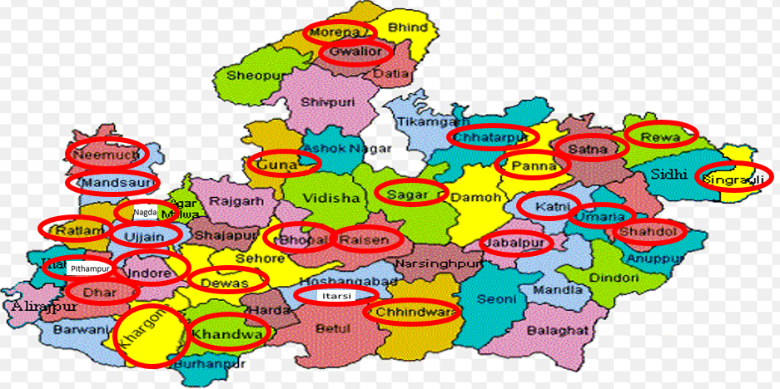
Geographical Coverage - 28 Towns

Slide 4
Demographics and Household Characteristics

Slide 5
Terms of Reference
Water Supply and Sanitation | Improved drinking water-Piped/public tap/hand pump; Sanitation facility/drainage system Disposal of child excreta; Use of Iodized salt
Family Planning | Contraceptive prevalence rate/Currently using any spacing method/Female sterilization/Male sterilization
Antenatal Care | Mothers consumed 100+ IFA tablets during pregnancy and received TT injections
Safe delivery | Institutional deliveries/deliveries at home Deliveries attended by a heath professional
Child Feeding and nutrition related Practices | Infants breast fed within one hour of birth; Children 6-9 months who received breast milk and solid food; Children receiving Vitamin A
Immunization Rates | Children immunized - receiving Polio vaccine, measles, DPT
HIV/AIDS, RTI/STI | Awareness amongst women about AIDS/HIV/RTI/STI Treatment of RTI/STI
Child Morbidity and care seeking | Children suffering in past two weeks from survey – diarrhea and ARI, Fluid intake, Place of treatment
Nutritional Data | Nutritional status: Mid Upper Arm Circumference Measurement for assessing nutritional status of children (0 to 59 months) and Body Mass Index (BMI) of women

Slide 6
Key Findings

Slide 7
Key Findings
S. No. | Key Findings | Slums | Non-slums
Ante Natal Care: Slum
1 | BP | 93.2% | 91.9%
2 | Weight | 92.1% | 94.9
3 | Blood group test | 88.1% | 94.7%
4 | Hb | 83.6% | 94.6%
5 | Abdomen check | 93.5% | 96.1%
6 | Urine/Sugar Test | 81.5% | 93.8%
7 | Ultrasound | 61.8% | 60.1%
Institutional delivery
1 | Govt. hospital | 67.5% | 66.7%
2 | Private hospital | 8.9% | 16.5%
Post Natal Care |  | 42.2% | 44.8%
Weight at birth <2.5 Kgs |  | 48.8% | 47%
Immunization |  | 92.5% | 95.5%
 |  | 13.8% | 14.2%
ARI |  | 16.1% | 17.1%
Awareness of RTI/STI |  | 13% | 17%
Awareness of AIDS |  | 54.9% | 66.5%

Slide 8
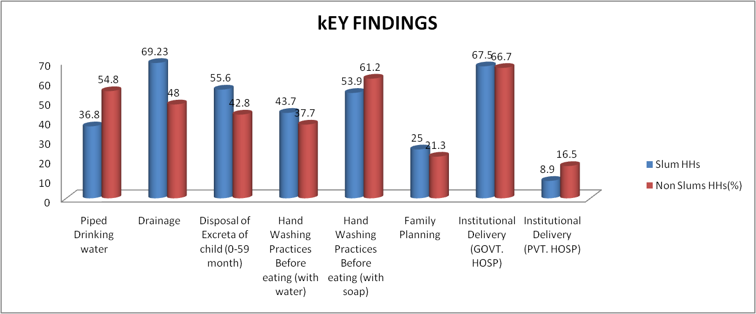
Key Findings

Slide 9
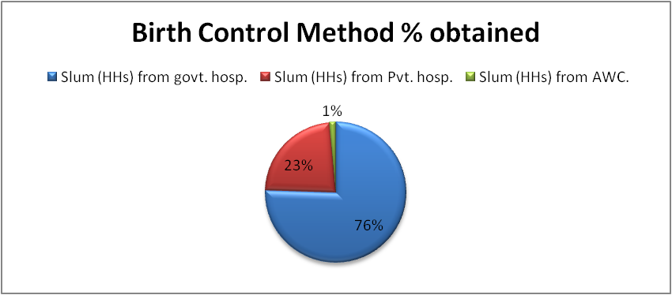
Key Findings

Slide 10
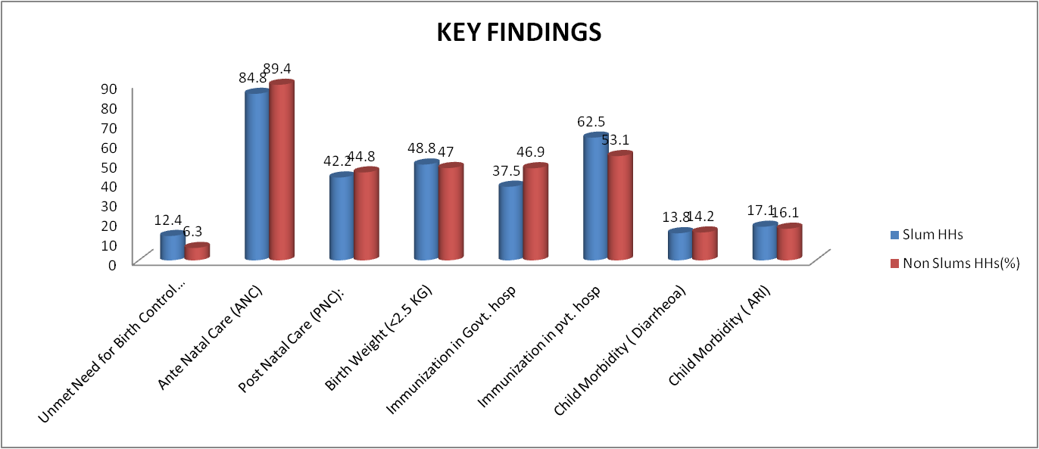
Key Findings

Slide 11
Key Findings

Slide 12
Key Findings
RTI/STI - Awareness - Slum HHs – 13%, Non-Slum HHs – 17%
HIV / AIDS - AIDS Awareness - Slum HHs - 54.9%, Non-Slum HHs - 66.5%; HIV Awareness - Slum HHs - 43.8%, Non-Slum HHs - 55.2%.
Nutritional Measurement
BMI: Below Normal BMI - Slum HHs - 18.7% women, Slum HHs - 11.6%; Obese – Slum HHs - 4.9%, Non Slum HHs -7.5%; More than normal BMI – Slum HHs - 14.6%, Non-Slum HHS - 22.5% ; Normal BMI - 60.7, Non-Slum HHs - 58.4% in normal range.
Mid Upper Arm Circumference measurement (MUAC) Red Band – Slum HHs - 17.3% children, Non-Slum - 12.7%; Malnourishment threshold – Slum HHs - 9.5%, Non-Slum HHs – 8.3%

Slide 13
Sources of Drinking Water
In big cities like Jabalpur percentage of slum households having piped water connection is high, while in other cities most of households are found to be dependent on community taps and hand pumps. However, in the selected only 3 PSUs of Bhopal, only 22% of households in non-slum areas had access to piped drinking water while more than half of the households from both slum and non-slum areas are dependent on community tap.

Slide 14
Main Source of Drinking Water
Piped Personal Connection

Slide 15
Fuel Used For Cooking
Wood - Slums of Katni, Sagar, Singrauli & Shahdol - around 45%; In Non-Slums of Panna - around 18%
Bio-gas: Slums: 0.5% in (Umaria 7.3% and Shahdol 2.3%). Non-Slums: 0.2% (0.9% Raisen & Mandideep and 0.5% in Panna and Dewas).
Notes:
Slums of Katni, Sagar, Singrauli and Shahdol – around 45% use of wood and in non-slums around 18% in Panna

Slide 16
Hand Wash Before Eating
Slums
Wash with Only water: > 80% - Bhopal, Dhar, Mandsore, Neemuch and Nagda.
Non-slums:
Wash with Only Water: > 80% - Neemuch, Mandsore and Nagda.
With Soap: >80% in slums and non-slums; Dewas, Guna, Gwalior, Itarsi, Raisen and Mandideep, Rewa, Sagar, Satna and Khandwa.
Neemuch: <6% soap in non-slums
UMARIA: 8.3% in slums do not wash hands before eating

Slide 17
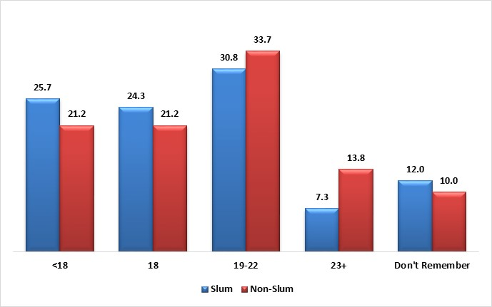
Age At Marriage
Slums:
< 18 years: 30 to 41% of Females found to be married before the age of 18 years in Guna (41%), Dewas, Singrauli, Sagar, Dhar, Katni, Shahdol. Lowest being around 10% in Khargone and Chhindwara.
Non-Slums:
< 18 years: Around 25% of Females found to be married before the age of 18 years in Singrauli, Guna, Bhopal, Raisen & Mandideep, Umaria, Rewa, Satna and Pithampur. Lowest found in Khargone and Chhindwara.

Slide 18
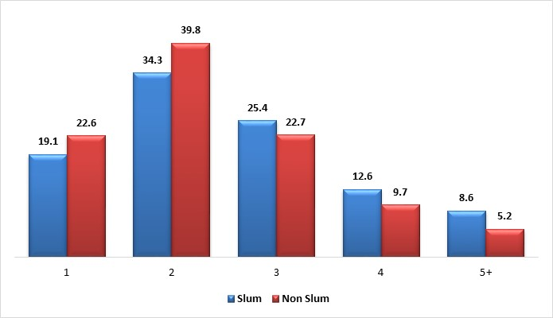
Number of Living Children
Slums:
53% of the households have 1 to 2 children.
About 35% households - 3 children: of Neemuch, Katni, Umaria, Itarsi, Nagda. 20% household with 4 children: Sagar 10 to 15% households with 5 or more children: Panna, Singrauli, Neemuch, Morena, Sagar, Shahdol
Non- Slums:
62% households have 1 or 2 children.
Around 25% households with 3 Children: Towns like Khandwa, Bhopal, Raisen & Mandideep, Umaria, Singrauli Around 12% households have 4 Children: Bhopal, Morena, Khandwa, Raisen & Mandideep, Singrauli, Neemuch and Around 8 to10% households with 5 or more : Panna, Khandwa, Itarsi, Panna, Rewa, Guna, Umaria

Slide 19
Family Planning Methods Currently Being Used (1/2)

Slide 20
Family Planning Methods Currently Being Used (1/2)

Slide 21
Availability of Anganwadi Centers
Slums:
53 to 70% AWC: Khargone, Chhatarpur, Ujjain, Singrauli, Chhatarpur, Itarsi, Pithampur.
>90%: Bhopal, Nagda, Dhar, Raisen & Mandideep, Rewa.
Non-Slums:
53 to 68% AWCs: Indore, Umaria, Khargone, Chhatarpur, Gwalior, Jabalpur, Satna, Chhindwara, Shahdol.
> 85% AWCs: Bhopal (highest 94.8%), Khandwa, Raisen & Mandideep, Mandsore, Morena

Slide 22
Observations

Slide 23
Observations (1 of 6)
Drinking Water: Availability of clean and safe drinking water in Slum HHs and also Non-Slum HHs – Need to redouble efforts in a time bound manner.
Drainage & Sewer System: Network of covered drainage systems across all towns in Slum HHs as well Non-Slum HHs needs urgent expansion.
Excreta Disposal: Wide prevalence of disposal of excreta of children in open drains and outside homes in the open, especially in Slum HHs, needs to be curbed urgently through counselling and social mobilisation efforts.
Toilet Facilities: Toilet facilities need improvement and more public toilet facilities need to be built in order to eradicate prevalence of open defecation which currently is quite high in the 28 cities/towns.

Slide 24
Observations (2 of 6)
Convergence with Municipal Bodies: Role of municipal bodies needs to be strengthened to promote convergence; Need to sensitise and orient municipal workers to pay special attention to determinants of good health
Social Behavioural Change Communication (SBCC) & Strategies: Well targeted and well designed behavioural change communication as a core strategy; develop capacities of health functionaries in inter-personal counselling and of managers in social mobilisation and media management.
Hand Washing: Benefits of hand washing with soap before eating are recommended; Incidence of Diarrhoea, certain types of fever and other water borne diseases can be considerably reduced as a result.

Slide 25
Observations (3 of 6)
Prevention & treatment of Anaemia: Need to increase awareness about preventing anaemia, it’s harmful consequences; Easy methods of prevention through change in dietary habits coupled with intake of at least 100 IFA tablets along with 2 TT injections during pregnancy.
Nutritional Status of Women: Low BMI amongst women living in Slum HHs is a matter of concern and it is recommended to be addressed as it effects the quality of life and results also in low birth weight babies weakening the foundations of a healthy life. Effective counselling and behaviour change strategies
Ante-natal Care & Low Birth Weight of New-borns: High incidence of low birth weight of babies across Slum HHs and Non-Slum HHs in the 28 cities and towns is a matter of serious concern needing urgent attention. Redoubled efforts are recommended to develop capacities of frontline health functionaries, family level counselling in households with pregnant women as well as social mobilisation of communities.

Slide 26
Observations (4 of 6)
Post Natal Care: Effective mobilization of frontline level health to motivate married women to go for Post Natal Care and avail services offered in government health facilities. PNC services in government run health facilities may require strengthening and increased accessibility including rationalisation of timings of PNC clinics.
Paediatric Care: Focus on improving the provision of these services in government health facilities and making them child friendly. At the same time it is recommended that public private partnerships should be established in these cities and towns with existing private health facilities to offer standard paediatric treatment as agreed prices to poor families and the expense is reimbursed by the Urban Health Programme.

Slide 27
Observations (5 of 6)
Nutrition: 20-27% children below 6 years of age were undernourished in the Non-Slum HHs and Slum HHs Address these gaps through effective and sustained social mobilisation and behavioural change communication strategies and campaigns.
Prevention & Treatment of Diarrhoea: The high rate of Diarrhoea incidents reported in both Slum HHs and Non-Slum HHs. It is recommended to redouble efforts of frontline health functionaries and rope in services of Anganwadi Workers and ASHAs as change agents. Timely treatment using Zinc and ORS combination.
Prevention & Treatment of Acute Respiratory Infections: Incidents of ARI amongst children below six years of age were alarmingly high as reported in both Slum HHs and Non-Slum HHs of 28 surveyed cities/towns. This reflects on poor household level care practices. It is recommended that sustained campaigns be launched in the cities/towns to educate care givers at household levels on prevention of ARIs, recognition of signs of ARIs

Slide 28
Observations (6 of 6)
Immunisation Services: High percentage of Slum HHs and Non-Slum HHs availed immunisation services from private health facilities. It is recommended that this trend is reversed by strengthening capacities & accessibility of government health facilities; Extension work of the frontline health workers and role of ASHAs and AWWs in this regard may be further strengthened.
Reproductive Tract Infections & Sexually Transmitted Infections: Knowledge of symptoms of RTI and STI was found lacking in the Slum HHs and Non-Slum. Large majority of those who were aware, reportedly resorted to treatment from government health facilities, it is recommended that the information gaps in prevention of RTI and STI as well as recognition of symptoms and timely treatment from government approved treatment centres, be bridged through effective social and behavioural change campaigns
HIV/AIDS: While knowledge of AIDS is quite prevalent in the Slum HHs and Non-Slum HHs of 28 surveyed cities and towns, knowledge of HIV infection and how it is transmitted was found lacking. It is recommended to address this gap through sustained SBCC campaigns.

Slide 29
Utilization of Base line findings
& GIS Mapping Data
Incorporate conclusion of Base line survey & GIS mapping to develop strategies based on findings on different indicators for Slum & Non slums i.e. establishment/ relocation of health facilities, Area specific interventions- IEC/BCC / health service provisioning.

Slide 30
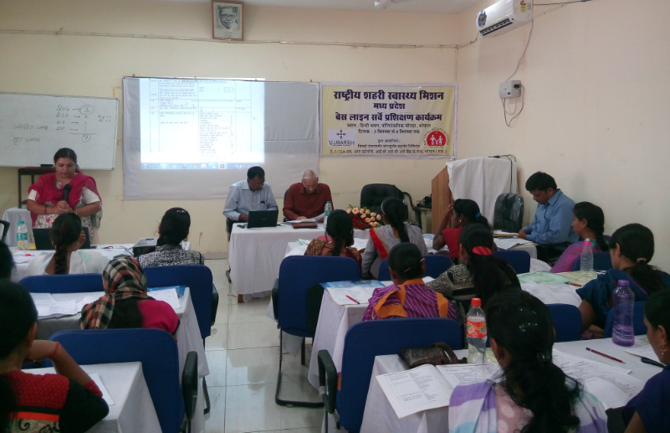
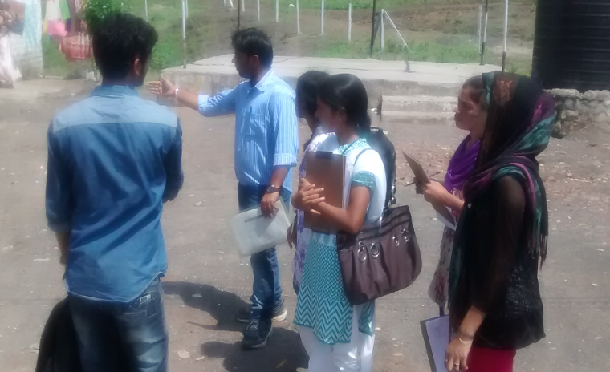
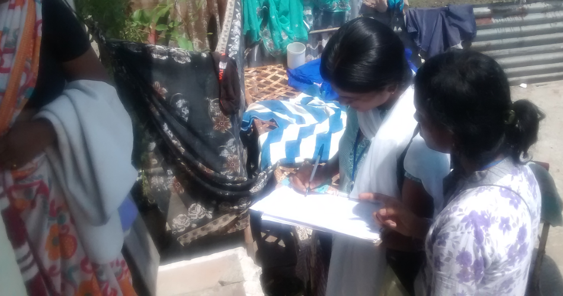
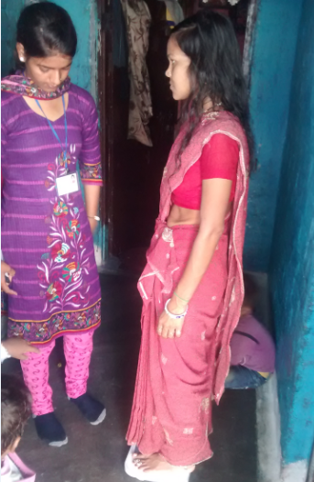
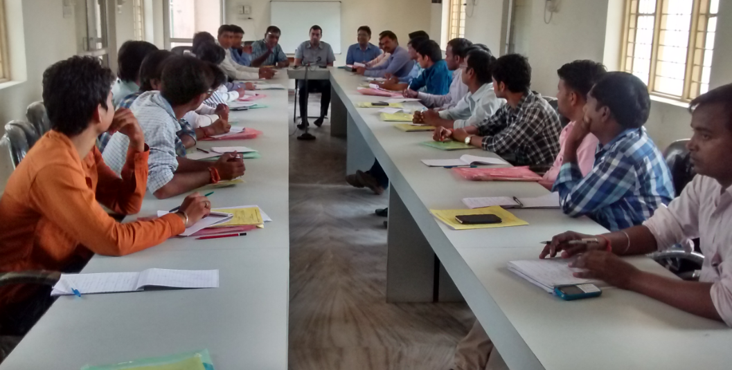
Some Pictorial Moments of Base Line Survey

Slide 31
Thank you

