Slide 1
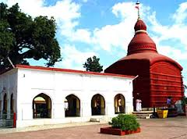
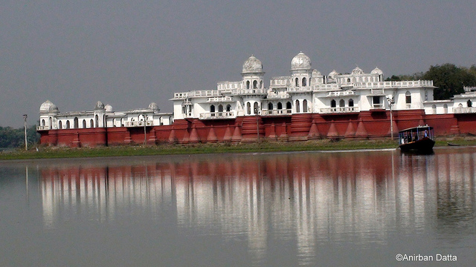
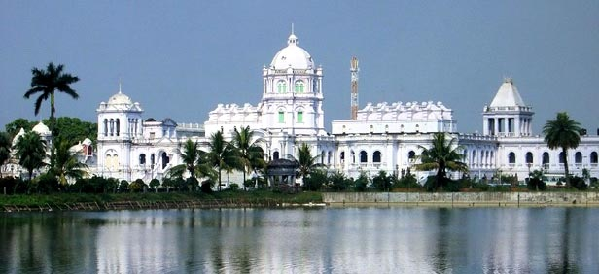
Dr. Shailesh K. Yadav, IAS MD NHM Tripura drshaileshkyadav@gmail.com
Health Goes Green
TRIPURA EXPERIENCE

Slide 2
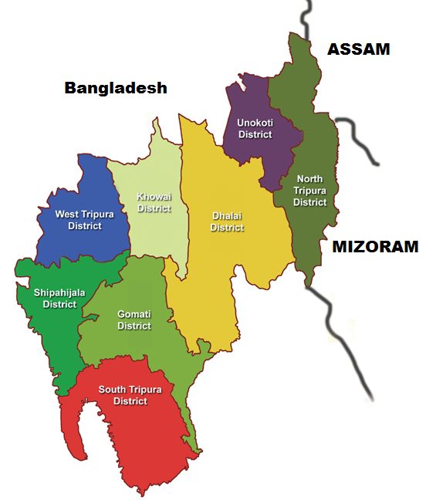
Demography & Health Situation
SL | Item | Number
1 | Population | 36.71 L
2 | District | 08
3 | Birth Rate | 14.9
4 | Death Rate | 4.7
5 | IMR | 21
6 | Institutional Delivery | 89%
7 | Medical College | 02
8 | State level Hospital | 05
9 | District Hospital | 06
10 | Sub-Div Hospital | 11
11 | PHC, CHC | 94, 21

Slide 3
Problem Statement
Difficult areas, hilly terrain
Power cuts
Transmission lines disturbed in rainy, stormy weather
Need for alternate power back up system
Smooth service delivery in Labour Room,OT, IPD
Maintaining cold chain

Slide 4
Solar Power-Options
Grid connected / Grid interactive
Net metering / Gross metering
Govt. Incentive : 15% subsidy
Priority sector lending
Loans with housing loan interest rate from PSBs
Off Grid
Portable lanterns, home lighting system, street lighting system, Solar Photo Voltaic (PV) Power Plant
Government Incentive
Capital subsidy : 30% Gen States, 90% NER, Islands & Special category States

Slide 5
Implementing Agencies (NSM)
State Nodal Agencies (REDAs)
SECI (www.seci.gov.in)
Empanelled channel partners (www.mnre.gov.in)
Few CPSUs
Govt Departments can directly avail subsidy from MNRE

Slide 6
Programme Description
Off-grid Roof top Solar Photovoltaic (PV) Power Plants
Implemented by Tripura renewable Energy Development Agency (TREDA) by open tender
1st Phase in 2014-15 in 85 PHCs
2nd Phase in 2015-16 in all remaining PHCs, CHCs, District Hospital
3rd Phase being implemented in CHCs upgraded to DH
In built Comprehensive Maintenance Contract (CMC) for Five (05) years
Remote Monitoring unit with sms linkage with TREDA

Slide 7
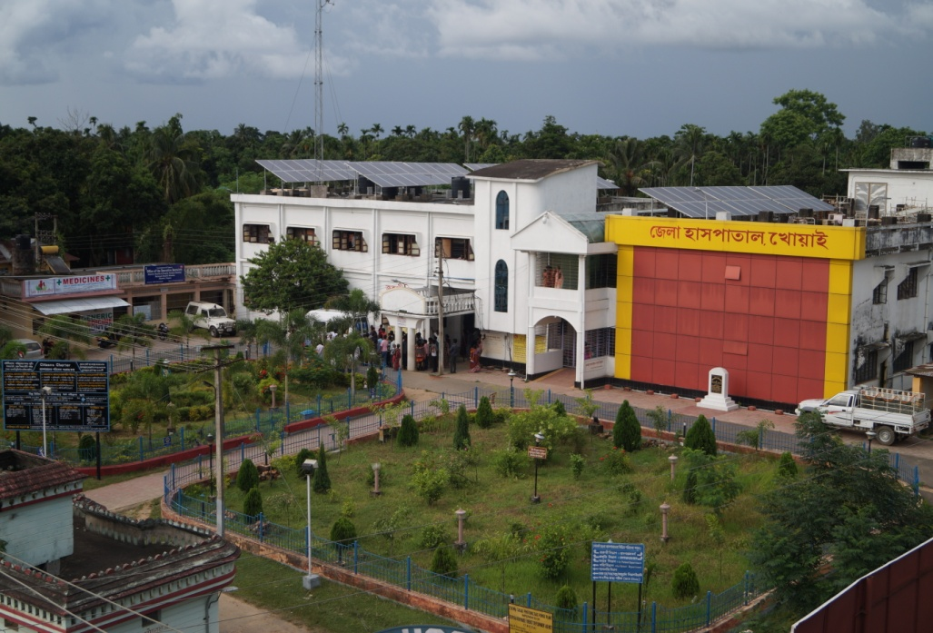
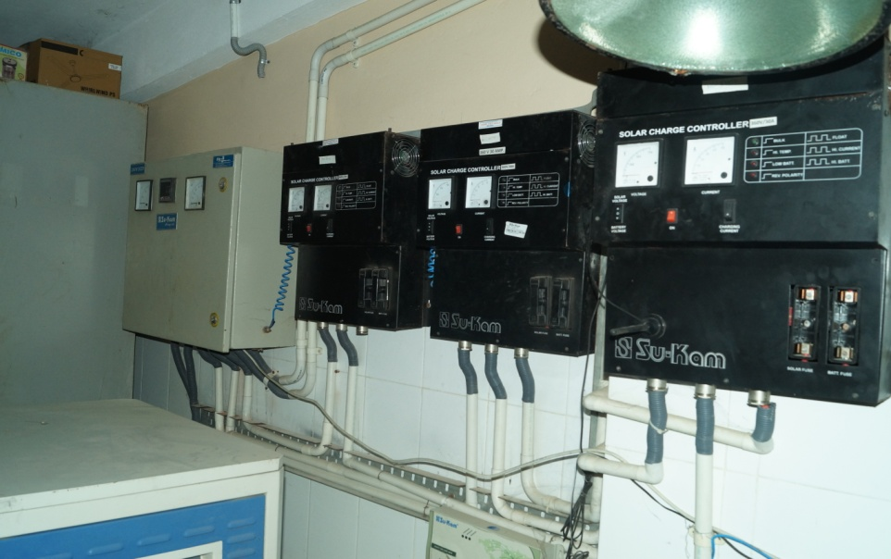
Programme Description
Category | Capacity (kWp) | Cost (Rs. Lakhs)
PHC | 5 | 10
CHC | 10 | 20
DH | 25 | 50

Slide 8
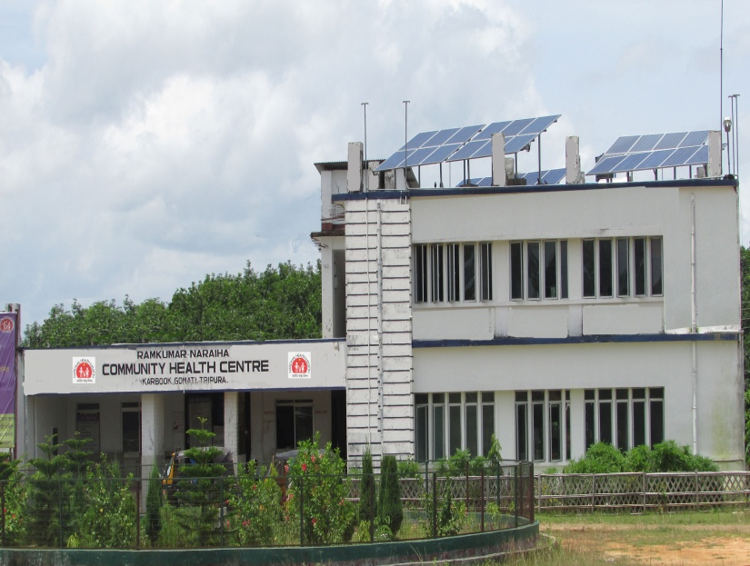
Technical Specs/ Financial Implication
For 1 kWp
Space – 10 sq m
4 Panels – 3 ft X 6 ft each (250 W)
Capacity denoted as kWp (kWpeak)
90% capital subsidy from MNRE under NSM
Total Project Cost is Rs. 11.32 Crores
State Health Department share is Rs. 1.70 crores

Slide 9
Programme Outcome
24X7 fully operational health facilities
Maintenance of cold chain, 24 hours labour rooms, hot water
Electricity bills- upto 30% decrease
No more candle-lit evening or nights to be spent by patients in wards
No more surgeries under torch lights
Better services for patients
Reducing carbon emission

Slide 10
Scalability/Replicability
One time installation, minimum maintenance
Average lifespan : 25 yrs
Certainly a solution for remote/inaccessible areas & power cuts
Cost of fossil fuel based electricity increasing
Cost of Solar power declining
Guidelines : MNRE Letter No.
5/23//2009-P&C (Pt.III) dated 03rd Nov 2014
30/11/2012-13/NSM dated 26th May 2014

Slide 11
THANK YOU
Notes:
11

