Slide 1
state NCD control program STEPWISE Approach To Airway DISEASE Kerala COPD Control Initiative
Dr.Latheesh K V,
District program manager (nhm), kannur,
9946105496
dpmknr@gmail.com

Slide 2
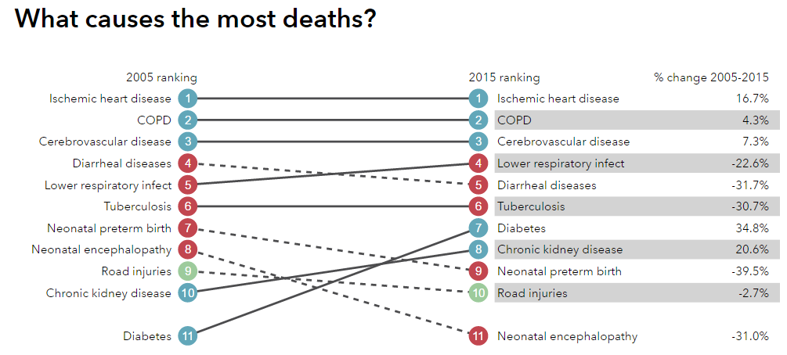
GBD Estimates for mortality - India

Slide 3
COPD Burden of Kerala
Studies shown 6-10 % of total population
Scarcity of data
Estimated COPD cases in Kerala - 530,000, Estimated Asthma patients among adults -480,000.
Increased Life Expectancy – More COPD
There is no specific public health program for COPD in India or Kerala

Slide 4
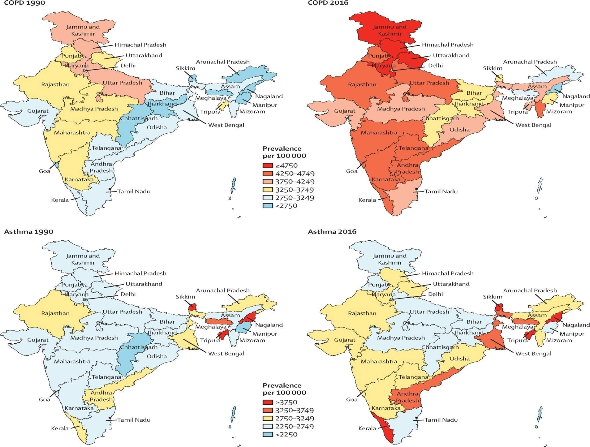
Figure 1
The Lancet Global Health 2018 6, e1363-e1374DOI: (10.1016/S2214-109X(18)30409-1)
Copyright © 2018 The Author(s). Published by Elsevier Ltd. This is an Open Access article under the CC BY 4.0 license
Notes:
Crude prevalence of COPD and asthma in the states of India, 1990 and 2016
COPD=chronic obstructive pulmonary disease.

Slide 5
Time Line
2015
PAL introduced by WHO
April
2016
COPD included in NCD control program
August 2016
ACS Health entrusts a high level committee to draft guidelines
Dec 2016
Procurement of spirometers and other equipment
Feb 2017
Health minister announces SWAAS program

Slide 6
Objectives
1. Identification of COPD in the early stages
2. Develop a structured program for COPD
3. Develop a system for generating information
on disease burden of COPD
4. An indigenously development of an
indigenous pulmonary rehabilitation program

Slide 7
Basic structure of the Kerala COPD prevention and control program
Level |  | Institution |  | Person responsible |  | Support
Primary care |  | PHC (COPD Clinics) |  | MO - PHC |  | COPD – Nurse
Taluk level |  | Taluk Hospital (Taluk COPD clinic) |  | MO-COPD (Respiratory Specialist) |  | MOTC Physician THQH
District Level |  | District Hospital (District COPD Clinic) District TB Center (District COPD Center) |  | District COPD Officer (Respiratory Specialist) |  | DMO(H) DTO
Sub-state level |  | Medical Colleges |  | Professor (Pulmonary Medicine) |  | DME
State Level |  | State COPD Center |  | State COPD Coordinator |  | State COPD Administrative Team State COPD Technical team

Slide 8
Components of SWAAS programme
Screening & Diagnosis using Spirometry
Staging of Disease
Guideline based Treatment for Asthma and COPD
Provision of Inhaler medications
Pulmonary Rehabilitation Programme
Smoking cessation clinics
Exercise clinics
Depression Screening
Dietary Advices
Referral & Follow up Services

Slide 9
Equipments
Drugs
Tiotropium MDI
Formoterol + Budesonide MDI
Salbutamol MDI
Salbutamol Respirator Solution
Ipratropium Respirator Solution
Spacer Device with Valve
Mini / Full Spirometers
Oxygen Concentrator
Nebulizers
Pulse oxymeter
Non Invasive Ventilators

Slide 10
Materials Developed
SWAAS Operational Guidelines
SWAAS Module for Medical Officers
SWAAS Module for Staff Nurses
SWAAS Registers, Reporting Formats and SWAAS Diary for Patients
SWAAS Training Demonstration Videos

Slide 11
Ideal Patient Flow on all days
patients subjected to respiratory symptomatic screening & PFT
NCD Pre-assessment Area

Slide 12
Patient flow in SWAAS clinic
Identification of Respiratory symptomatic
Medical Officer will identify patients who requires
PFT & schedule an appointment for PFT
After diagnosis medications will be started by M.O
as per guidelines
Inhaler technique demonstration , smoking cessation
advice and breathing exercise training
Referring to concerned Sub centre for follow up

Slide 13
Spirometry test at FHCs

Slide 14
Achievements of Kerala COPD Control Programme (120 FHCs + 39 Sub Districts /District Hospitals)
Number of patients undergone symptomatic screening (Attended SWAAS clinic) | 47601
Number of patients screened with Spirometry | 15881
Number of COPD diagnosed | 10726
Number of Asthma diagnosed | 7081
Number of patients received smoking cessation services | 5821
Number of patients who Quit smoking | 674
Number of patients received pulmonary rehabilitation services | 3247
Number of alternate diagnosis made (TB/Cancer ,ILD , Bronchiectasis, Cardiac Diseases etc) | 545

Slide 15
Pulmonary Rehabilitation Centres
One centre per district for pulmonary rehabilitation

Slide 16
Preventive Strategies
After strengthening the service delivery provisions
community level screening,
risk reduction strategies
work place interventions
biomass fuel exposure reduction
environmental protection.

Slide 17
Scope of the Programme
Early diagnosis
Standard Treatment
Improving Quality of life of Patients
Alternate Diagnosis
Focus on Risk reduction

Slide 18
Evaluation by an Independent agency major findings
Among the patients registered at FHCs, 98% of the symptomatic patients undergone spirometry .
The average number of visits per patient to health centre for taking injectable drugs and for nebulisation was significantly decreased

Slide 19
Conclusion
The overall experience shows a feasible model in the field of Airway Diseases Control
Decentralised planning and policies, Pooling of resources , Multisectoral coordination and Strict Monitoring & Evaluation aids sustainability

Slide 20
Hon Health Minister releasing the SWAAS logo in the presence of ACS, SMD & DHS
Thank you

