Slide 1
Special Action Plan for Eradication of Leprosy
NLEP – Chhattisgarh
2019-20

Slide 2
New case detection- Raigarh and Durg having highest burden of new leprosy cases

Slide 3
SAPEL- Special Action plan for Elimination of Leprosy
RATIONALE
Sporadic, predominantly passive reporting of leprosy cases occurred in the districts.
Situational analysis was done and villages and wards with high endemicity i.e. high prevalence rate and area with new child cases needed to be targeted in a ‘special’ way to find new cases.
This prompted the District Administration of Durg and Raigarh and State/District Leprosy Unit to plan Special Action Plan for Elimination of Leprosy in high endemic areas.

Slide 4
Objectives
Achieve Leprosy free district.
Early case detection and complete treatment by active case detection.
Achieve Zero child case
Achieve <1 Grade -2 Deformity per million population
Identify Eligible patients for reconstructive surgery (i.e zero backlog cases)
Increasing community awareness by intensified IEC activities.

Slide 5
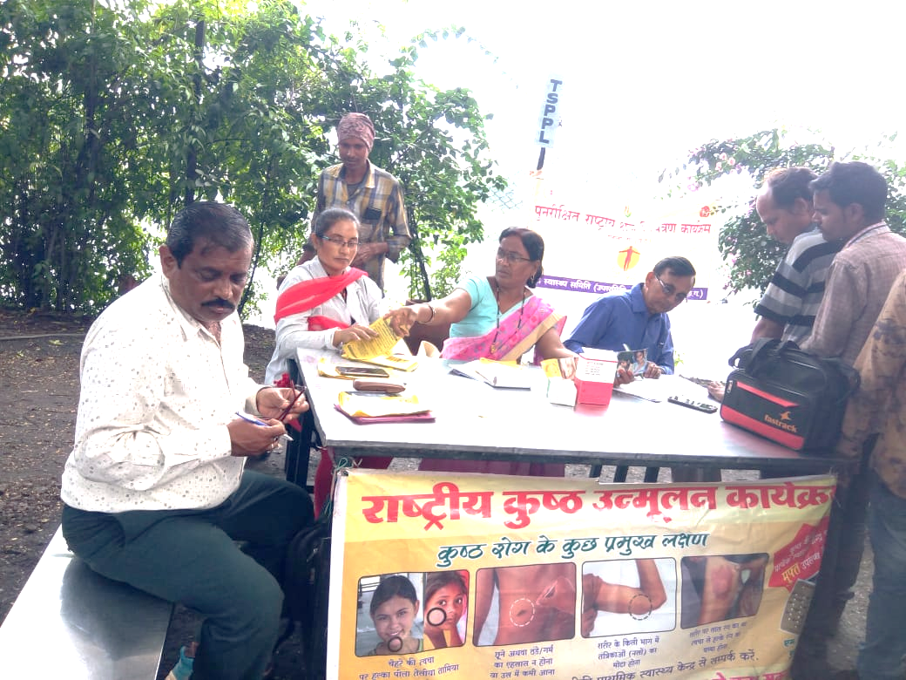
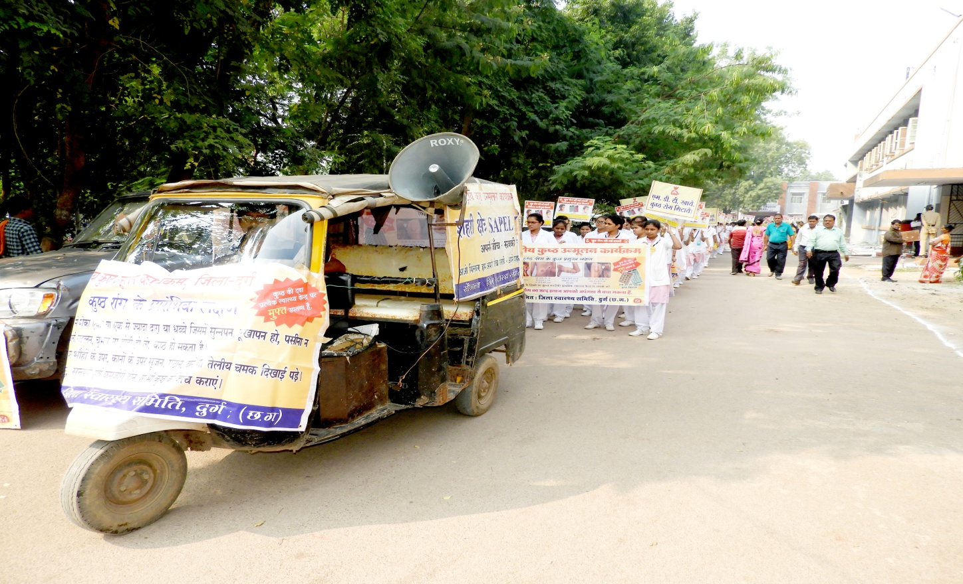
Strategies
Training of Frontline workers, Mitanin, Shiksha mitan, PRI members and MPW on screening Leprosy suspect.
Organizing ward wise Group meetings- Mahila mandals, SHG etc.
IEC and IPC - School activities, Quiz, Essay writing, Awareness Rallies in the listed area of survey
House to house survey for suspect identification
Skin diagnostic camp -on spot diagnosis and start of treatment at village /ward level
Contact survey and Post Exposure Prophylaxis of index case contacts
Identifying deformity cases for reconstructive Surgery
Village/ ward level Prevention of Disability camps

Slide 6
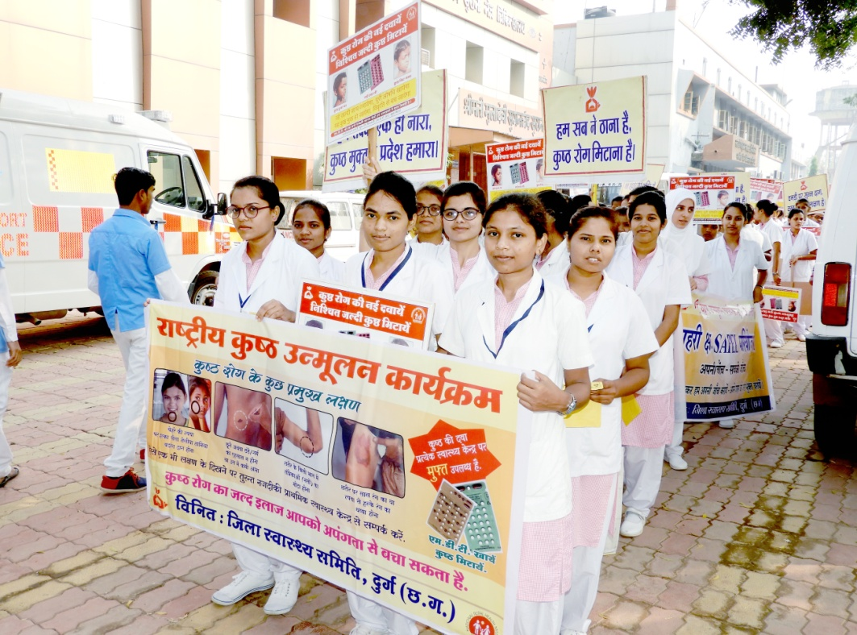
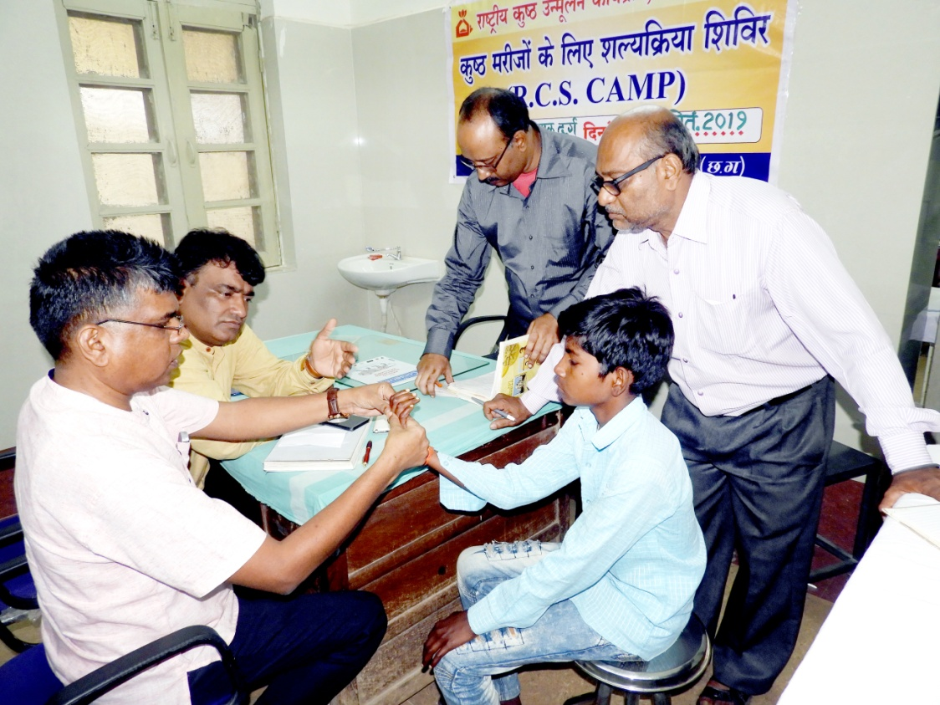
ACTIVITIES in detail:-
SAPEL targeting high risk areas in Urban and Rural settings conducted from 11/09/2019 – 31/3/2020 (186 days) in Durg and Raigarh.
Micro-planning and Training of survey team –from 16/08/2019-23/08/2019
School activities –rallies ,quiz , essay competition
IEC/BCC activities-using posters, banners, pamphlets, rallies, nukkad natak, wall writing, miking
IPC- Group meeting done to educate people regarding signs and symptoms and to reduce the myths/ stigma related to leprosy.
Healthy contact survey and PEP done
RCS eligible cases identification.
Follow up of registered cases and RFT cases in POD camps
Distribution of MCR and Self Care Kit.

Slide 7
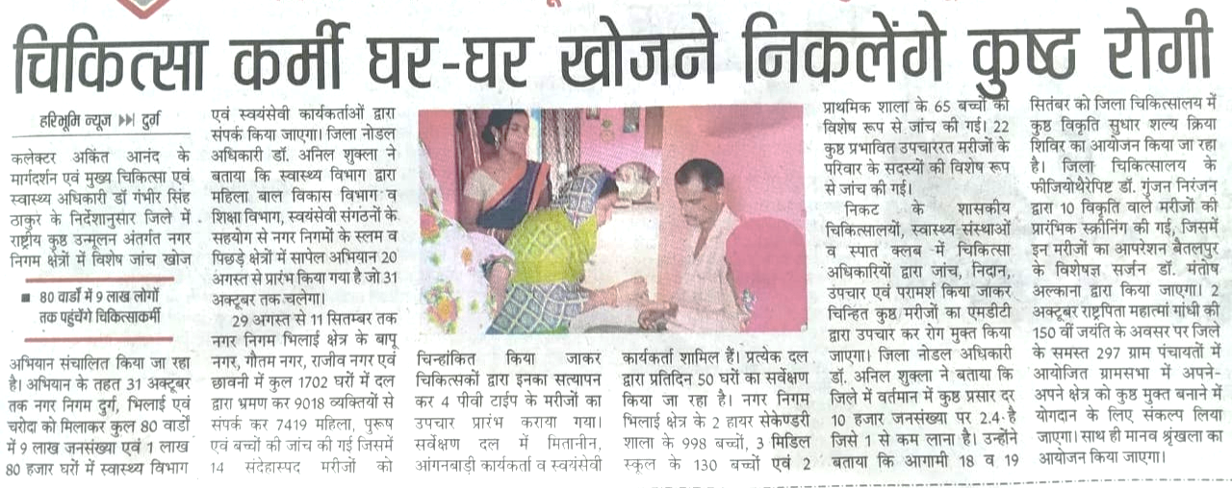
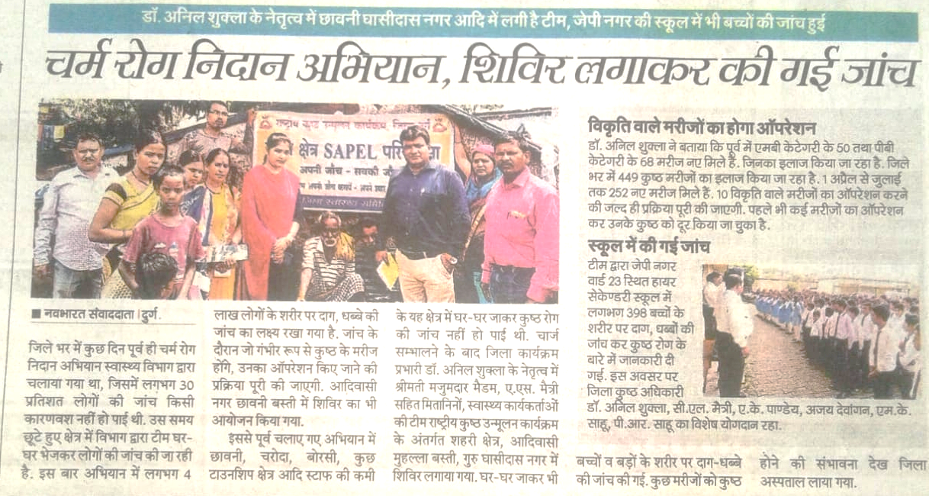
LOGISTICS:-
Survey formats , supervisor formats, diagnostic cards, identity card for the supervisors.
Chalk for wall writing and certificates for the school students printed with sign of collector on it for appraisal and encouragement.
MDT and other drugs
SURVEY TEAM :-
Survey done by the mitanin ,AWWs, MTs ,voluntary workers(family members of mitanins, malaria link workers)
Total teams-650 in Durg and 175 in Raigarh
SUPERVISION AND MONITORING:-
Supervision done the retired NMS/NMA
For every 05 survey team 01 supervisor.
1 NLEP Trained MO at diagnosis camp site along with NMA/ NMS. (In Durg, voluntary retired NMA/NMS were also roped in to assist the teams)

Slide 8
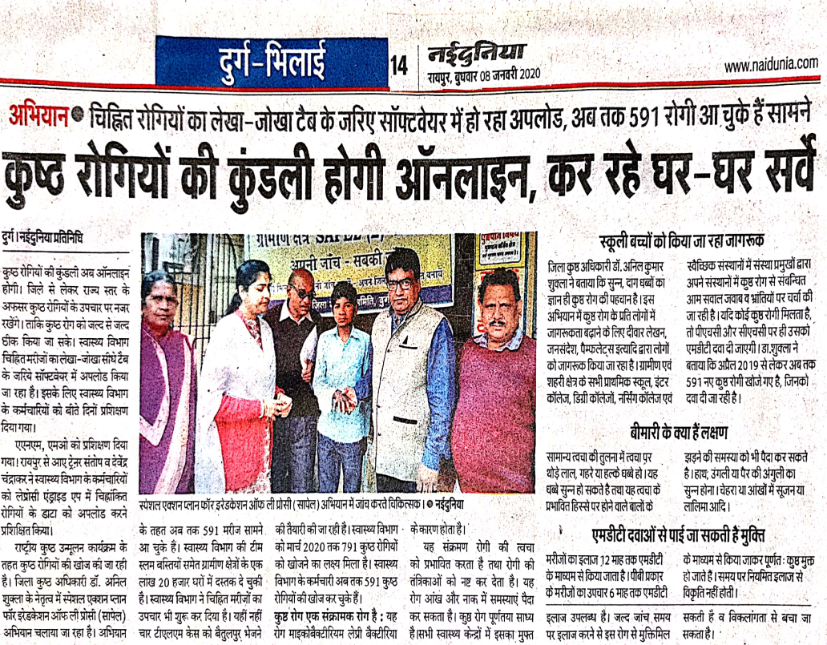
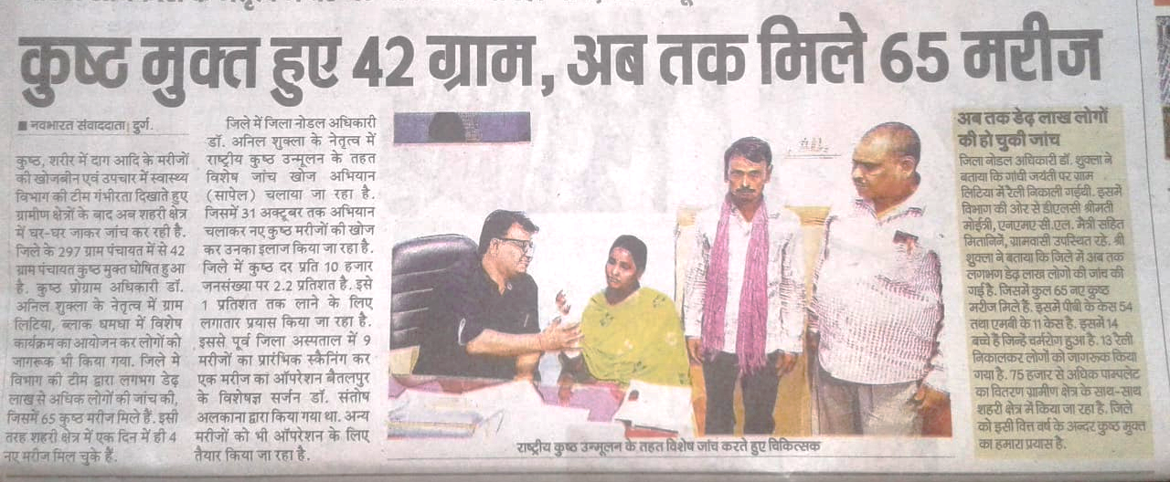
Output
Total houses visited= 174940
Enumerated population= 875810
Examined population= 757477 (87%)
Number of awareness rallies = 46
Group meeting= 208
Handouts and Bills distributed= 398000
Wall writing= 825 sites
School health education given in= 187 schools
PEP= 26575 (Single Dose Rifampicin)
RCS eligible = 3 deformity patients identified

Slide 9
Output
CHILD CASE |  |  | GRADE 2 DEFORMITY CASE |  |  | TOTAL CONFIRMED CASE
PB | MB | TOTAL | PB | MB | TOTAL | PB | MB | TOTAL
43 | 8 | 15 | 0 | 12 | 12 | 321 | 158 | 479

Slide 10
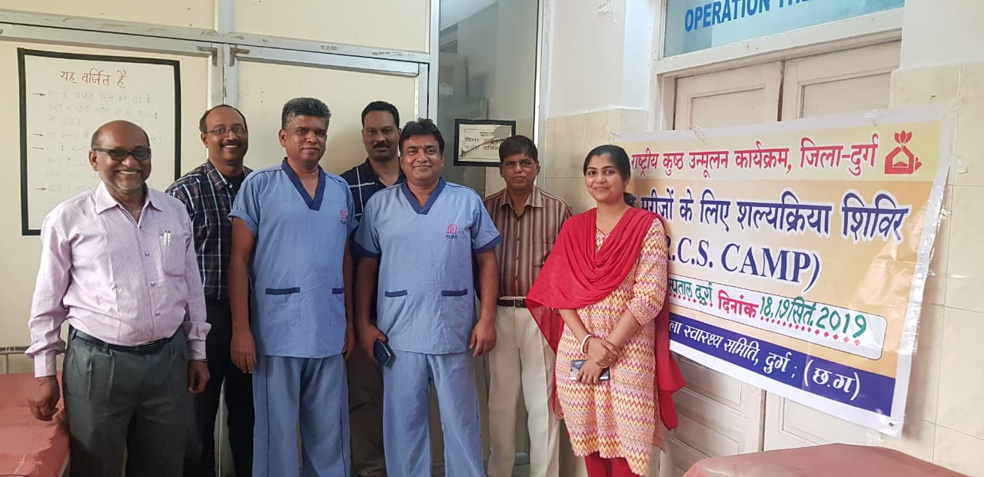
Long way to Go….
Scaling up LEPTRACK application for case monitoring.
Continued Active Case Detection in high endemic areas.
Implementing village level diagnosis camps to prevent delay in diagnosis.
Strengthening RCS and POID activities.
Integration of NLEP services with General Health services and implementing sustainable framework of Leprosy control and elimination.

Slide 11
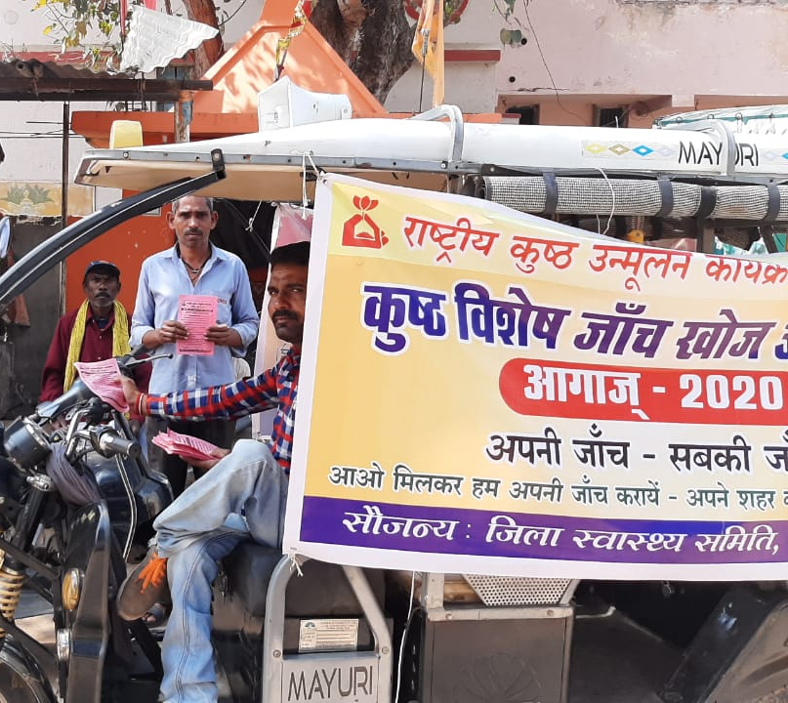
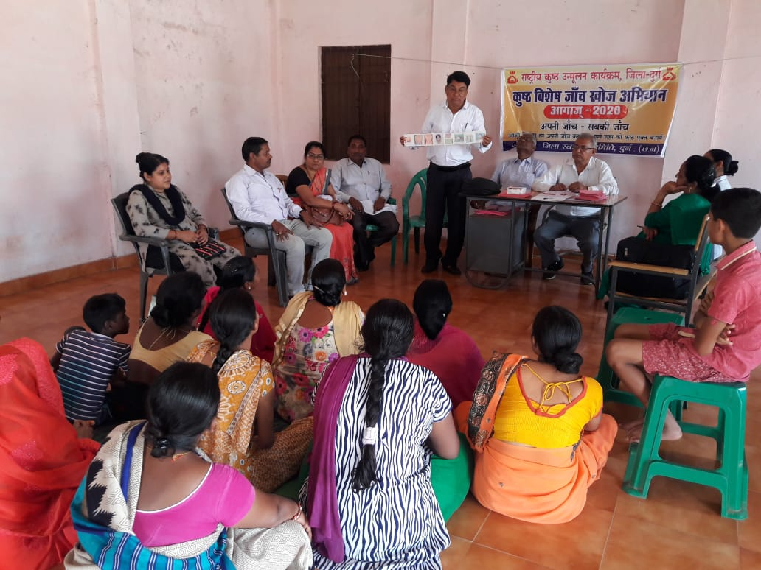
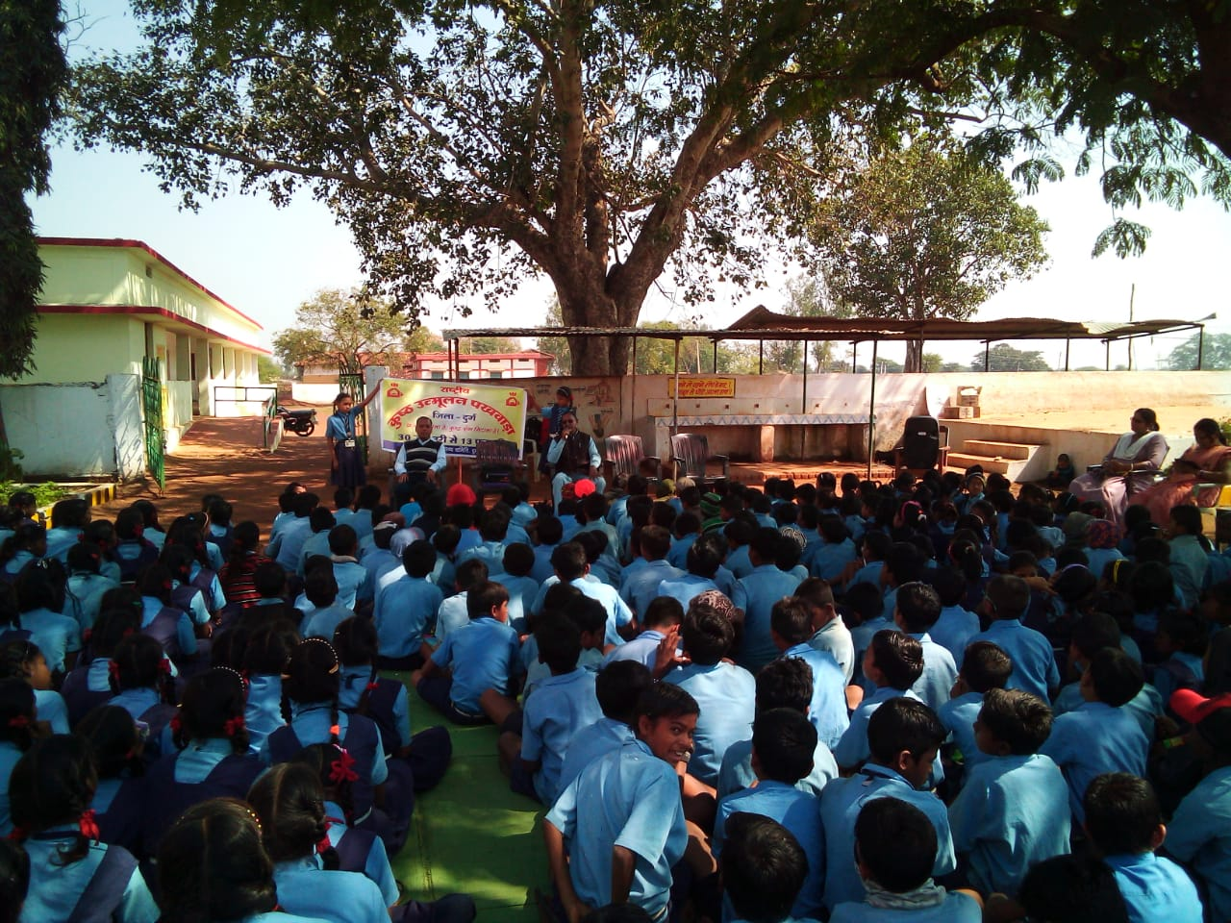
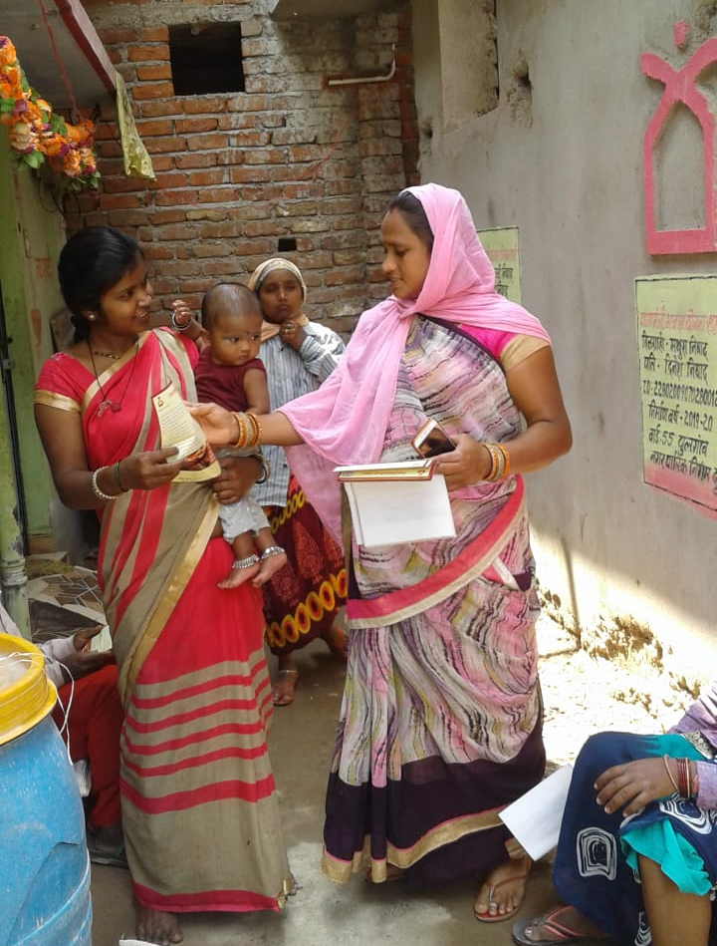
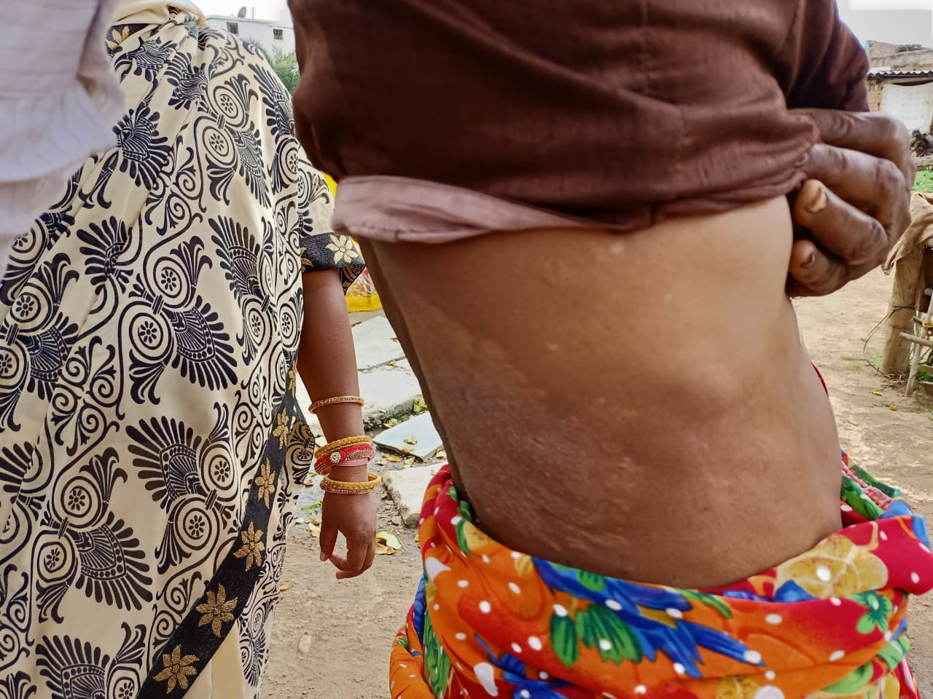
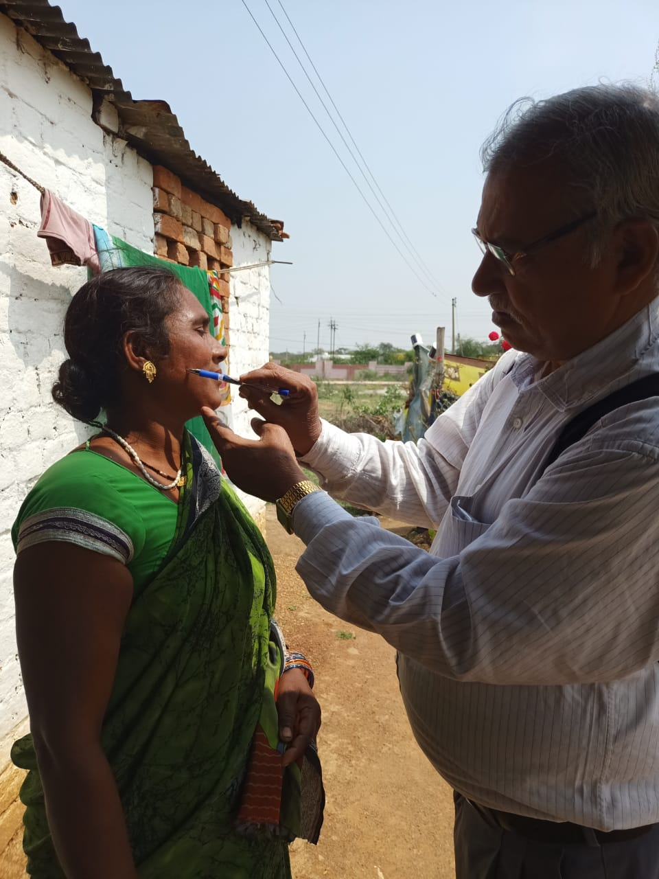
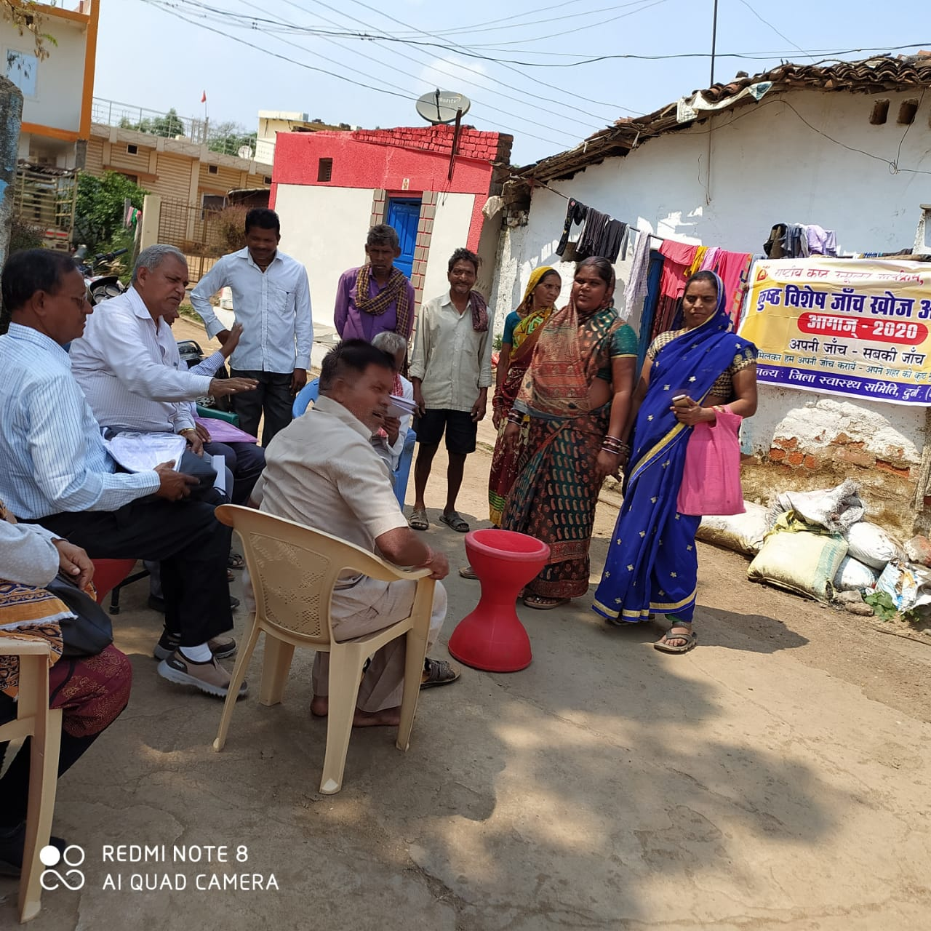

Slide 12
Thank You

