Slide 1
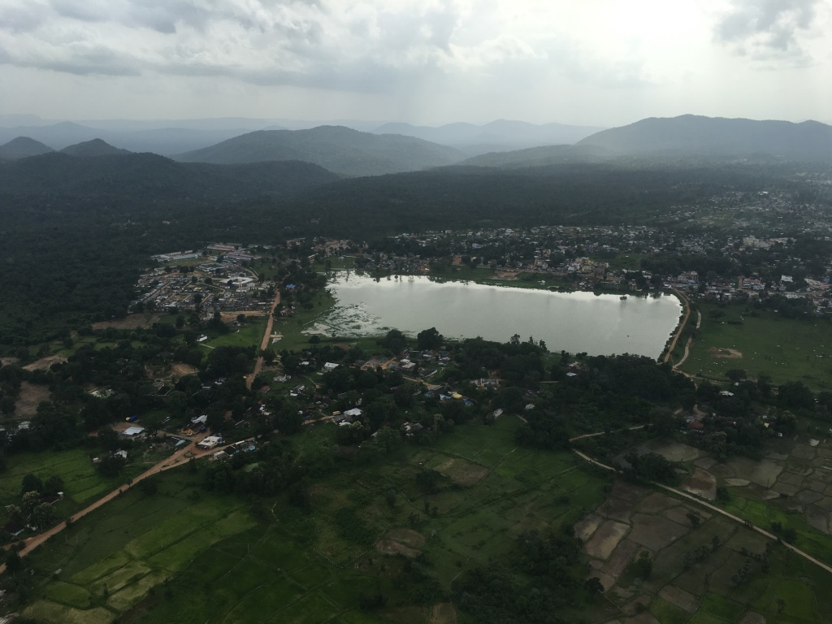
Finding the rarest of rare recruiting and retaining Specialists and other HRH—Bijapur Model
Prasana R.
Commissioner &Mission Director, Chattisgarh

Slide 2
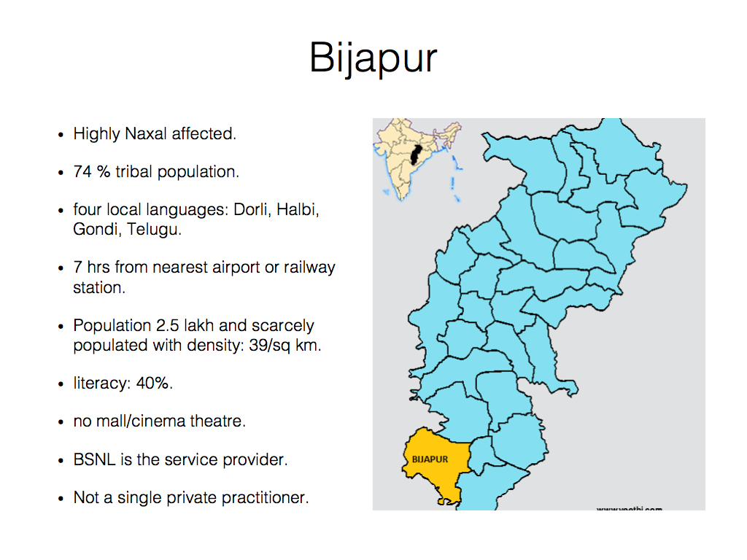

Slide 3
Challenges
Recruitment related issues: Reservation, age, geographical limitations etc.
Huge difference between govt salaries and open market earnings.
Issues related to lifestyle: accommodation, recreation, settlement of family etc.
Negative perception about Govt work culture: no incentive for merit, Non-clinical assignments and medico legal duties etc.
Infrastructural issues: lack of good equipments, irregular medicine supplies, general facility upkeep etc.

Slide 4
Planning
workshop in collaboration with PHFI on strategy framework in June 16.

Slide 5
Steps
Get furnished accommodation ready. ( May to Aug 16)
Supporting staff recruitment. [June-July 16]
Improve infrastructure priority wise. Specially Blood bank, Pathology lab, Mortuary, OT, OPD and Wards. [ July -Dec 16]
formal advertisement along with sos and Facebook post. [Sept-Nov 16]
strategy to sustain specialists.

Slide 6
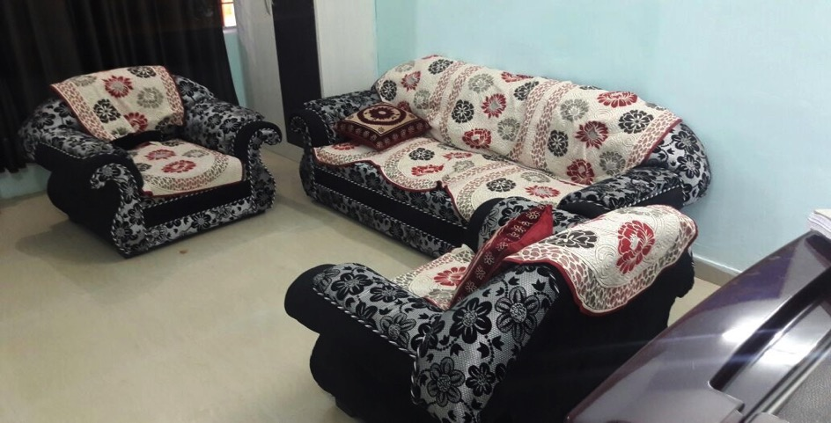
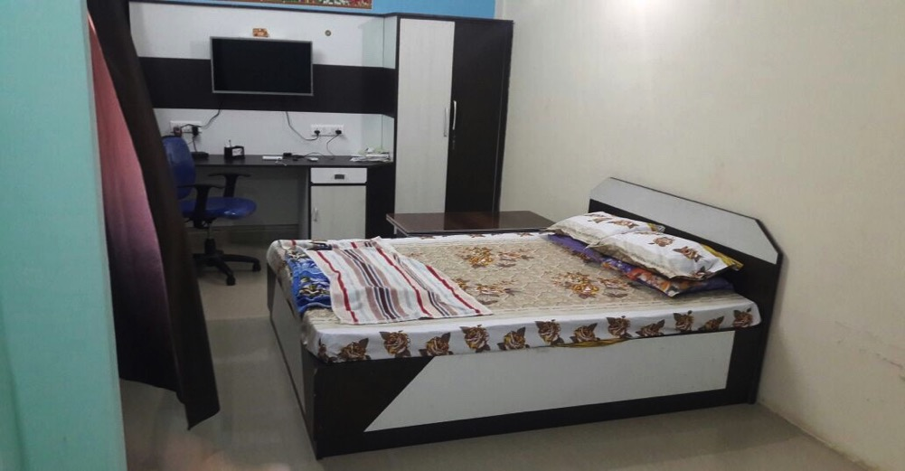

Slide 7
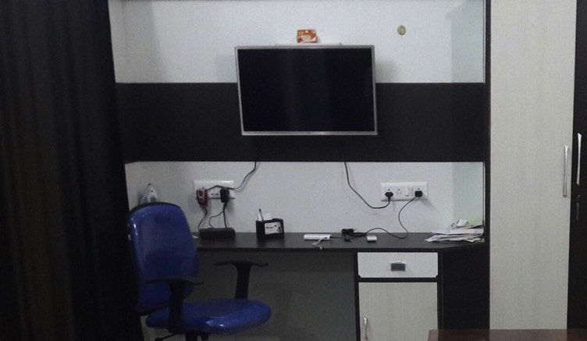
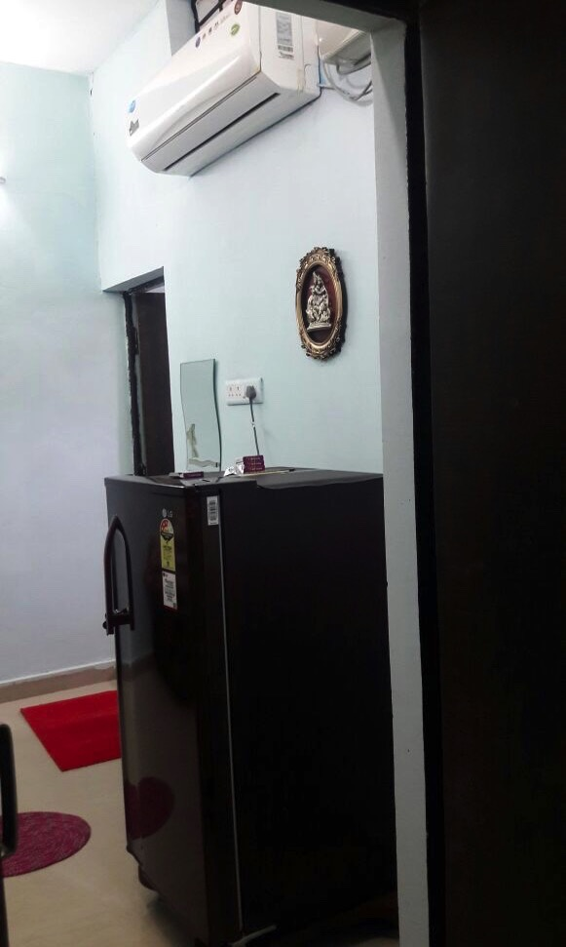
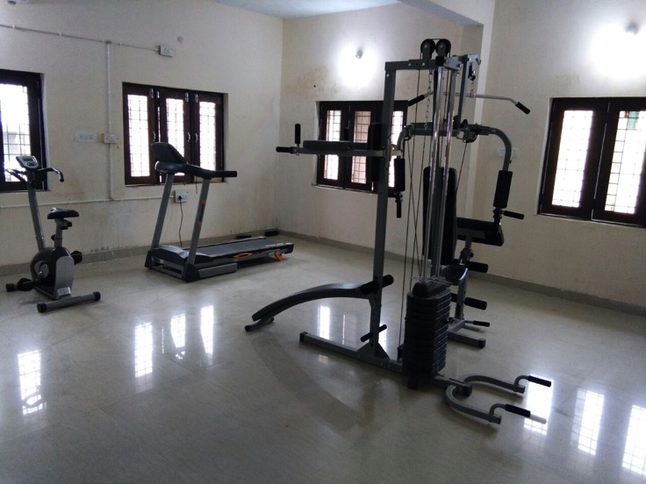

Slide 8
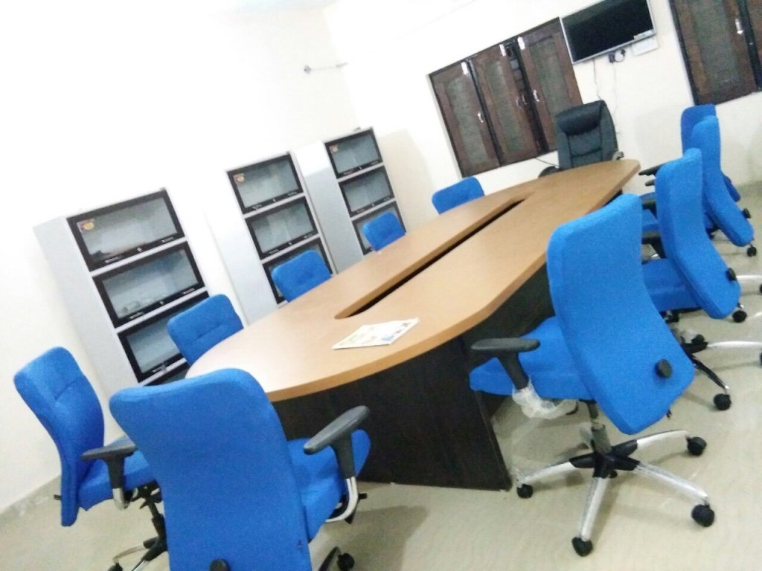

Slide 10
Negotiable Salary
Under NHM specialists salary 1.65 lakh/month
Differential salary based on terrain and naxal issue.
Weightage for experience and skills.
Offered negotiable salary in range of 1.8 to 2.2 lakh for contractual appointees.
scaling of salary package done with collector Sukhma & Dantewada to maintain parity.

Slide 11
Other Incentives
Recruitment for spouse in related field on contract basis.
Free membership of officer’s club
Facilitation for Sim Cards, Bank Account opening and Gas connection.
Incentive for participation and paper presentation in state and national level CME conferences.
Monetary incentive from RSBY earnings.

Slide 12
Infrastructure Improvement
Blood bank, oxygen pipeline, physiotherapy units etc.
Modular OT
Fully equipped ICU and casualty.
Modern Mortuary.
Better OPD chambers.
Mechanised cleaning system.

Slide 13
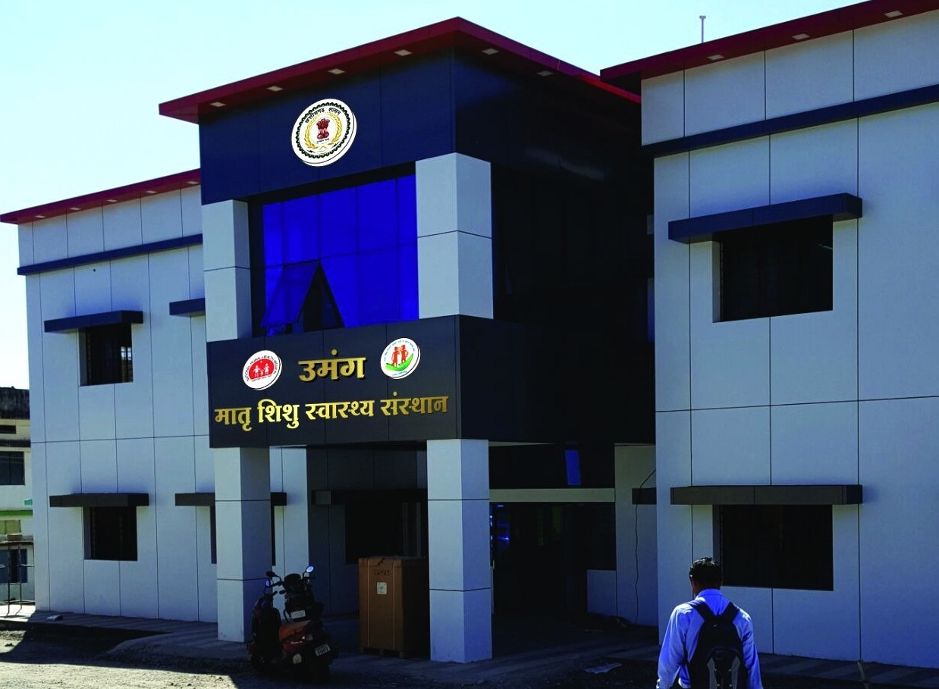

Slide 14
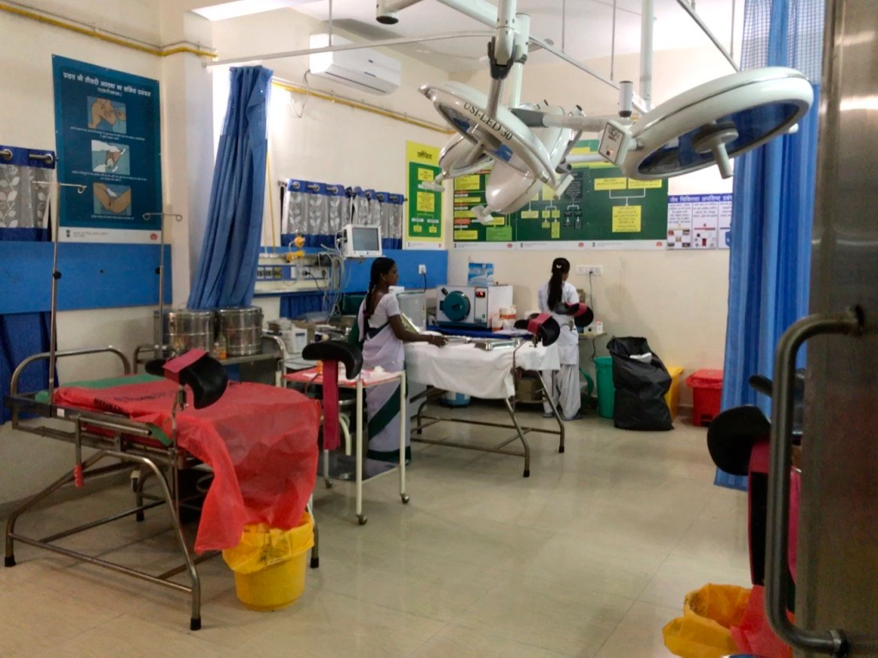

Slide 15
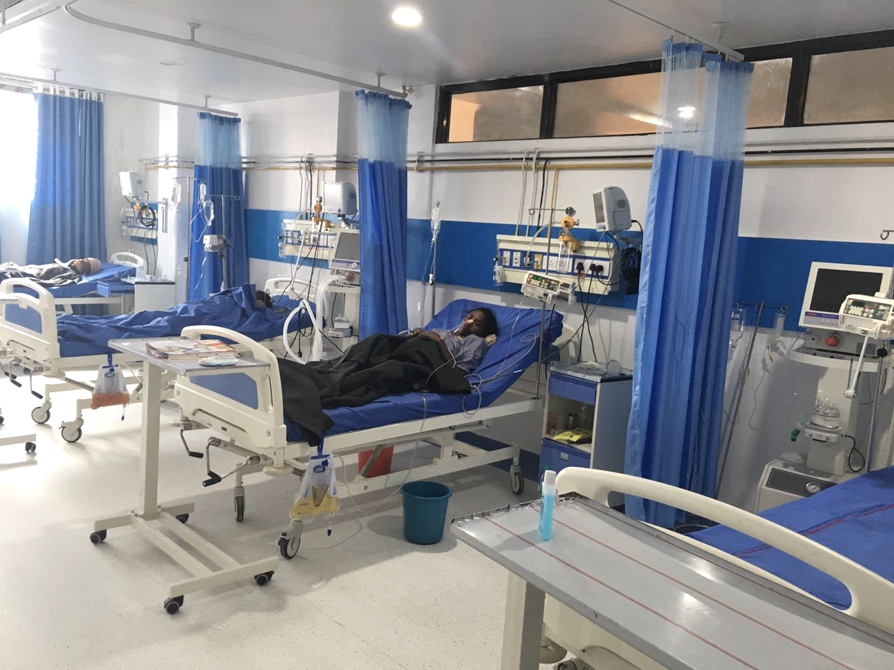

Slide 16
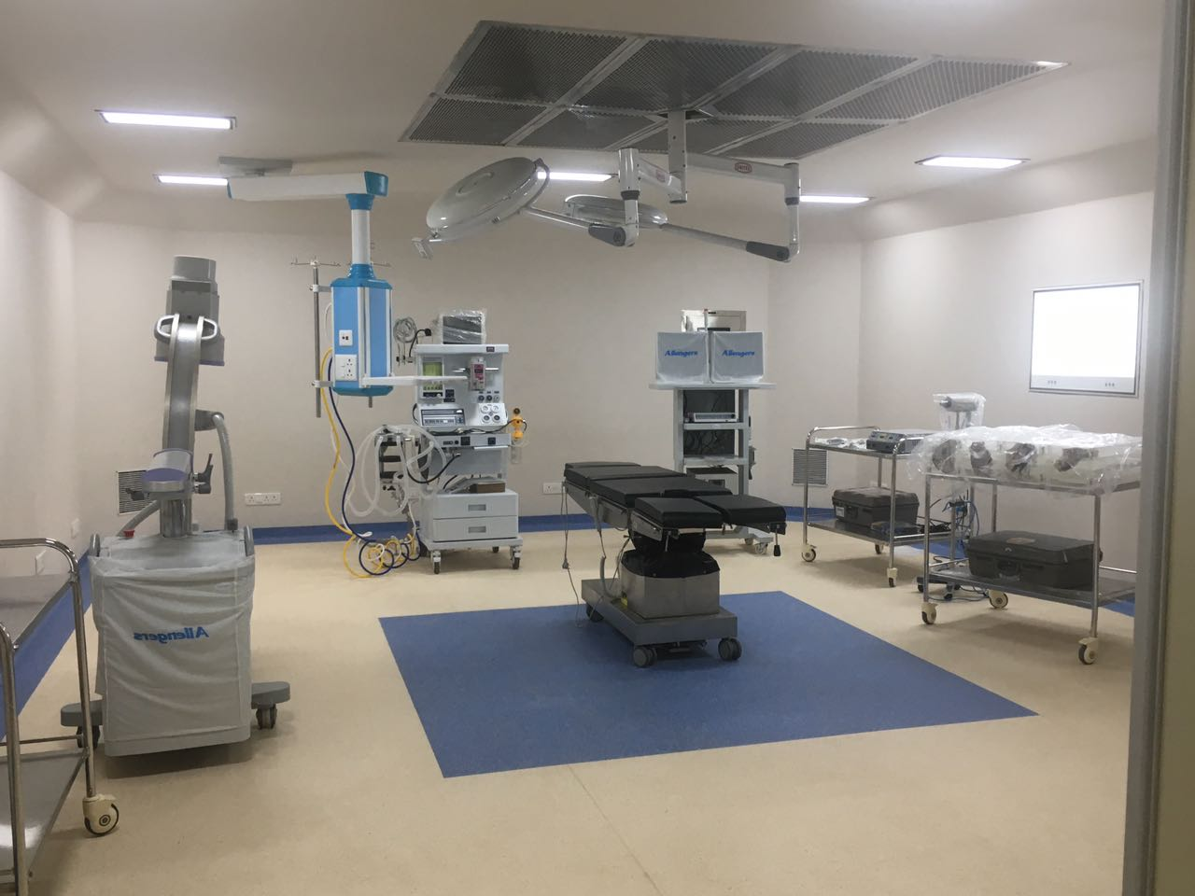

Slide 17
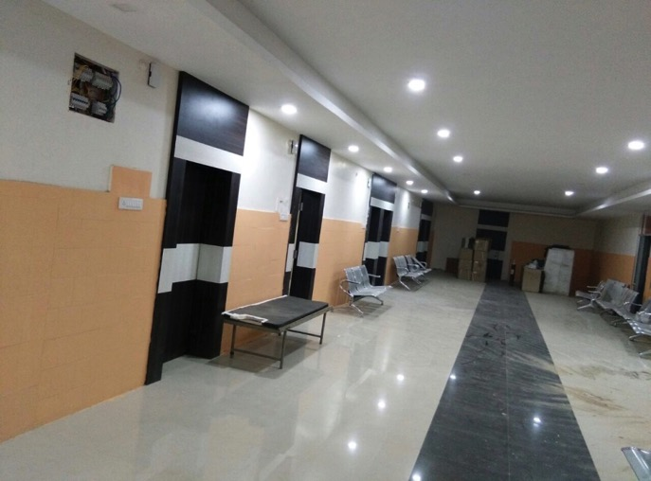
OPD

Slide 18
Result
In 2010-11 only 6 doctors in entire district, increased to 16 till April 2016. Now 38 doctor works in district including 16 specialists.
Surgeon is from TN, Gynae from MH & UP, Anaesthesia from UP & MH, opthalm from MH, Patho- UP, Micro-Andhra, ENT- Telangana.
Shared list of specialists to sukhma and dantewada as well.
Till June 2016, only 14 staff nurses. now 45 staff nurses in DH.
91 LSCS , 648 Major surgeries and minor surgeries in last 9 months.
Increased OPD, IPD, Institutional deliveries & FP services at DH.

Slide 19
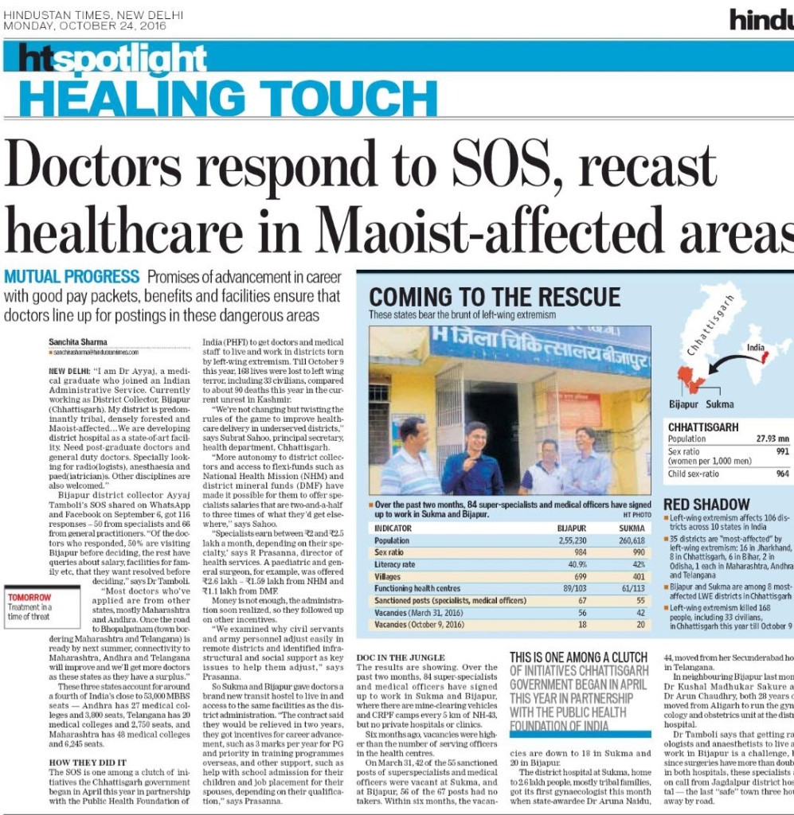

Slide 20


Slide 21
Replicability
Transit hostels including furnishing from NHM.
Contractual post with higher salary based on justification can be availed under NHM.
Difficult area incentive (CRMC) permitted.
Equipments, free drug, free diagnostic funding.
Anything and everything for MCH from NHM.
RSBY earnings as performance incentive and to maintain the infrastructure.
Improve Mortuary, Blood bank, lab and OT on priority.
Better work atmosphere and availability of support staff can make things better.

Slide 22
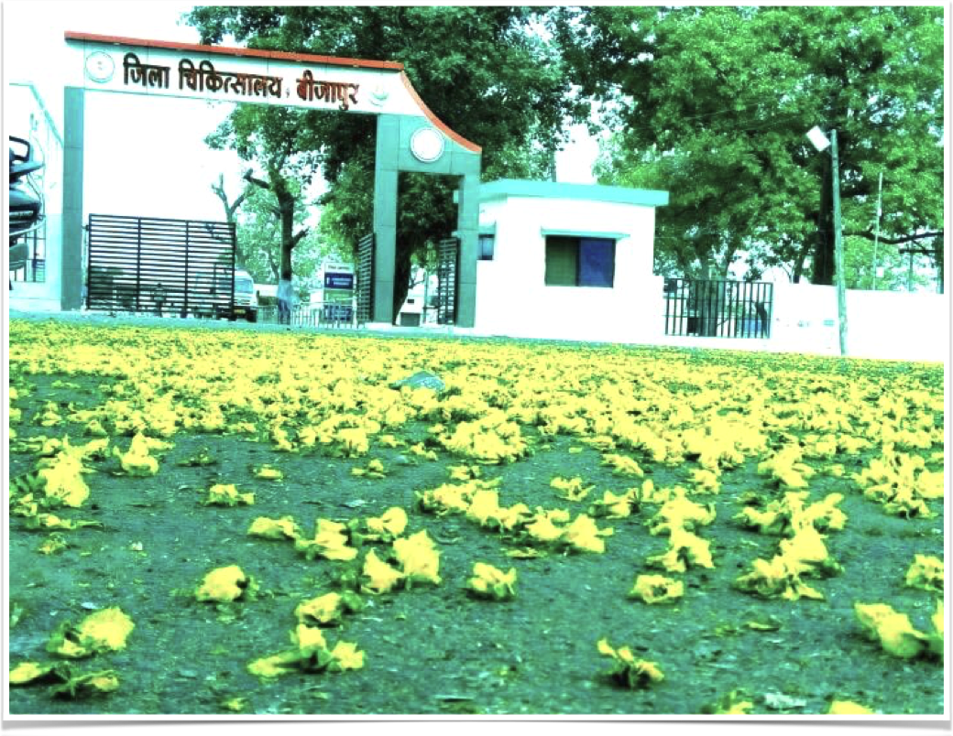
Thank you...

