Slide 1
day care centers in Himachal Pradesh: An innovative geriatric care model
National Health Mission,
Himachal Pradesh

Slide 2
Challenges with Geriatric Care in HP
rapid urbanization
and societal modernization
8.6% in India
10.2% in Himachal Pradesh
INCREASING GERIATRIC POPULATIONS
ISOLATION
LOW MOBILITY
Multiple comorbidities
INCREASED NCD LOAD
physical constraints – terrain, transport

Slide 3
Geriatric Care Models
Geriatric care is currently an evolving science.
HCP training – most of the medical and paramedical curriculums do not have any separate subject on geriatric care
Multiple comorbidities – multidisciplinary approach required
Multiple psychological issues in addition to co-morbidities

Slide 4
Geriatric Care Models
Hospital based
Acute geriatric care
Home/Community based
For chronic conditions
Follow ups

Slide 5
Day Care Centres - Concept
Provision of comprehensive services under a single roof.
Focus on areas with high geriatric load particularly urban areas
Community based setting – community support
Physical and mental engagement
Provision of Health Care services

Slide 6
PHYSICAL ACTIVITES
LEGAL AID AND COUNSELLING
Trainings using IT platforms
FIGHT ISOLATION AND NEGLECT
MENTAL ENGAGEMENT
DAY CARE CENTRES
Skill Building
COMMUNITY SUPPORT
RECREATION
Health Care

Slide 7
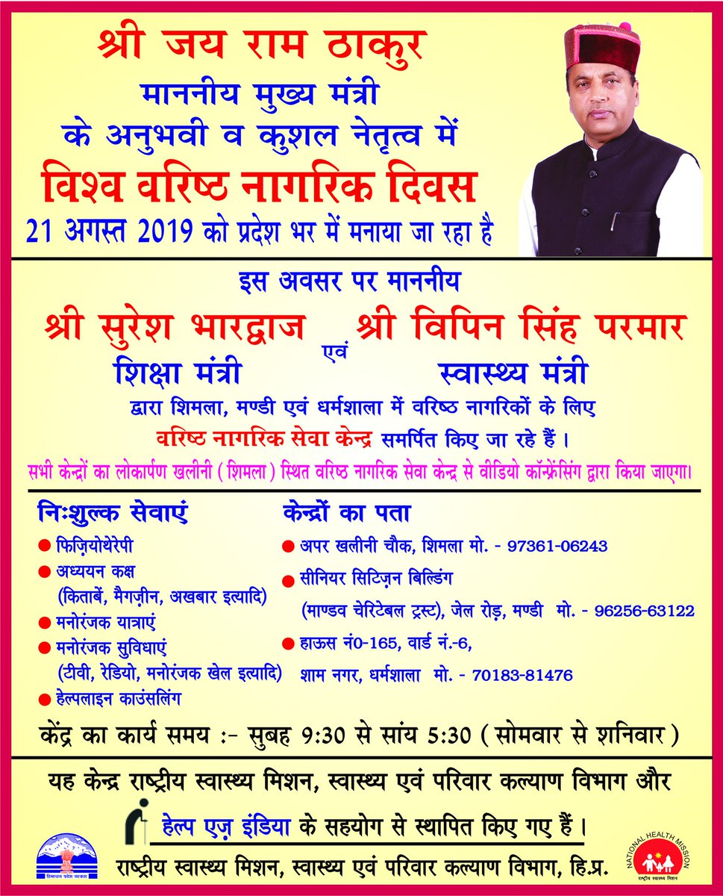
Operational Aspects
Shimla, Mandi and Dharamshala towns identified
Spaces identified which are easily accessible
‘HelpAge India’ a NGO with known name in geriatric care engaged and MOU signed
Day Care centres inaugurated on 21st August 2019 – World Senior Citizen Day

Slide 8
Health Care
Weekly health checkups
Provision of free medicine – dovetailing with EDL
Physiotherapy sessions
Health awareness programs- on various occasions like World Diabetes day etc, involvement of private sector
Wellness activities – Yoga, meditation

Slide 9
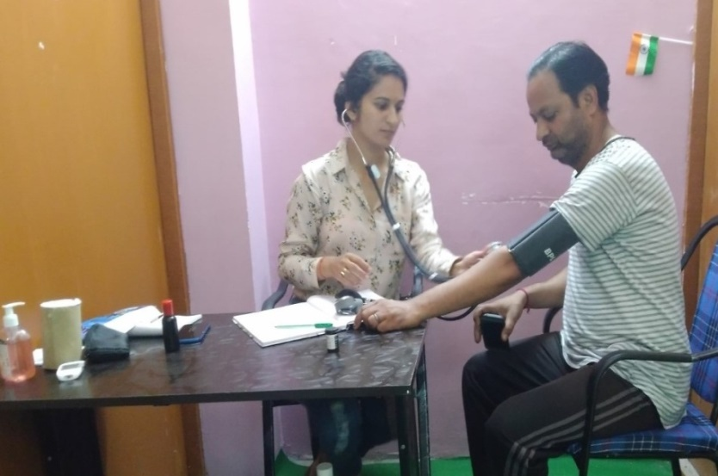
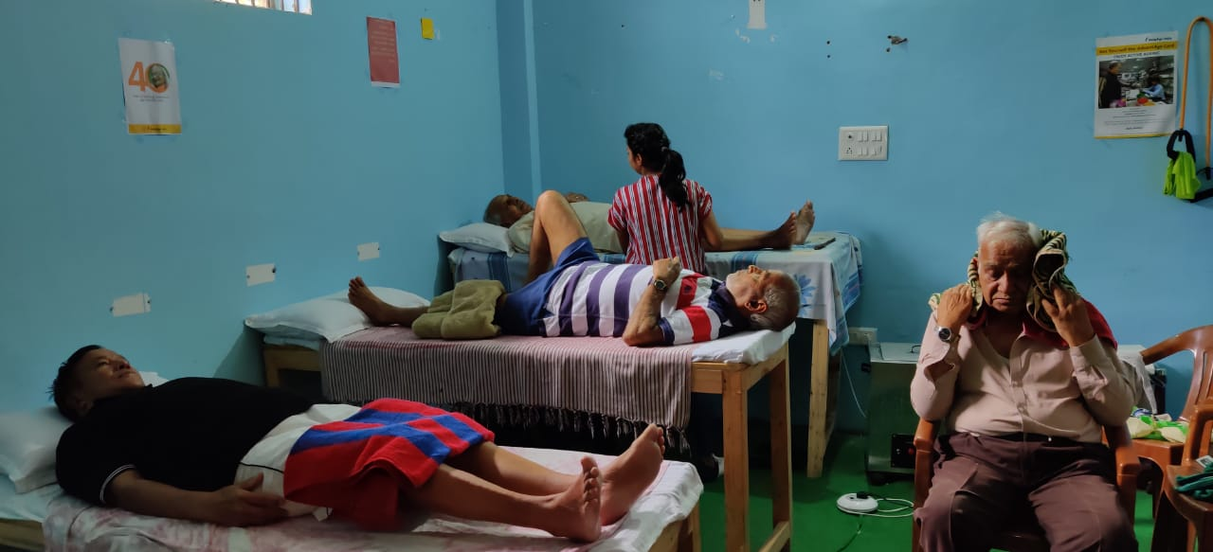
Physiotherapy beneficiaries till Nov 2020
Location | Male | Female | Total
Shimla | 1155 | 1233 | 2388
Mandi | 2541 | 3269 | 5810
Dharamshala | 2068 | 4713 | 6781
Total | 5764 | 9215 | 14979

Slide 10
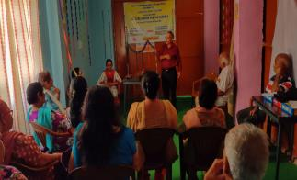
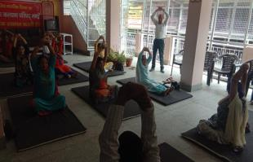
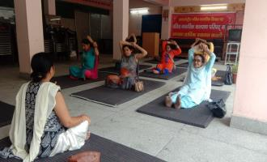
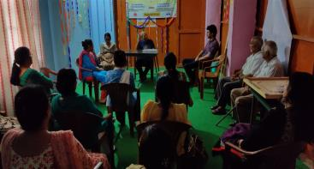

Slide 11
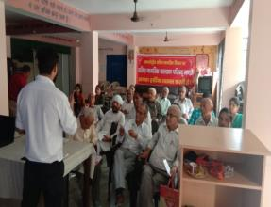
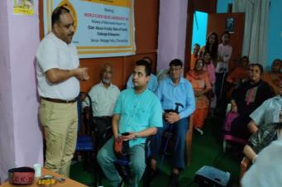
Skill Building
Digital literacy classes help them
Stay connected socially
Learn and practice online bill payments, online transactions

Slide 12
Fight Isolation and Neglect
Same age to talk
Engagement in recreational activities
Celebrations – Birthday and other festivals etc
Recreational/pilgrimage tours
Elder for Elders – well knit

Slide 13
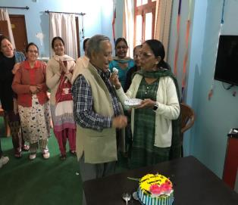
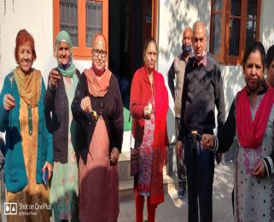
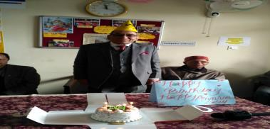

Slide 14
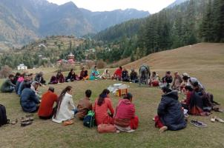
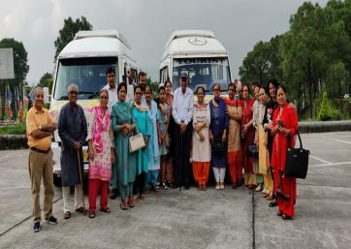
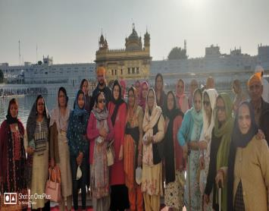

Slide 15
Legal Aid and Counselling
Legal and counseling services are provided to those senior citizens who faces abusive behaviors at their home.
Day care centre has provided a forum to ventilate their feelings, get counseled as well as legal aid through the centre

Slide 16
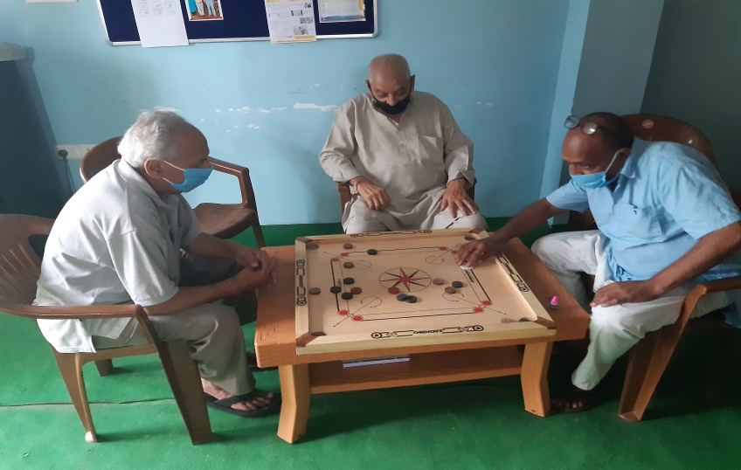
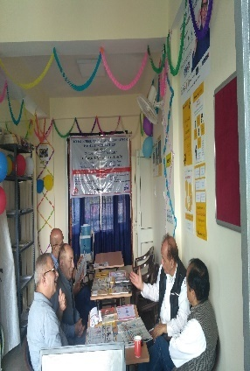
Activity based physical and mental engagement
Library ( Books, Magazines and news papers
Recreation Services (TV, Music, Carom Board, Chess, Ludo and cards etc.)
Outdoor Activities

Slide 17
Service utilization at three day care centre August 2019 -March 2020
Number of persons utilizing services at these centers

Slide 18
Issues during COVID-19
During the lockdown phase the centers were closed
Detailed guidelines were issued to take care of elderly on 05-05-2020 in the state
MOU between NHM & Help age India has been signed w.e.f 01.09.2020 to continue the centers
Services of the three centers has been resumed in Sept. 2020

Slide 19
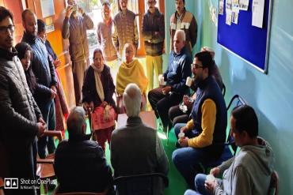
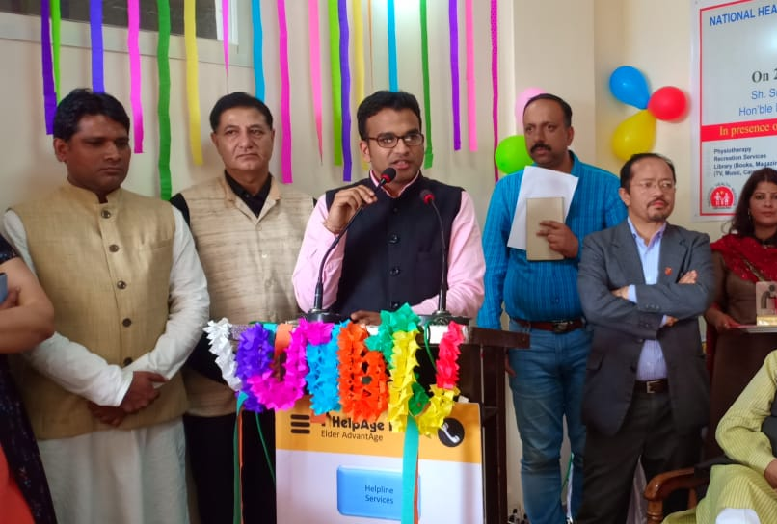
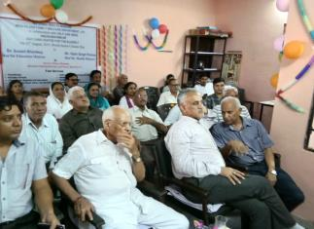
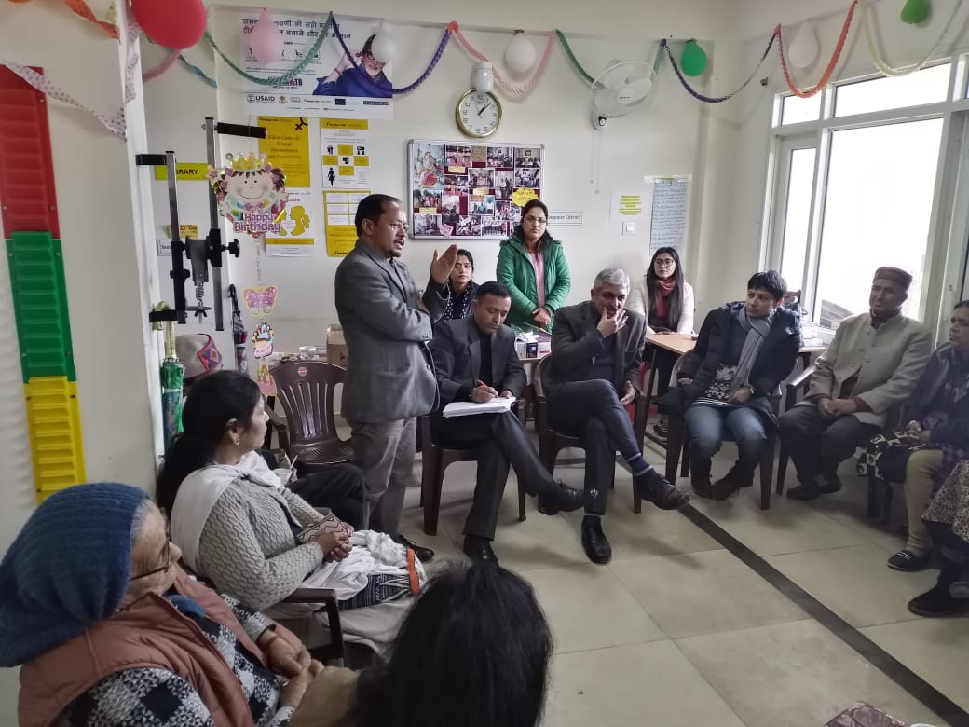
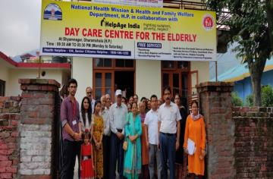
Monitoring visits by NHM

Slide 20
Outcomes
A nerve centre for elderly in these towns
Comprehensive care
Community support
Dovetailing with other National Health Programmes – NCD programme, Free Drugs etc.
Convergence with other Government Schemes – Digital Literacy, legal services etc.
Patronised by the political class as well - popularity

Slide 21
Way forward
Scaling up in other areas
Service delivery – convergence with telemedicine for specialist care

Slide 22
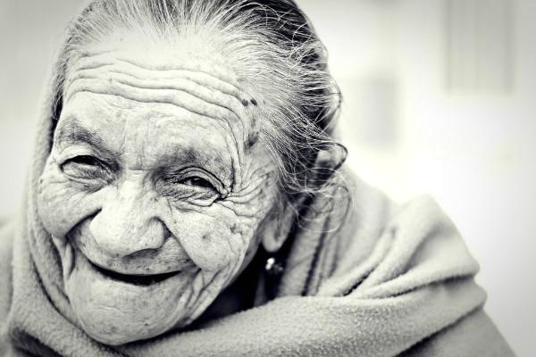
Thanks

