Slide 1


Converting 1000 days Approach into Implementable Model
Developing Gujarat as a Cognitive Capital of India
Dr. Jayanti S Ravi, IAS
Principal Secretary, Health
Government of Gujarat
Notes:
Alternative Title Suggestion: Walk the Talk - 1000 days: Making Gujarat Cognitive Capital Of India.

Slide 2
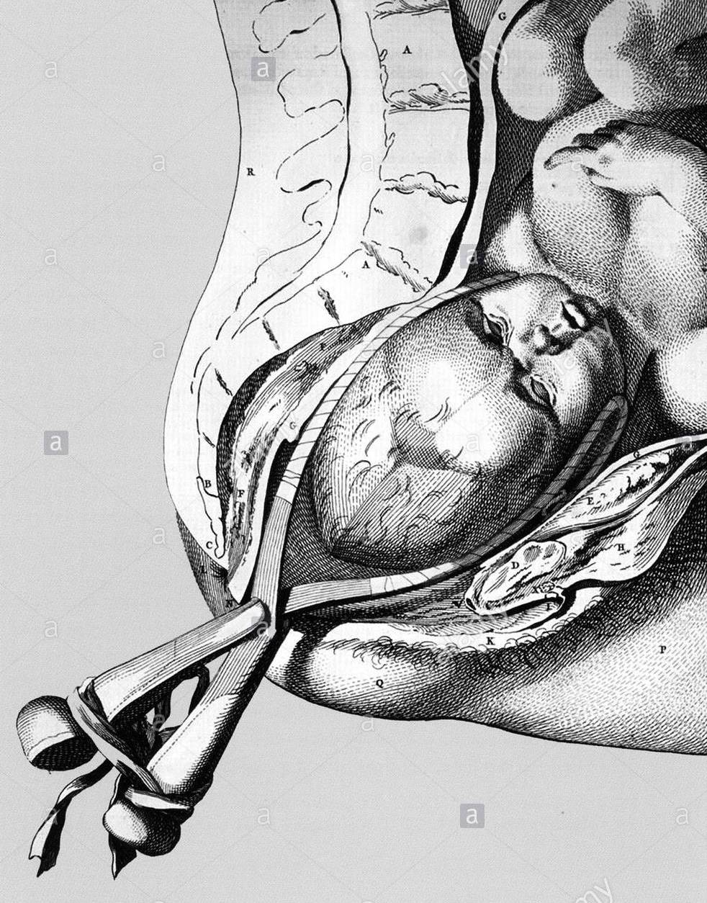
Paradox in Pregnancy: Medicalization of Mother
The growing knowledge on…… the physiological process of labour and childbirth has led to an increasing medicalization of the process.
It is now being understood that this approach may undermine a women’s own capability in giving birth
And could negatively impact her experience of what should be a positive life changing experience
WHO Guidelines on Intra partum care 2018

Slide 3

Physiological Birth
Spontaneous onset and progression
Biological and psychological conditions that promote effective labor
Results in the vaginal birth of the newborn and placenta;
Results in physiological blood loss;
Smooth intrauterine to extra uterine transition of newborn through zero separation and early initiation of breast feeding.
Courtesy : Normal Birth Campaign

Slide 4
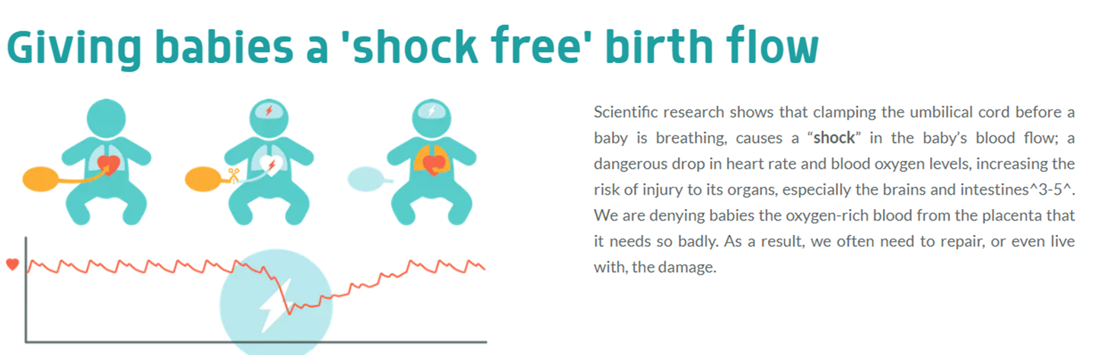

Physiological cord clamping till natural delivery of placenta
Giving babies a 'shock free' birth and making childbirth a “positive experience”
Sharing our experiences from Gujarat
Scientific research shows that clamping the umbilical cord before a baby has established proper breathing causes a silent “shock” to the baby as the oxygen rich blood flow from the placenta is forcibly stopped before the baby had a chance to establish the alternative supply of oxygen rich blood using its own lungs. This results immediately in a drop-in heart rate and decreased blood oxygen levels to all the organs of the baby including the brain. Let us not deny our babies the oxygen-rich blood from the placenta that it needs so badly
A 'shock free' birth for every baby
Scientists Prof. Arjan te Pas and Prof. Stuart Hooper, and a team from Leiden University Medical Center

Slide 5
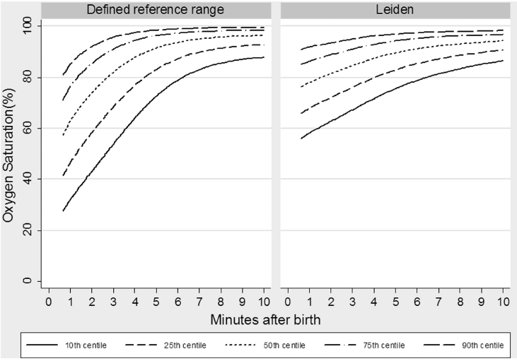
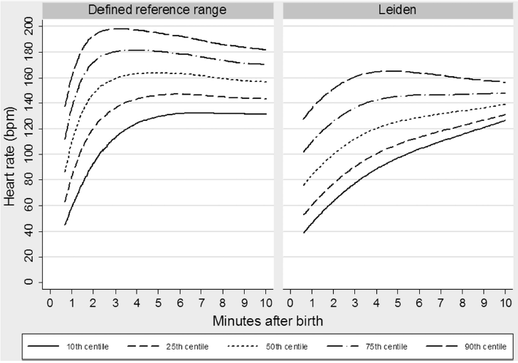
Shock at Birth
Early cord clamping leads to sudden increase in Heart Rate and lower oxygen saturation during first few minutes of life, a shock to newborn.
Smit M. Arch Dis Child - Fetal Neonatal. 2014;99(4):F309–14.
Notes:
Physiological cord clamping can prevent this shock by ensuring smooth intrauterine to extrauterine transition of newborn.

Slide 6
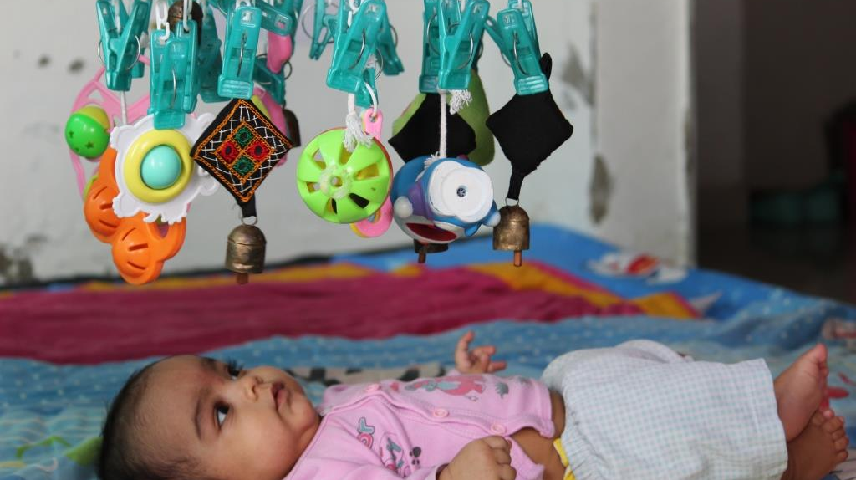
Walk the Talk : First 1000 Days Approach
Encouraging Physiologic Birth
Designing and implementing first 1000 days compliant interventions for every stage of pregnancy and first two years of child.
Creating enabling environment for every newborn to reach his /her full genetic potential and thus by making Gujarat as a cognitive capital of India

Slide 7
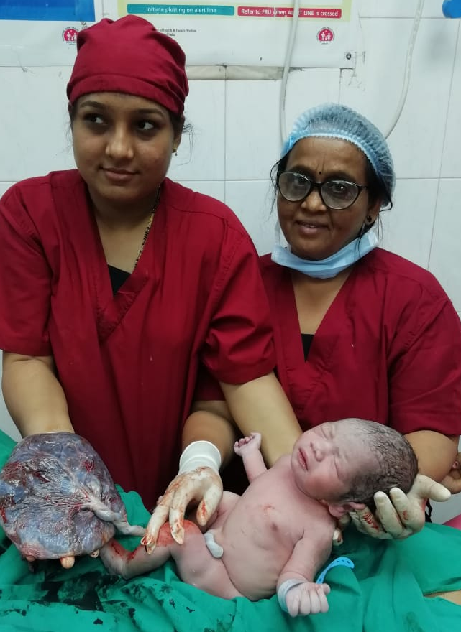
Physiological Cord Clamping:
Gujarat Experience

Slide 8
Challenges in Practicing Physiological Cord Clamping
Implementation Issues
Different time of Cord Clamping in different Guidelines
Practical difficulty in cutting cord as per prescribed norms
More focus on performing Active management of third stage
Less focus on care of newborn and breast feeding

Slide 9
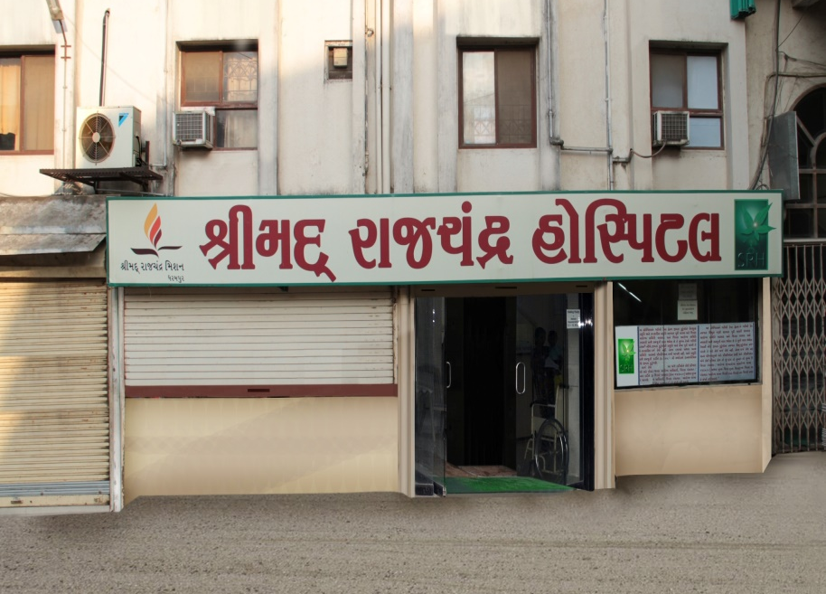
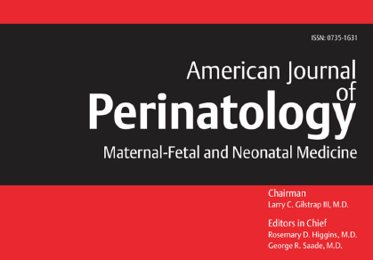
Study on Physiological Cord Clamping
Study at Shrimad Raj Chandra Hospital, Dharampur,
170 Newborns in DCC (Delayed Cord Clamping) & 178 newborns in ECC (Early Cord Clamping) group.
Published in American Journal of Perinatology.

Slide 10
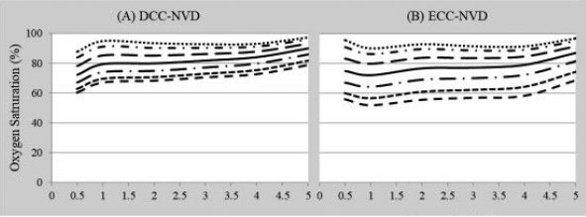
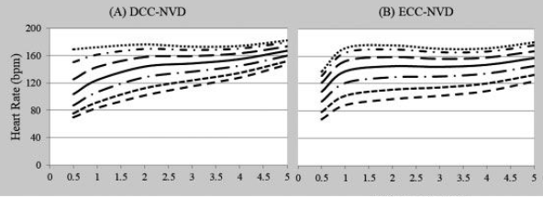
Findings
  Study reiterated findings of previous work of less shock in DCC group
  Oxygen saturation 3-8% higher in DCC group & so was slower acceleration of heart rate contributing smoother cardiopulmonary transition.
Higher Oxygen
Saturation
Slower acceleration
of Heart Rate

Slide 11
Clinical Outcomes
Maternal
  No case with PPH
  One case had retained placenta – required manual intervention
  No blood transfusion
Newborn
  Neonatal admissions – 48 (5%)
  Neonatal jaundice – 11 (1.1%)
  Neonatal jaundice with other associated problems (sepsis, LBW)- 6 (0.6%)
Unpublished data

Slide 12
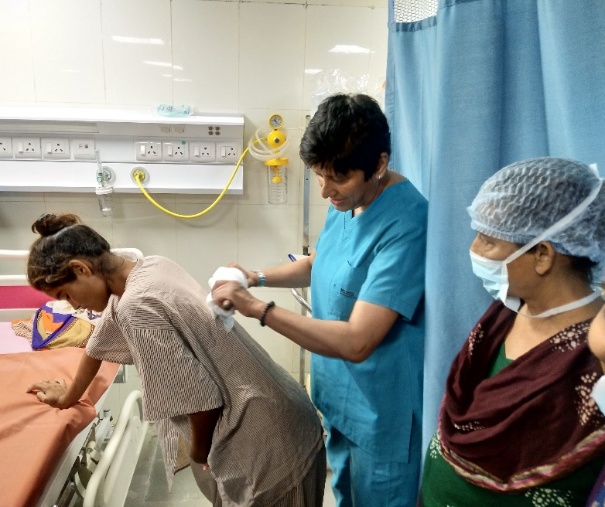
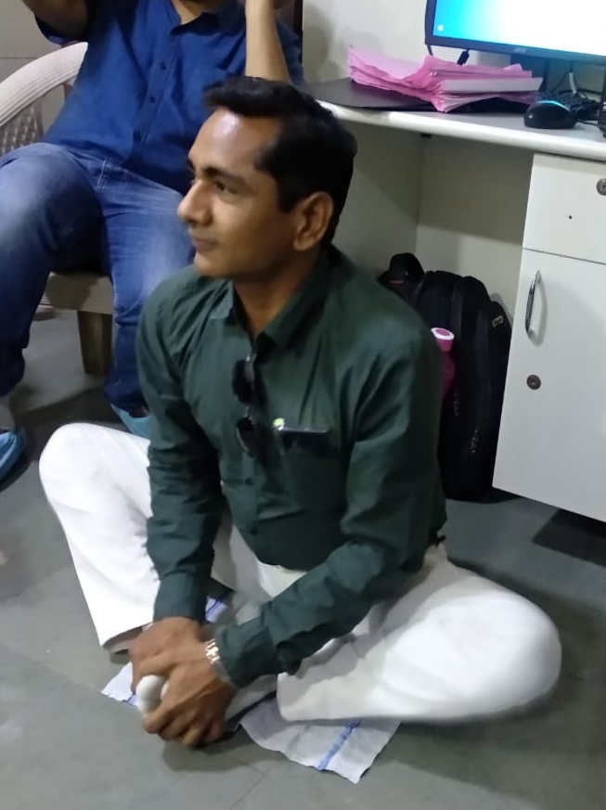
Scaling up the intervention in Gujarat
State level training for midwives was organized in collaboration with UNICEF and Fernandez Foundation.
Seven Institutions participated in training
Obstetricians, Midwives and Staff Nurses were trained hands on in labour room for five days on Alternative Birthing Positions including Physiological Cord Clamping
Six facilities are practising currently

Slide 13
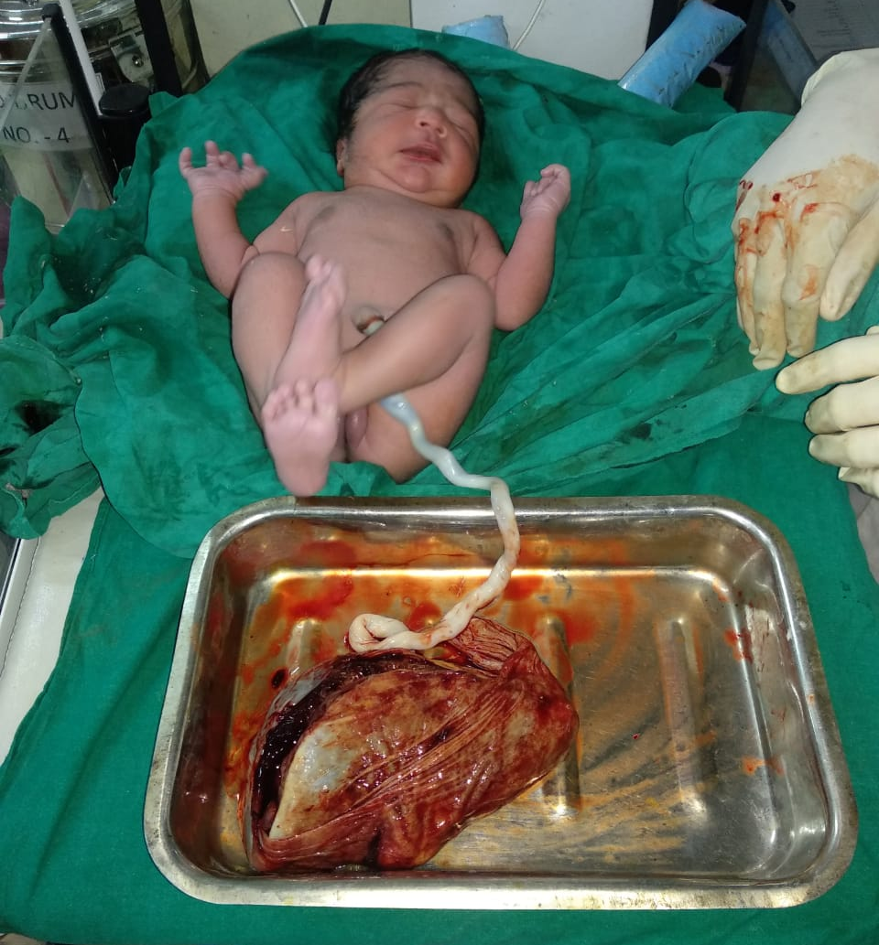
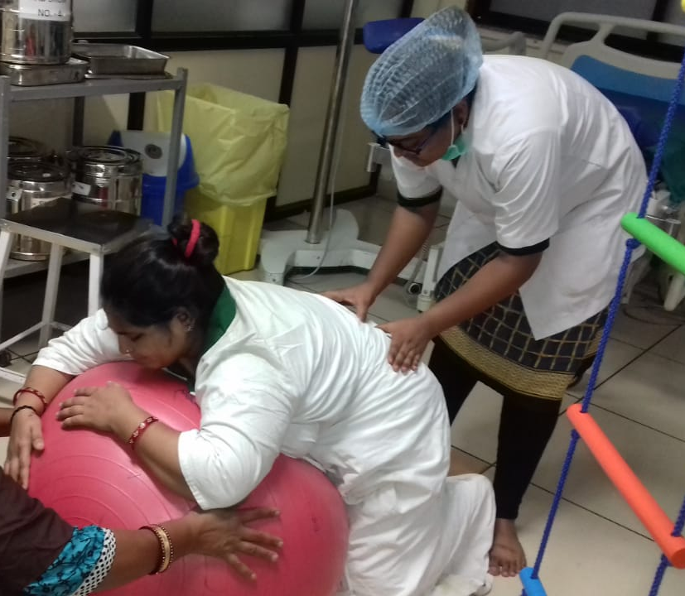
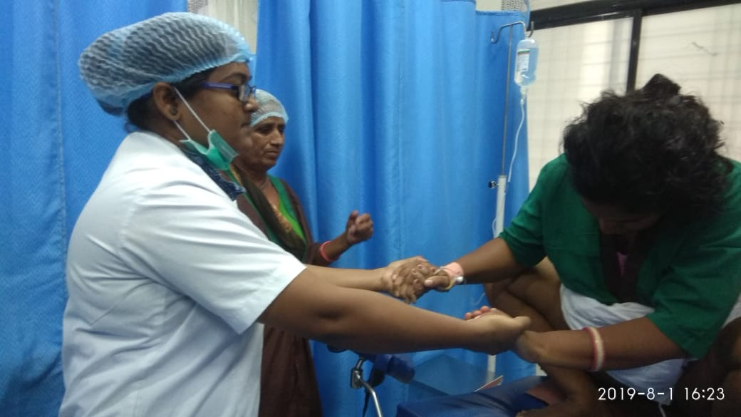
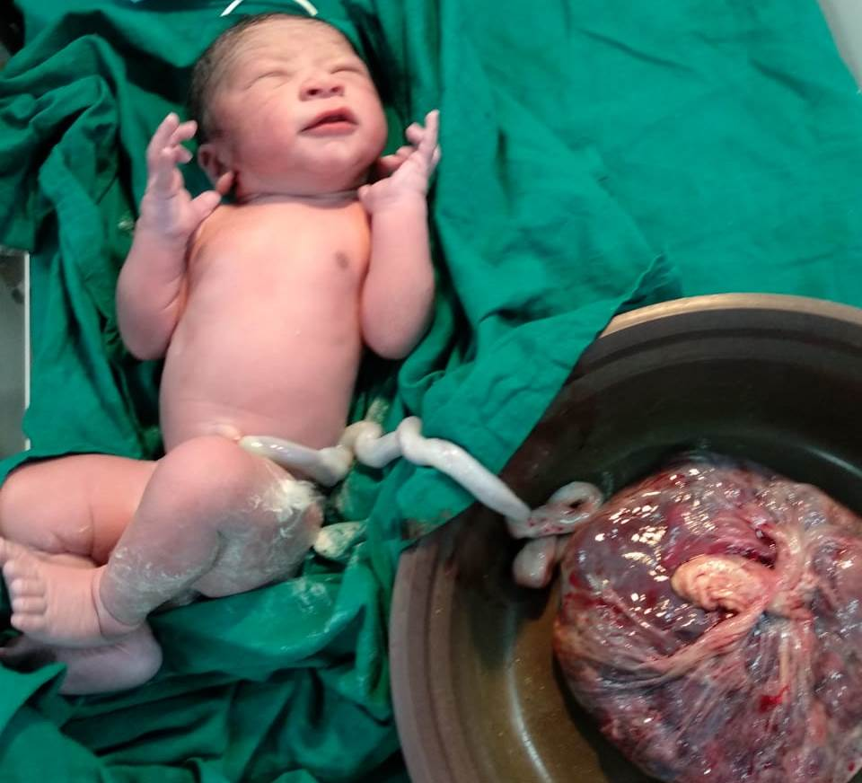
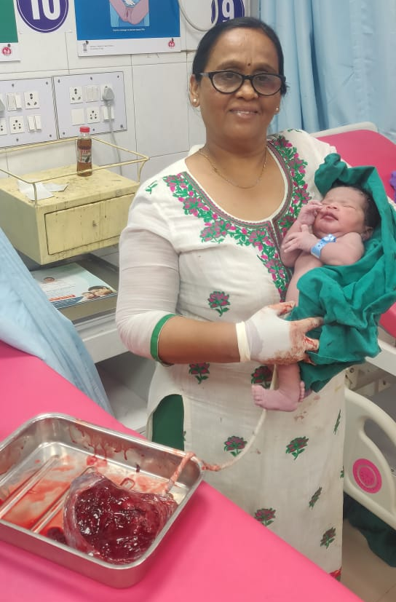
Silent Revolution has just begun

Slide 14
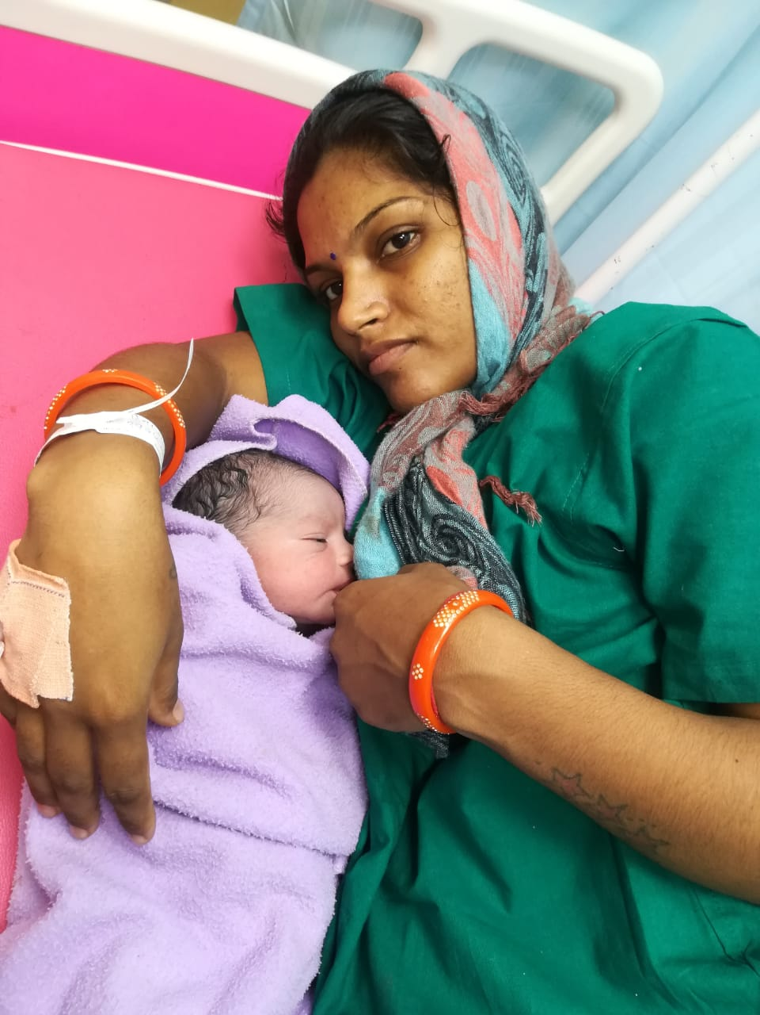
Major Benefits of the practice
Physiological cord clamping is feasible and all the benefits can be extended to mother & child
Shift in focus from cord cutting to taking care of newborn
Increase in comfort of the nurses & mother,
Better birth weight due to additional 80 ml blood
Help in Early Initiation of Breast Feeding
Fewer lactational failure
Drop in top feeding and galactagogues

Slide 15
Physiological Cord Clamp is just one of the many interventions
Comprehensive ANC Care
Midwife led Care Units
Partner Involvement
Labour Room Reorganization
Family Participatory Care
Respectful Maternity Care
Alternative Birthing position

Slide 16


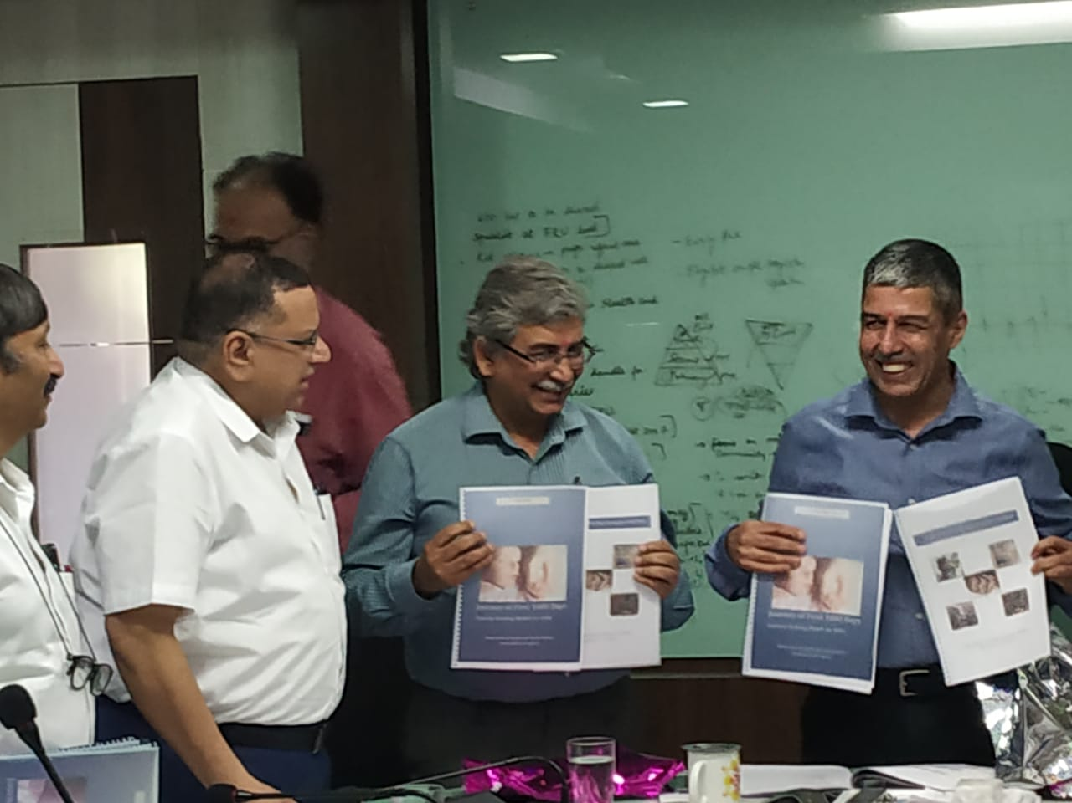
Development of Resource Materials
Certification
Course
Guidelines
Capacity Building
Module
Notes:
Development of Resource materials
Certification course on 1000 days with Baba Saheb Ambedkar Open University,
Guidelines on first 1000 days compliant facility
Capacity Building Module for ASHA
Release by Manoj Jhalani Sir and Dr Arun Singh

Slide 17
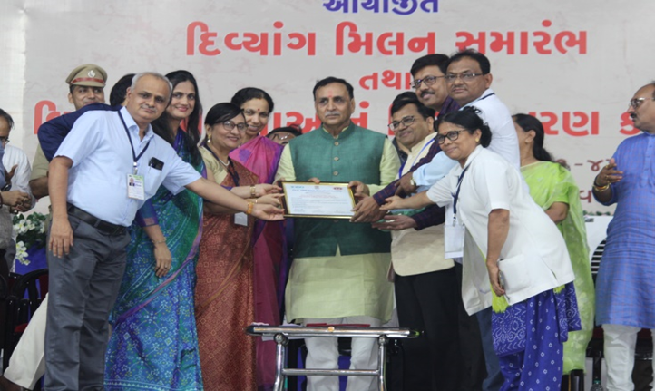
Certification of PDU Hospital Rajkot as a first
“First 1000 Days Compliant Facility” by Hon. CM of Gujarat

Slide 18
PDU Hosp. Rajkot First 1000 Days video

Slide 19

Community Awareness Activities
Community Awareness
SATCOM
Messages for Mothers
Saptdhara
Programs on Door Darshan
Use of Technology: My TeCHO app

Slide 20
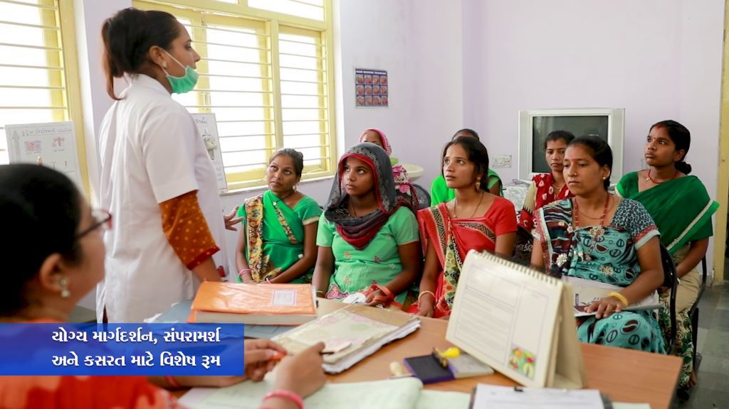
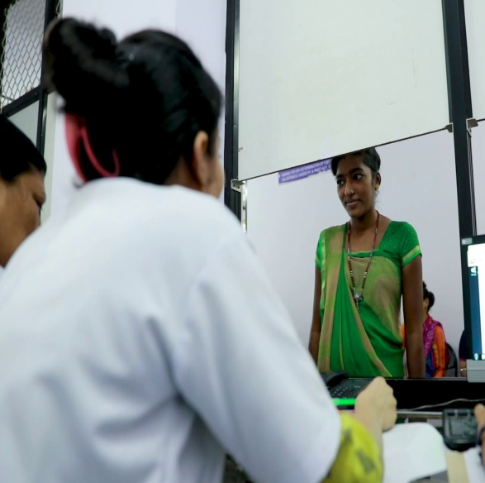
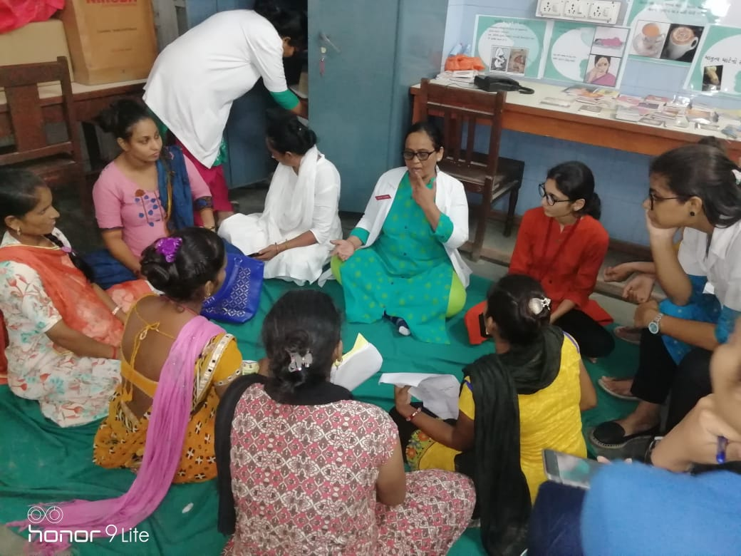
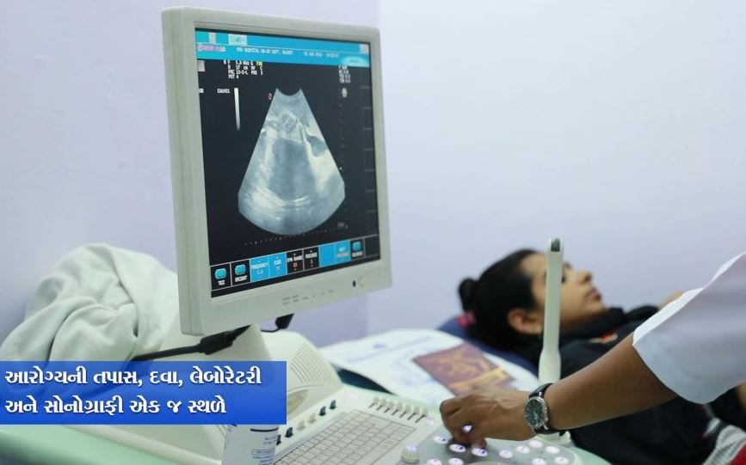
Comprehensive Antenatal Care
ANC Counselling Room
Separate registration
window for pregnant women
Exercise during Pregnancy
One Stop All ANC Services

Slide 21
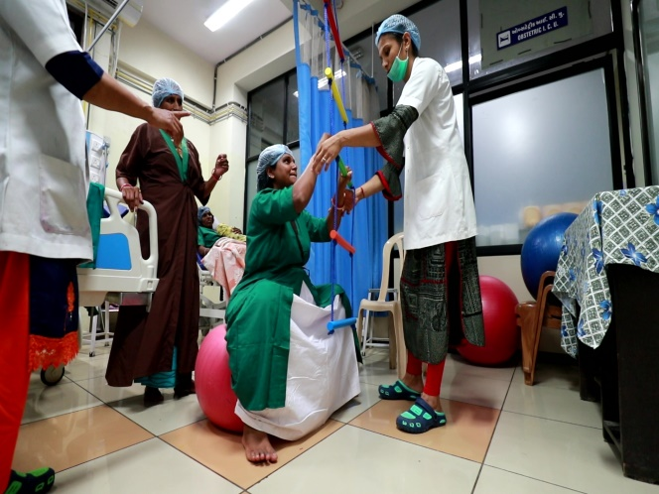
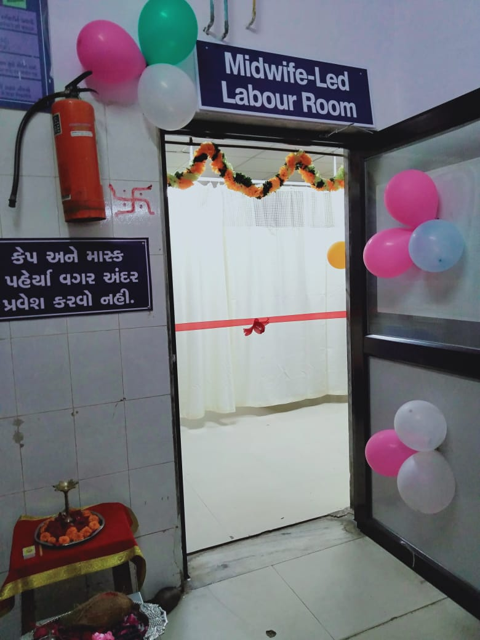
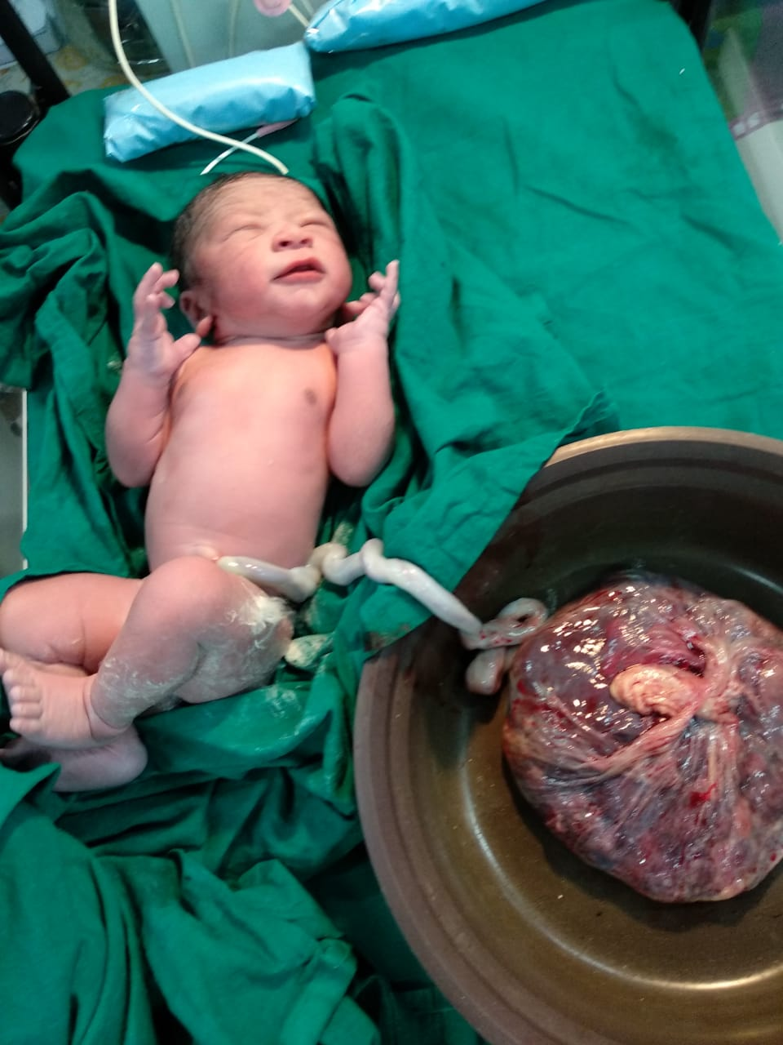
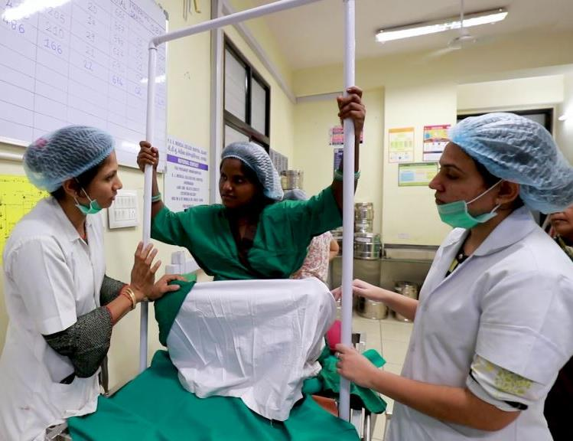
Strengthening Midwifery Led Services
Exercise During Delivery
Delivery in Alternate
Birthing Position
Physiological Cord
Clamping
Midwifery Led Care Unit

Slide 22
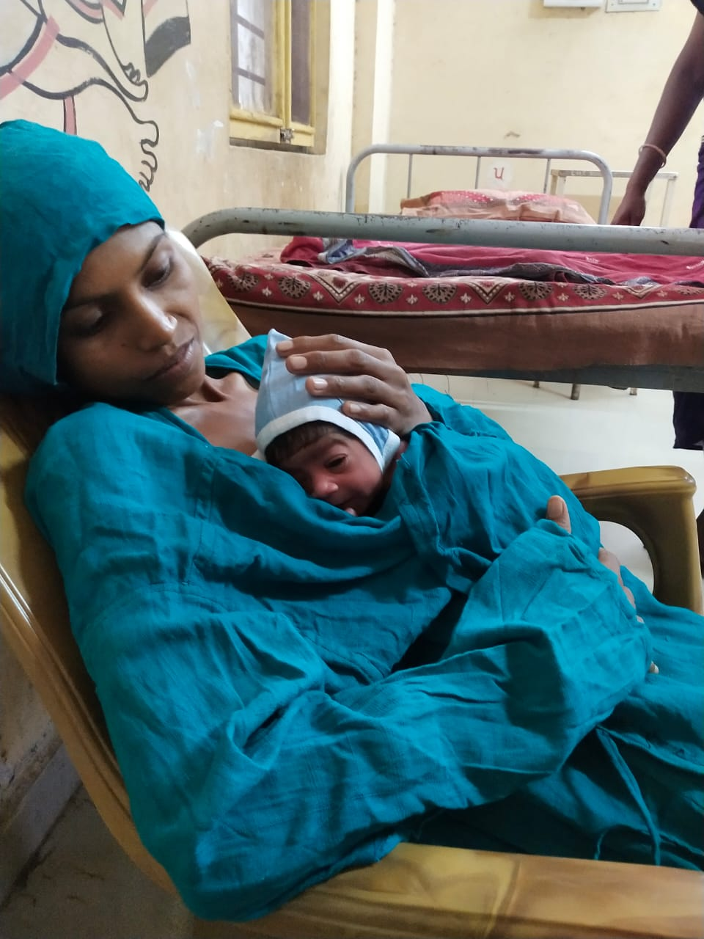
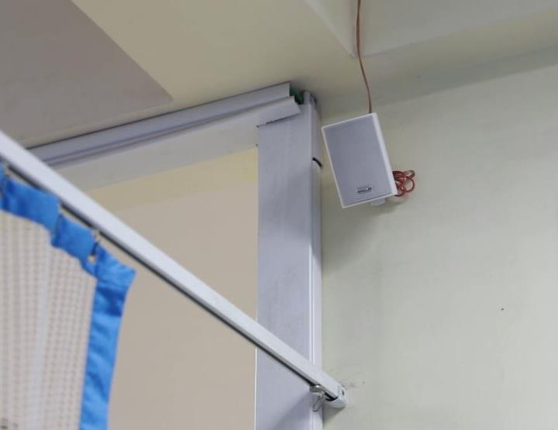
New-born care with Humanized Touch
Respectful Maternal & Newborn Care
Dignity, Privacy and Humanized Touch
Skin to Skin Care
Music & Dim Lights in LR & NICU
Birth Companion
Family Participatory Care in NICU

Slide 23












Engagement of Partners
Notes:
my-TECHO- SEWA-Rural, GVK-EMRI, Argusoft, Kangaroocare
Community Awareness Activities
SATCOM, Sapthdhara, live programs on Doordarshans
Development & Dissemination of 46 audio & Video messages in each language, Gujarati, Hindi and English

Slide 24
Programme Outcomes
Inborn Admissions in Surat SNCU: Before MLCU Vs After MLCU
Source: SNCU Online Software
Notes:
Community Awareness Activities
SATCOM, Sapthdhara, live programs on Doordarshans
Development & Dissemination of 46 audio & Video messages in each language, Gujarati, Hindi and English

Slide 25
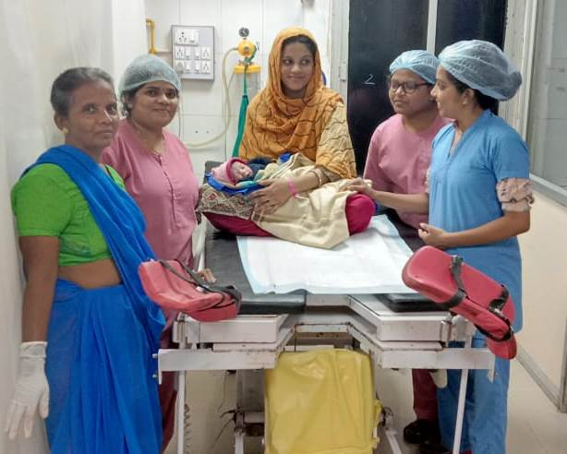
Program Outcomes
Positive birthing experience and joyful motherhood.
Humanized care with privacy, dignity and respect
Optimal family participation in care of newborn
Benefits of newer evidences such as alternate birthing positions and physiological cord clamping
Integration with My TeCHO app to ensure maximum reach
Notes:
Positive birthing experience for mother and baby
Humanized care with privacy, dignity and respect
Optimal family participation in care of newborn
Benefits of newer evidences such as alternate birthing positions and physiological cord clamping
Support in cognitive development of children to reach their full potential.

Slide 26

Way Foreword
Developing Gujarat as a Cognitive Capital Of India
Convert all Public Health Facility to “First 1000 days Compliant facility”
Develop Centre of Excellence for First 1000 days
Communication campaign for first 1000 days
First 1000 days short courses for common public and health worker
Development of monitoring framework and monitoring indicators

Slide 27
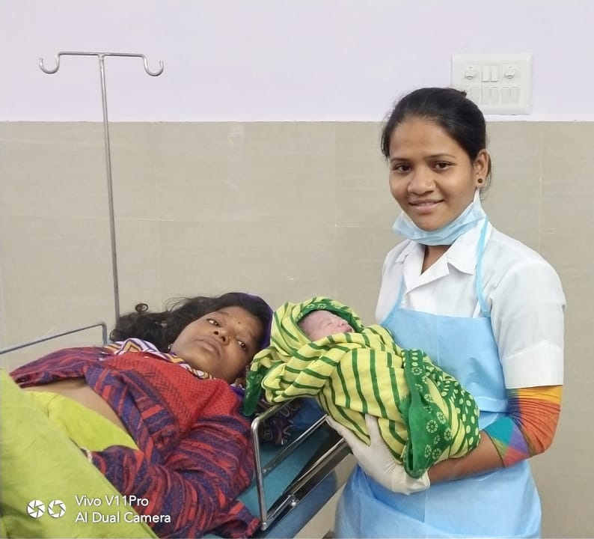
“The best way to find yourself is to lose yourself in the service of Others”\
Mahatma Gandhi

