Slide 1
e-Upchaar: Leveraging information technology to improve patient satisfaction and quality of care in public healthcare facilities of Haryana
State Health Systems Resource Centre, Haryana
Dr Sonia Trikha
Director Health Services
ED, SHSRC, Haryana

Slide 2
Public Healthcare: Challenges
Overcrowding at the facilities - poor patient satisfaction
Absence of reliable processes, compromising PSGs
Compromised inventory control leading to stock-outs, eventually increasing OOPE
Retrieval of medical records time consuming, reliability and authenticity of data?

Slide 3
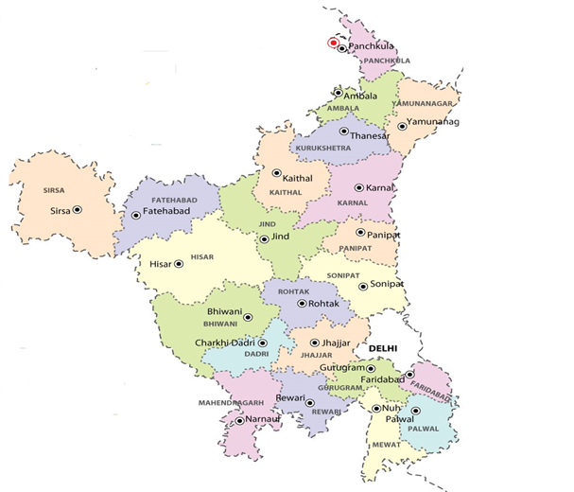
Project background
Hospital Management Information System (HMIS), ‘e-Upchaar’ initiated by Government of Haryana in 2014
Project being implemented by State Health Systems Resource Centre, Haryana
Stakeholders: Departments of Health, Medical Education & Research and AYUSH
SKG AC Kurukshetra
BPS MC Khanpur Kalan
PGIMS Rohtak
SHK MC Mewat

Slide 4
Objectives
Optimal utilization of infrastructure, equipment, facilities, HR, drugs & consumables
Availability of EMR for every registered patient across 56 facilities(MCs & DHs)
Reduction in waiting time through efficient queue management
Simplification and automation of manual processes
Transparency and availability of information related to hospital services

Slide 5
Objectives (contd…)
Integration with external applications, programs and schemes
100% service availability to all patients
Efficient grievance redressal mechanism
Real-time reporting, efficient analytics and decision support

Slide 6
e-Upchaar Modules
Registration
Out Patient Department (OPD)
Laboratory
Radiology and PACS
Pharmacy
Out Patient (OP) Billing
In Patient Dept (IPD) / Intensive Care Unit (ICU)
In Patient (IP) Billing
Birth and Death Registration
Labour Room
Operation Theatre
Maintenance Cell
Central Sterile Services Department (CSSD)
Human Resource Management System (HRMS)
Purchase Management
Blood Bank
Emergency & MLC
Record Room / MRD
Asset & Equipment Management
Store and Sub-store Management

Slide 7
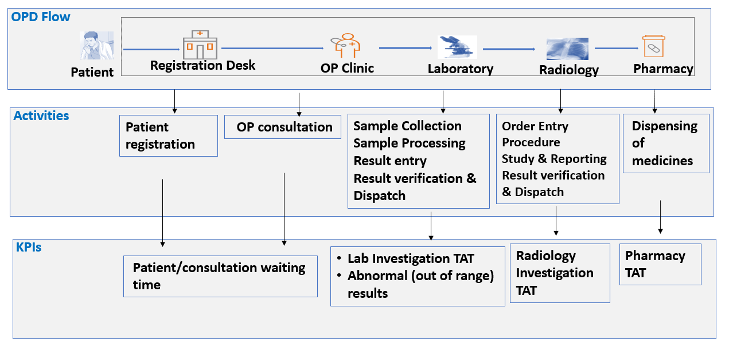
OP Touch Points, Activities and KPIs

Slide 8
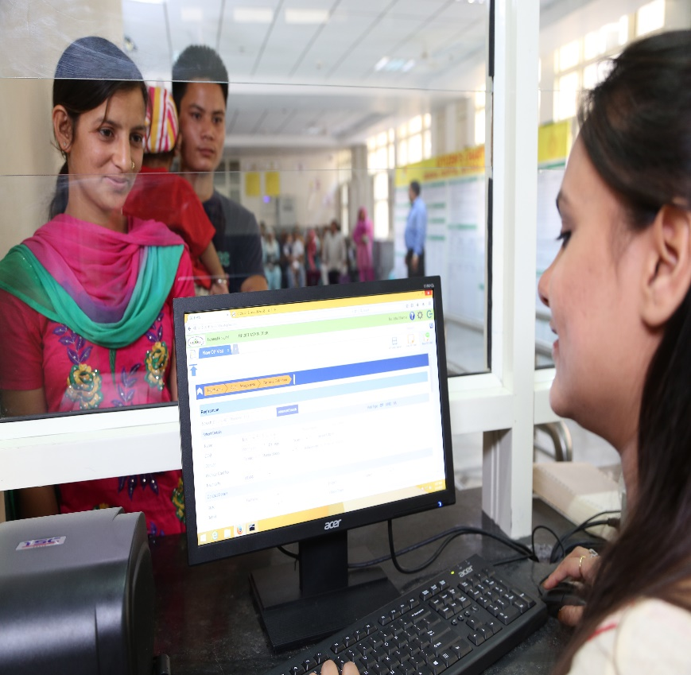
Registration module
Designated registration counters
Token system for better queue management
UHID for patient identification
Easy monitoring of patient waiting times

Slide 9
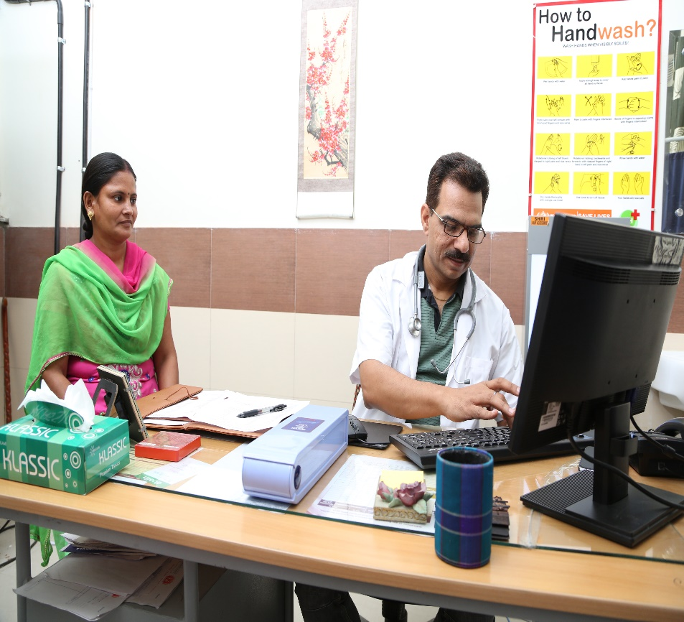
Doctors’ Module
User Friendly screens
Capturing diagnosis
Ordering investigations
Prescribing medicines
Viewing diagnostic reports

Slide 10
Doctors’ Module
View of patient queue (on Doctor’s screen)
Favourites/Tick list feature
The doctor can mark the patient as seen, send a patient for cross referral, order investigations (lab & radiology) and also view the patient’s EMR from this screen.
The regularly used diagnosis can be added to the Favourite list by an individual doctor. All the diagnoses are mapped to the ICD 10 classification of diseases.

Slide 11
… Past Practice

Slide 12
Diagnostic Modules
Laboratory Module
Unique Barcode for each collected sample
Integration of Lab equipment with the application
Reduction in the lab errors and sample
re-dos
‘Out of range’ values highlighted
Alerts for critical values
Radiology Module
Integration of radiology equipment with the application
X-ray images are available on the doctors’ screen for view & decision making
Cost saving due to discontinuation of printing of x-ray films

Slide 13
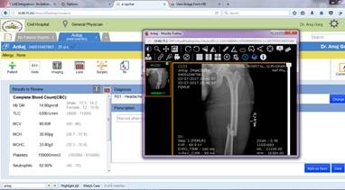
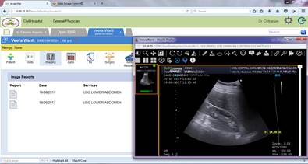
Integration of e-Upchaar with PACS

Slide 14
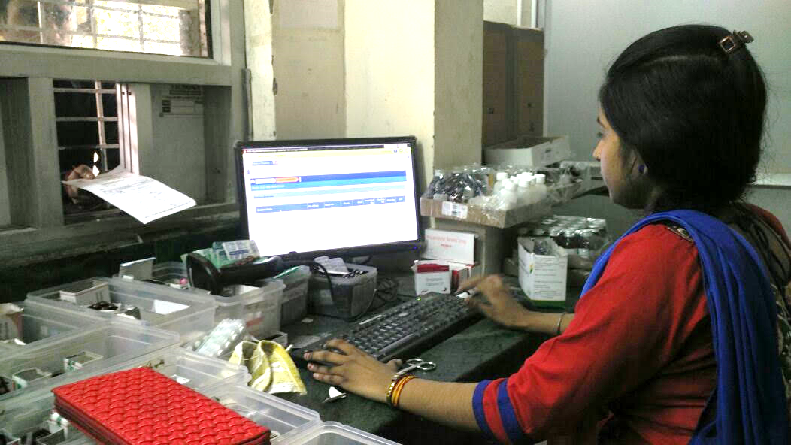
Pharmacy Module
Availability of online Prescription (part of EMR) for medicine dispensing
Automatic linkage with the store inventory
Alerts for stock outs, expiry etc.

Slide 15
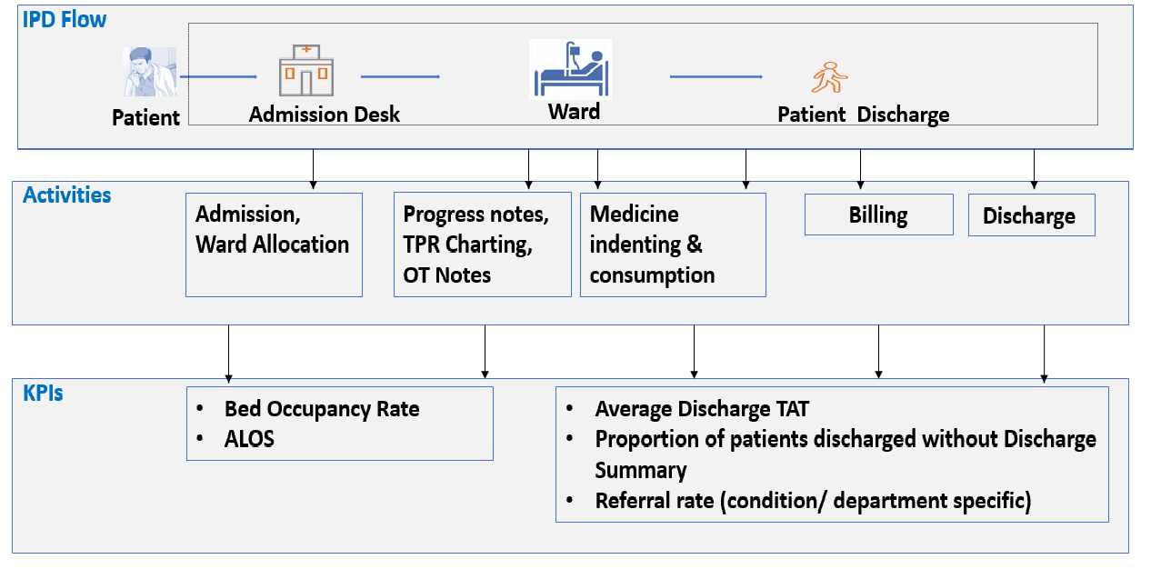
IP Touch Points, Activities and KPIs

Slide 16
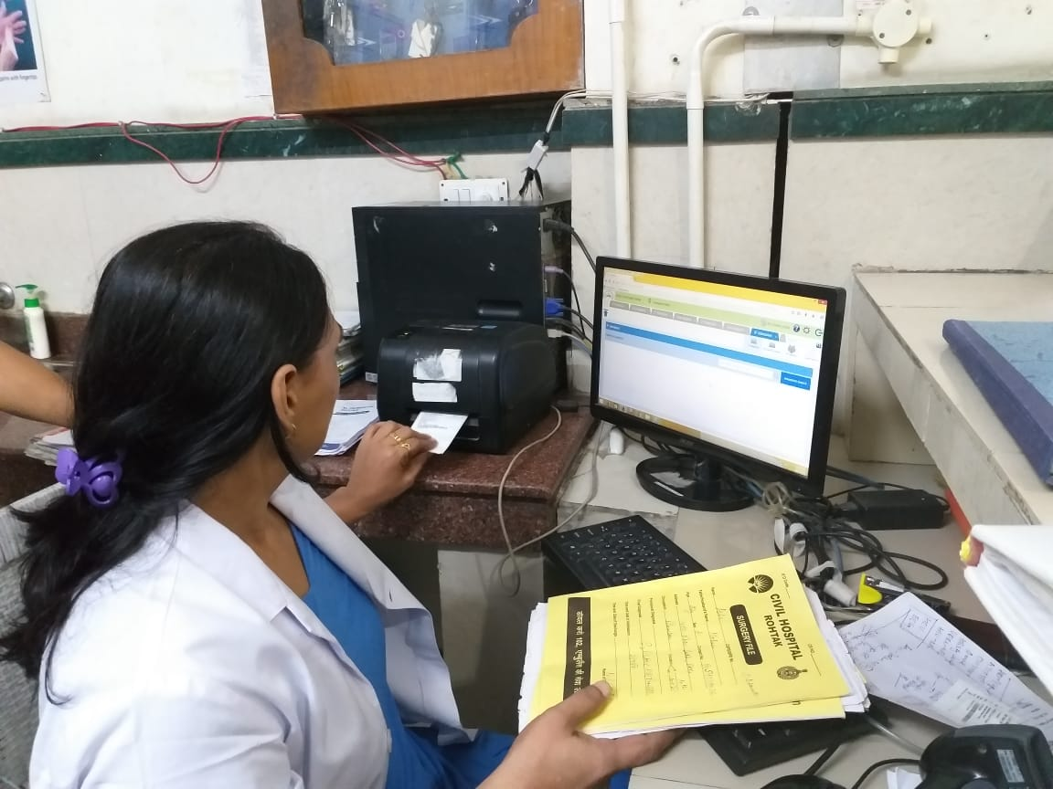
IPD Module
Capturing the diagnosis, investigations and the hospital course of treatment
Surgical procedures (including OT notes, Anaesthesia details)
Discharge summaries automatically populated with the course of events post admission

Slide 17
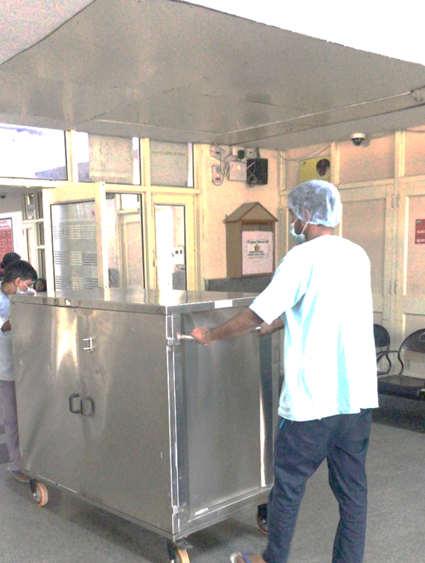
Sterile linen and instruments transported in linen/instrument trolleys

Slide 18
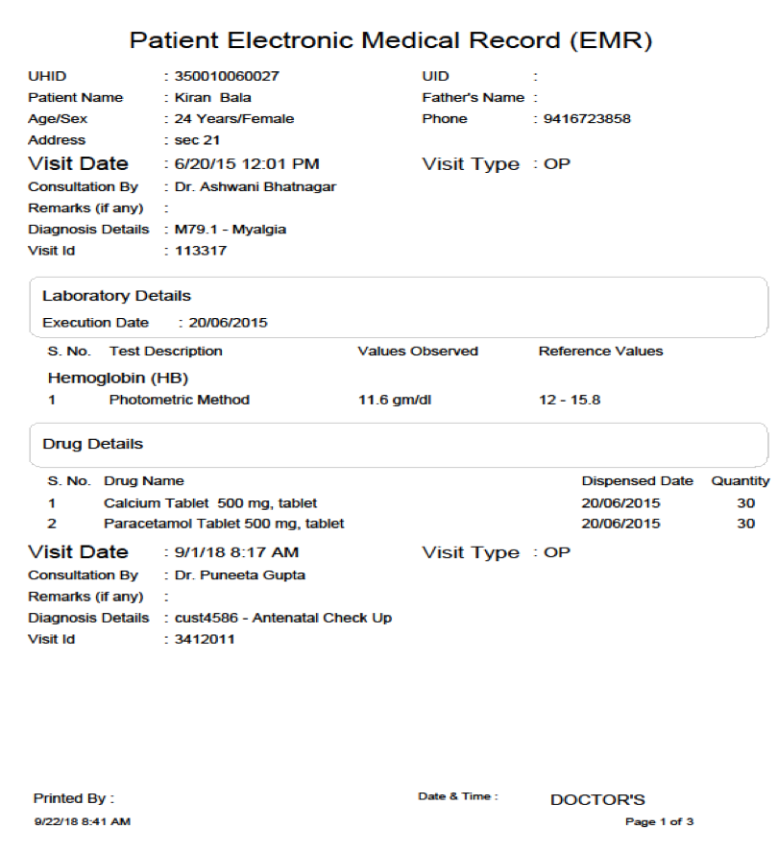
Digitisation of patient record
Patient record captured in the form of Electronic Medical Record (EMR) against each patient ID. Available for review and evaluation by the doctors.
It includes:
Patient diagnosis which is mapped to ICD 10 classification
Diagnostic reports
Medicines dispensed/issued
Surgery details (if any)
Discharge details

Slide 19
Store & Sub Store Module
Transparency related to stock availability
Reduction in wastage due to Expiry
Reduction in pilferage of drugs
Improved decision making
Alerts for
Stock outs
Near expiry drugs
Expired
drugs
Analysis of consumption patterns for fixing reorder levels for drugs
Dispensing of drugs through the pharmacy/
store module
Mapping of available drugs

Slide 20
Benefits of implementing e-Upchaar
Structure
Process
Outcome
UHID generation, Aadhaar linkage, facilitation through registration counters
In-patient identification through ID bands reducing medication errors
Token system in OPD, ER and diagnostics to reduce patient waiting
Manual records replaced with lean system
Electronic Health Record for all registered patients
Online laboratory reports
Monitoring of pre-defined health indicators
Improved patient outcomes
Capturing of patient feedback through ‘Mera Aspataal’
Improved patient satisfaction levels
Reduced waiting times
Quality patient care
Clinical effectiveness through standardized treatment protocols
Automation of laboratory and radiology services
System alerts in pharmacy and stores for stock-outs and near expiry

Slide 21
Cost effectiveness
24,20,700

Slide 22
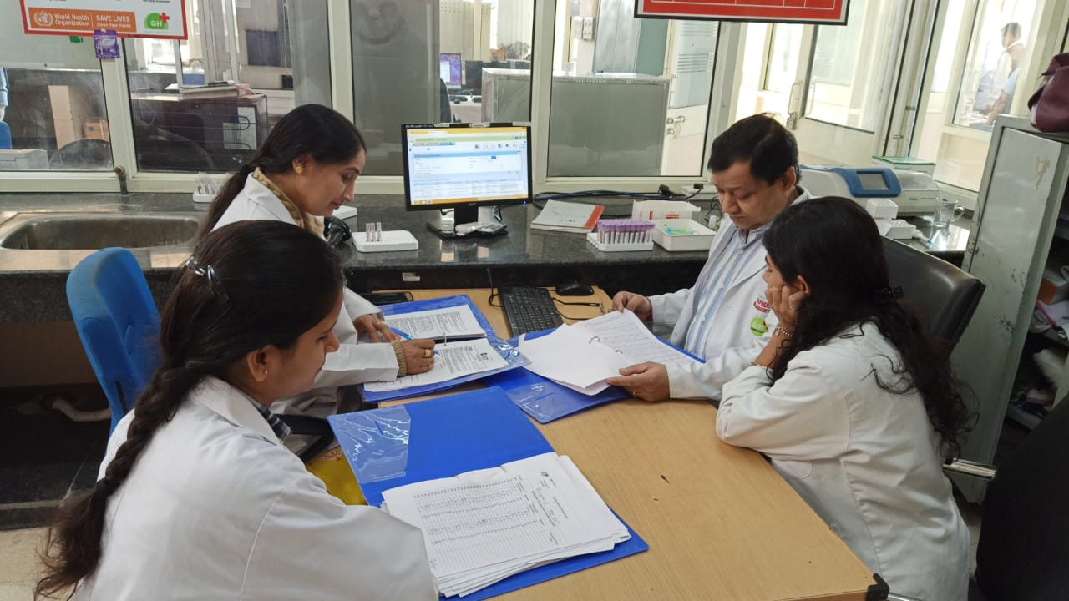
Laboratory errors and re-dos being analysed by the laboratory staff

Slide 23
Impact analysis
Services/Facilities | In Manual System | Through e-Upchaar
Patient Registration | 4-5 mins per new patient once the patient reaches the counter | 1 min per new patient
Follow Up visit with UHID | 3-4 mins per patient [In practice, a new card is issued to revisiting patients] | 30 secs per patient
Billing & Cash Collection | 2-4 hours per patient | 3-5 Minutes
Diagnostic report availability | 1 - 2 days | Same day in most cases
Inventory Control | Poor & lengthy system of management | Reduction in wastage with alerts for near expiry and expired stock
Blood Bank | No track of blood stock, information on available blood groups etc. Manual tracking of blood bag expiry date Manual Tracking of blood collected during blood camps | Increase in blood utilization Wastage Avoided Centralized Blood Inventory Information
Care Planning by Physicians | Care Planning is event based and time consuming | EMR of a patient helps physician in better care planning and monitoring. Follow up is easier.

Slide 24
Overview of implementation
Challenges
Poor queue management
Solutions
Implementation of token management system
Outcomes
Streamlining of patient flow
Availability of Electronic Medical Record (EMR).
Incomplete/inaccurate data
Reporting errors
UHID for patient identification
ICD 10 classification of diseases
Integration of diagnostic equipment with e-Upchaar
Reduction in reporting errors.
Easy understanding of disease burden
Timely availability of printed lab reports to patients
Breach in continuum of care
Bar code stickers for patient samples
Manpower constraints

Slide 25
New Developments
Central dashboard
Key performance indicators (KPIs)
HRMS
http://117.252.5.249:9093/#/Login
http://117.252.5.248:8092/dashboard/dashboardLanding.jsp

Slide 26
Challenges
Change management
Integration with external applications
Training of the users
Shift from manual data recording to a more transparent system
Standardization of processes
Interoperability issues with external application
Operational issues
Differential price master across facilities
Lack of transparency related to services
Manpower constraints
Issues with data validation
Delayed construction activities
Inadequate manpower

Slide 27
The way forward..
Web portal and mobile application
Expanding to the remaining healthcare facilities
(Approximately 670): New RFP in the process of finalization
Advanced analytics for decision making at the
state level
Data Mining for research studies/publications

Slide 28
Thanks

