Slide 1
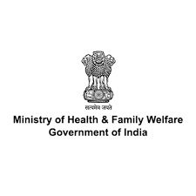
PEDIATRIC CARE IN COVID-19 INTRODUCTION

Slide 2
OBJECTIVES
By the end of the session participants will be able to
Respond correctly to prevailing myths related to COVID-19 in children
Discuss the state of children related to COVID-19

Slide 3
BUZZZZZ AROUND COVID 19
COVID Appropriate Behaviour
Mask
Sanitizer
Second wave
Oxygen support
COVID19 Vaccination
Pediatric Cases
COVID19
Frontline Health Workers
??? Third wave
Health system preparedness

Slide 4
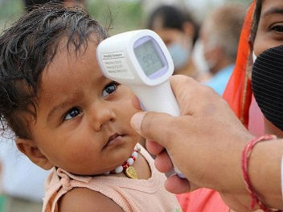
VACCINATION DRIVE
AT COMMUNITY LEVEL
SAFE BEHAVIOURS
??? Third wave
MORE CHILDREN IN THIRD WAVE

Slide 5
MYTH 1:
We do not need to worry about children getting COVID-19 because children are immune to COVID-19

Slide 6
National and international data indicated a maximum of 2-3% of such children requiring hospitalisation in wave 1/ 2.
However, to meet the surge in India, we need to be ready for a little higher number and for an indicative projection, a figure of 5% of children with COVID have been estimated to be requiring hospitalisation.

Slide 7
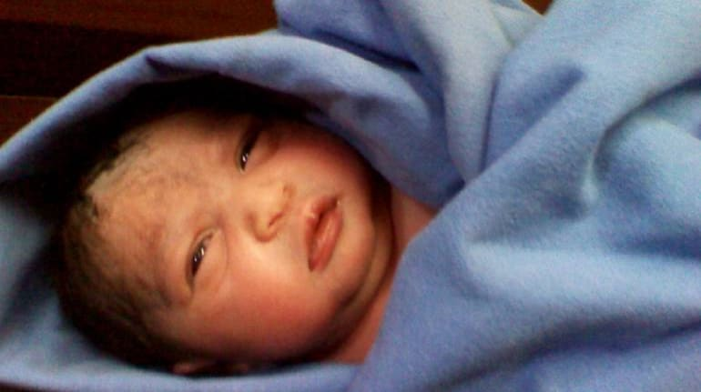
MYTH -2 A neonate cannot get COVID-19 from mother who has COVID-19

Slide 8
A neonate can get COVID -19 infection in three potential ways:
1. Through aerosol or direct contact from infected mothers or caregivers (including healthcare workers) in the postnatal period (postnatal infection): most likely method of transmission
2. Direct exposure to maternal blood or secretions during delivery (intrapartum infection): very rare, but more likely than the intrauterine transmission.
3. Transplacental passage from mother to foetus (intrauterine infection): extremely rare and not to be considered.

Slide 9
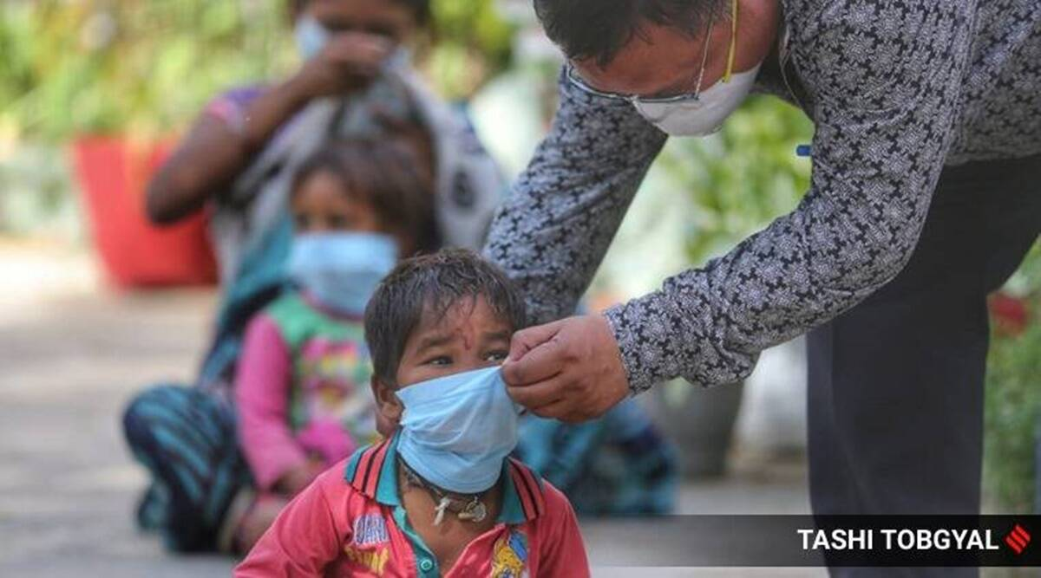
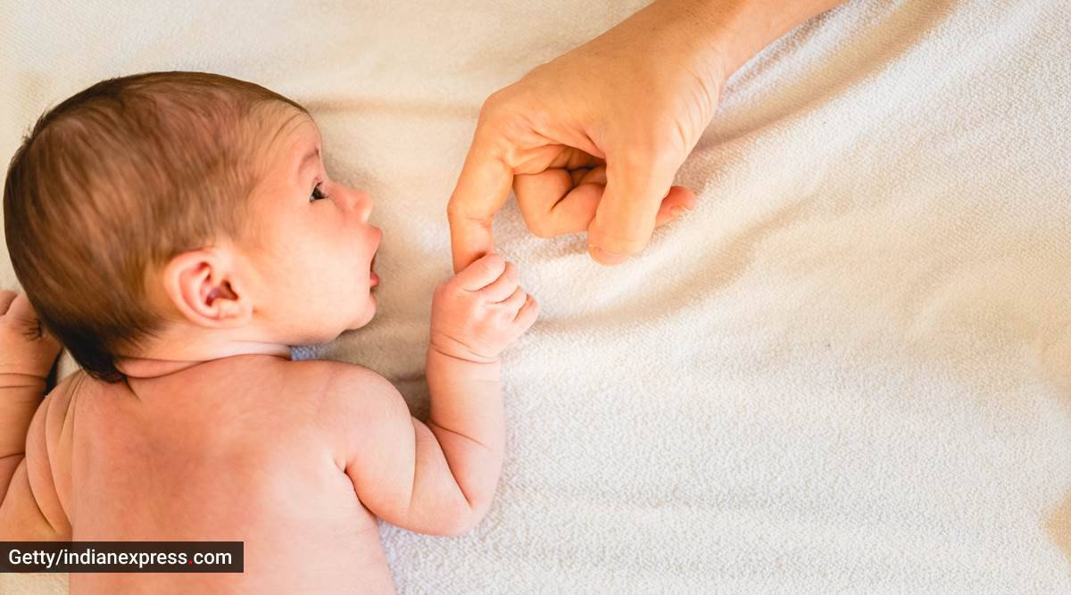
MYTH – 3 All children are safe from COVID -19

Slide 10
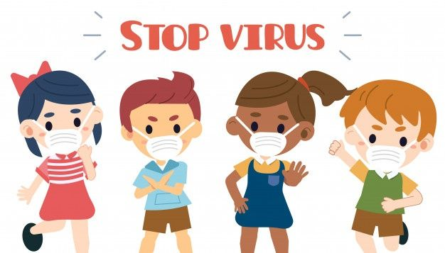
Burden of pediatric and adolescent cases in India (since 14th March 2020)
Cases below the age of 20 years= 12% (35,40,000)
Total confirmed cases in India: 3.03 crores (as on 28th June 2021)

Slide 11
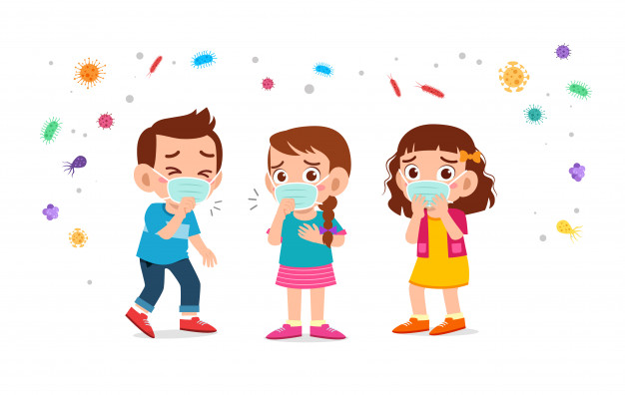
98% CHILDREN RECOVER FROM COVID-19
Deaths below the age of 20 years= 2% (7540)
Total deaths in India: to 3.97 lakh deaths
(as on 28th June 2021)

Slide 12
Why children are more vulnerable to COVID19?
Sero-positivity (age group of 10-17 years)
25.3% (similar to that of adults)
Proportion of confirmed cases is lower among the children < 20 years
Children - equally susceptible to infection, but remain asymptomatic
!
Age group not covered under vaccination
!
Possibility of opening of colleges and schools

Slide 13
MYTH- 4 Mothers with COVID-19 must not breast feed their baby

Slide 14
Presence of viable SARS-CoV-2 virus (virus causing COVID- 19) in breastmilk and transmission resulting in neonatal infection has not been reported till now.
Mothers must breast feed their babies after adopting all protective behaviour – triple masking , washing hands.

Slide 15
MYTH- 5 All children have the same risk levels for COVID-19

Slide 16
WHICH CHILDREN ARE MORE IMPACTED?
Children with prior mental/behavioral health conditions
Children with chronic health conditions, disabilities, & special health care needs
All children, all ages

Slide 17
MYTH- 6 If a mother has COVID-19, there are no effects on baby

Slide 18
THERE IS LIKELIHOOD OF PRE-TERM BIRTHS…
PREMATURITY RELATED COMPLICATIONS FOR BABY IS MORE

Slide 19
MYTH-7 It is better to separate mother and baby for baby’s protection if mother is COVID -19 positive

Slide 20
SEPARATING MOTHER FROM BABY NOT ADVOCATED
GUIDELINES FOR HOSPITALISATION OF BABY RECOMMENDS PARENTAL ACCOMPANIMENT WITH SAFETY PRECAUTIONS

Slide 21
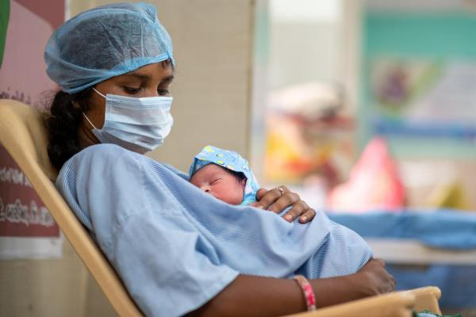
MYTH- 8 Kangaroo Mother Care is not advocated if mother has COVID 19

Slide 22
ESPECIALLY FOR PRE-TERM BABIES KANGAROO MOTHER CARE RECOMMENDED WITH CAREGIVER/PARENTS TAKING SAFETY PRECAUTIONS ( Triple layer mask)
ASHA CAN HELP HERE

Slide 23
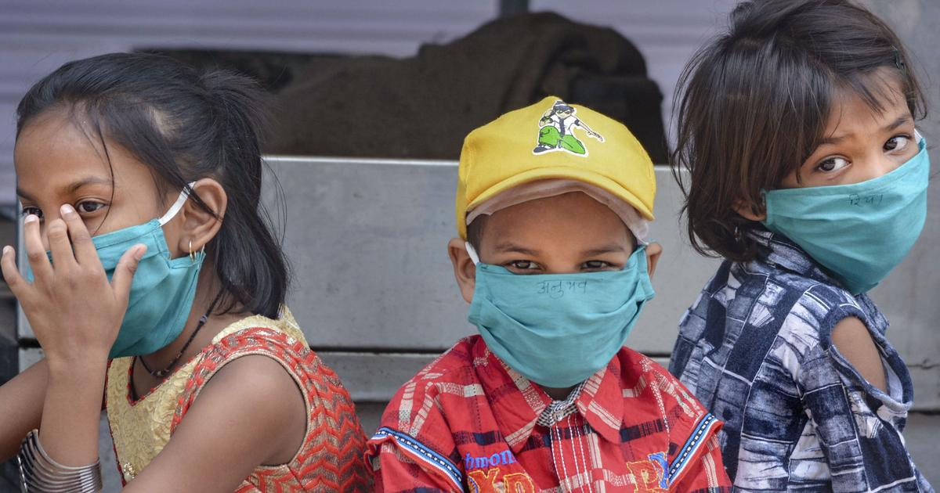
MYTH- 9 Children and adults with COVID-19 have similar symptoms.

Slide 25
MYTH-10 All children irrespective of age may require hospitalization if found to have COVID 19

Slide 26
NOT ALL CHILDREN
Infants less than 12 months of age and children 15 years and above are more likely to need hospitalization
Children with underlying co-morbidities (neurological, cardiac, haematological, oncologic )are more likely to need hospitalization

Slide 27
MYTH- 11 All children who have COVID-19 will need ICU care and oxygen. Therefore, we cannot do anything much at community level

Slide 28
Continuum of care approach in pediatric COVID19 cases
Community level
Level 1 care – CCC
Level 2 care – DCHC
Level 3 care – DCH
mild cases or mild COVID suspect cases
Moderate cases
For severe cases
IMNCI
Post COVID care
PHC MO/ AYUSH Doctors
Doctors at CHC/ DH
Doctors at Tertiary hospitals
Home based care
Initial Triaging
Listing
ASHA, MPWs

Slide 29
FLWs must be more alert when in their communities there is
Test Positivity of 10% or more in the last one week
Bed Occupancy of more than 60% on either oxygen supported or ICU beds.

Slide 30
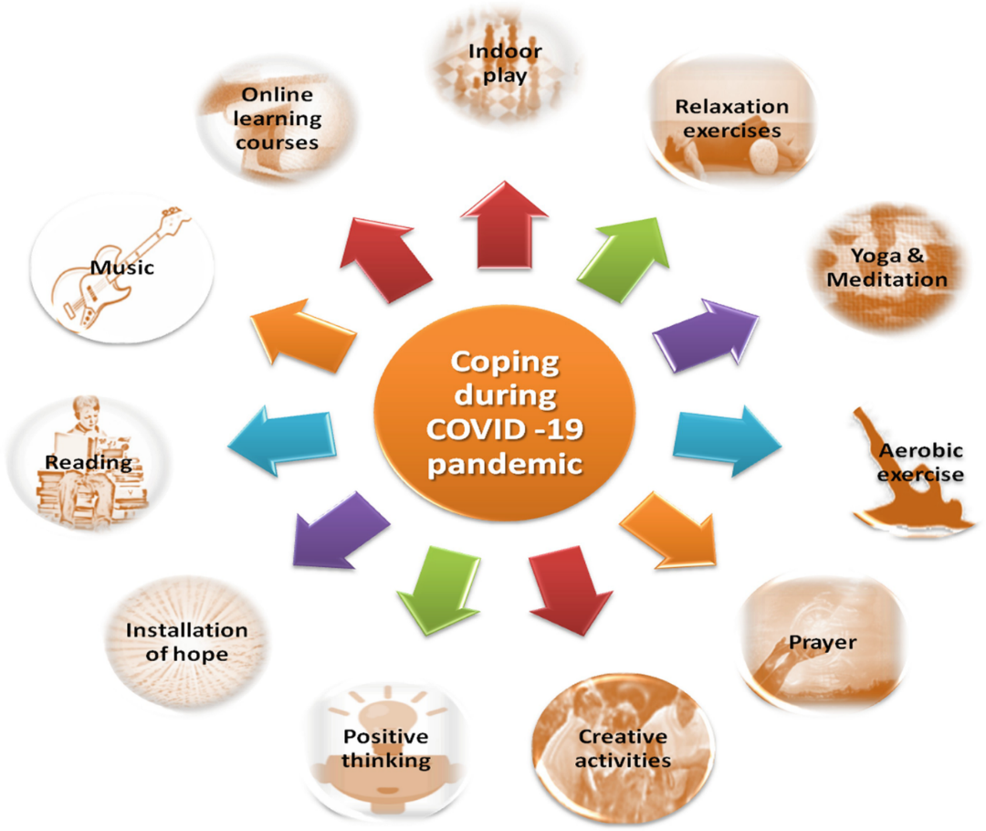
SUPPORT MENTAL HEALTH OF CHILDREN TOO EDUCATE THEM ON HOW TO STAY HEALTHY AND SAFE

