Slide 1
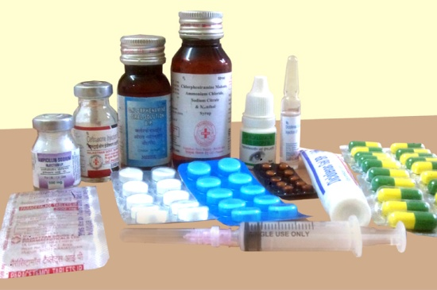
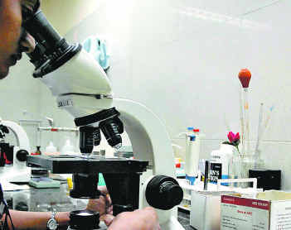
Improving
ACCESS TO TREATMENT
IN
RAJASTHAN
through
&
FREE MEDICINE
SCHEME
FREE DIAGNOSTIC
SCHEME
By:
Ajay Aswal RAS,
Executive Director,
Rajasthan Medical Services Corporation, Jaipur

Slide 2
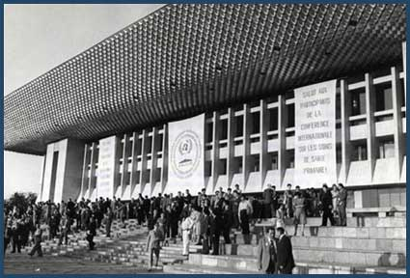
HEALTH FOR ALL
Declaration of Alma-Ata, 1978
International Conference on Primary Health Care,
Alma-Ata, Kazakhstan, 1978

Slide 3
Problem : 1 Medicines are beyond the reach of our people.
As per WHO 65% of the Indian population lacks regular access to essential medicines.
The expenditure on health is the second most common cause for rural indebtedness.
Over 23% of the sick don’t seek treatment because they are not having enough money to spend.
Over 40% of hospitalized patients has to borrow money or sell their assets to get them treated.

Slide 4
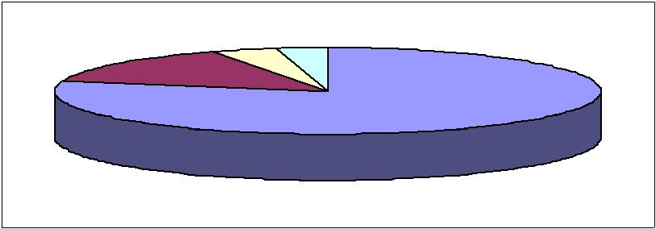
Problem : 2 Expenditure on medicines make people poor.
Where does the money for health expenditure (in India) come from?
Private out of pocket expenditure | 79%
State govt. | 14%
Central govt. | 4%
Private investment | 3%
Private insurance | 0 – 1%
Expenditure on drug constitute about 50-80% of the health care cost.
Expenditure on health is responsible for 3% shift from APL to BPL every year.
A study by World Bank shows that as a result of single hospitalization 24% of people fall below poverty line in India.

Slide 5
Problem: 3 Medicines are overpriced.
(COMPARATIVE PRICES OF GENERIC AND BRANDED DRUGS)
Use | Name of Drug | Pack size | Equivalent Popular Brand | MRP (Rs.) | RMSC Tender price (In Rs.)
ANALGESIC | DICLOFENAC SODIUM TABLET IP 50 MG | 10 TAB STRIP | VOVERAN | 31.73 | 1.24
CHOLESTEROL LOWERING | ATORVASTATIN TABLET IP 10 MG | 10 TAB STRIP | ATROVA (ZYDUS) | 103.74 | 2.98
BLOOD THINNING DRUG | CLOPIDOGREL TABLET IP 75 MG | 14 TAB STRIP | PLAVIX (SANOFI AVENTIS) | 1615.88 | 8.54
DIABETES | GLIMEPIRIDE TABLET IP 2 MG | 10 TAB STRIP | AMARYL (AVENTIS) | 125.00 | 1.95

Slide 6
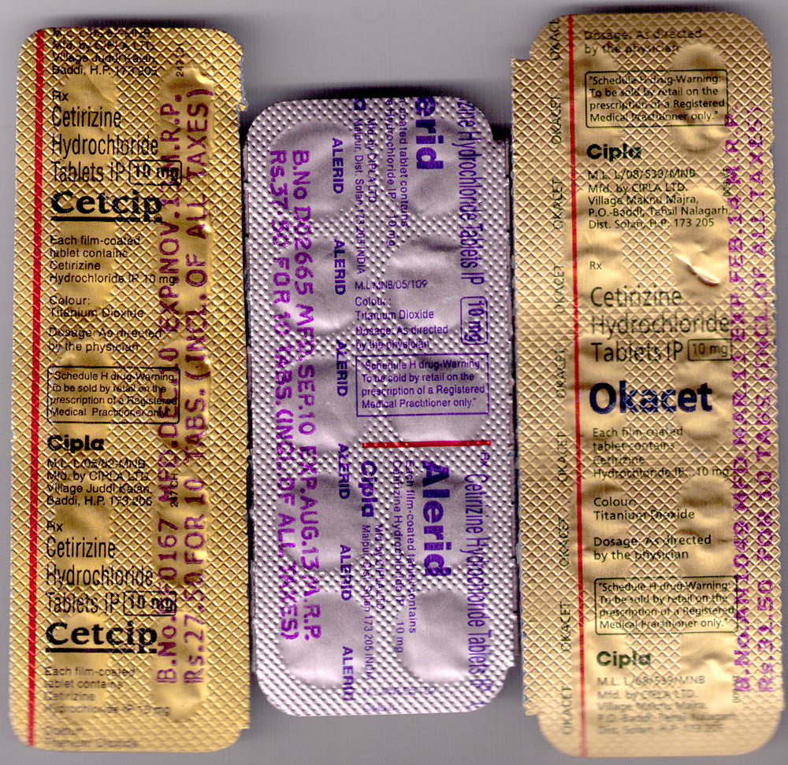
Problem : 4 Differential Drug Pricing
MRP for 10 tabs
Rs. 27.50
Rs. 39.30
Rs. 31.50
Purchase price for 10 tabs
Rs. 2.02
Rs. 23.70
Rs. 2.27
Manufacturer is Cipla for all the three brands
One branded
&
Two generic

Slide 7
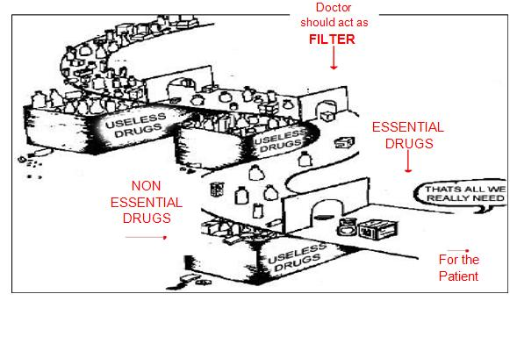
Problem : 5 Promotion of Non essential drugs

Slide 8
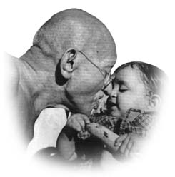
Solution
MUKHYAMANTRI NIHSHULK DAVA YOJNA
AN INITIATIVE………
TO SAVE LIVES

Slide 9
COMPONENTS OF FREE MEDICINES SCHEME
(Hardware Component) TO MAKE DRUGS AVAILABLE IN GOVT. HOSPITALS. | (Software Component) B. TO CHANGE PRISCRIPTION BEHAVIOUR OF DOCTORS.
1. Establishment of autonomous centralized procurement agency : Rajasthan medical services corporation. | 1. Sensitization and orientation about rational use of drugs (RUD).
2. Identification of drugs for free essential drug list (EDL) | 2. Write prescription on self carbonated prescription slips
3. Procurement through a two-bid transparent e-tendering process | 3. Diagnosis must be written
4. Drug Warehouse at every district | 4. Write Generic / Salt names
5. Empanelled laboratories for quality testing | 5. Use out of Essential Drug List
6. System for transportation of drugs | 6. Follow Standard Treatment Guidelines
7. System for storage and distribution of drugs in all hospitals | 7. Constitution of Drug and Therapeutics Committee (DTC).
8. e-Aushadhi Software for Inventory management | 8. Prescription Audit.
9. Transparent and prompt payment system | 9. Computerized drug dispensing up to PHCs.
10. Sufficient funds. | 10. Patient counselling

Slide 10
COMPONENT-1
STEPS TO MAKE DRUGS
AVAILABLE IN GOVT. HOSPITALS.

Slide 11
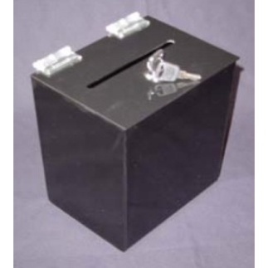
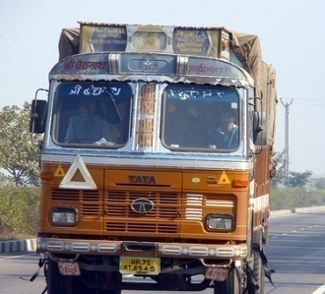
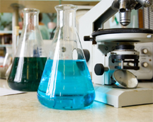
1. Autonomous centralized procurement agency.
ESTABLISHMENT OF
RAJASTHAN MEDICAL SERVICES CORPORATION
PROCUREMENT
SUPPLIES
QUALITY CONTROL
IT CELL

Slide 12
2. Identification of drugs for free essential drug list (EDL)
Technical Advisory Committee
has developed
the procurement list of RMSC (EDL).

Slide 13
3. A two-bid open transparent tendering process.
Only manufacturer/importer can participate.
Only those bidder can participate who have annual turnover more than Rs.20 Cr.
GMP Certificate.
Non-conviction certificate.
Only e-procurement from 1st April 2012.

Slide 14
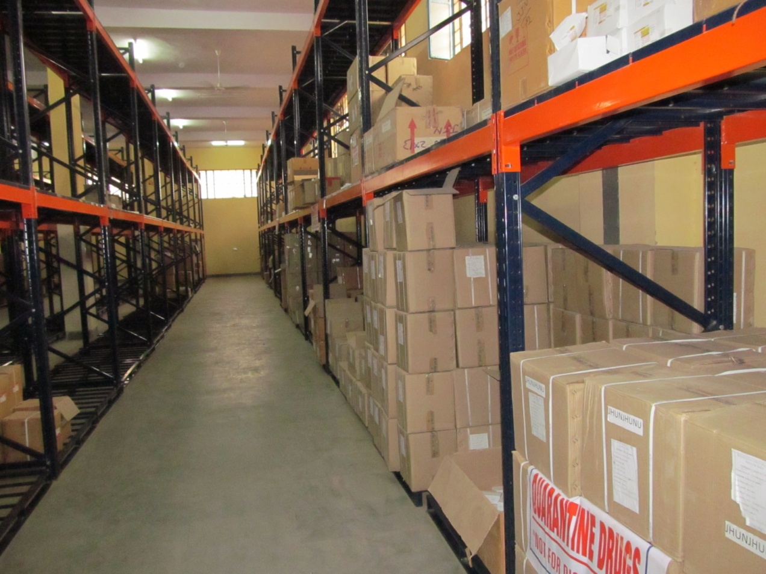
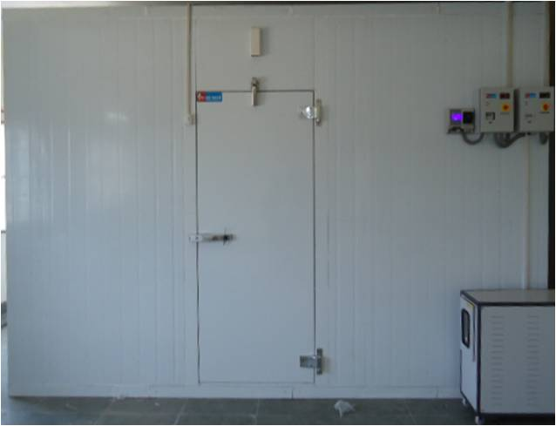
4. Warehouse at every district.
Warehouse
Walk in Cooler

Slide 15
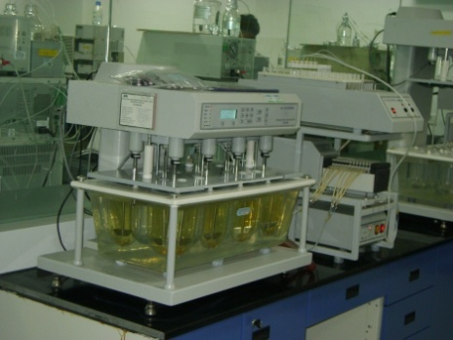
5. Empanelled laboratories for quality testing.
Drugs are received at DDW with manufacturer’s test report.
They are stored in quarantine area.
Sample are sent to QC cell at RMSC head office.
Samples are coded & sent to empanelled labs.
RMSC has empanelled 6 NABL accredited / schedule L1 compliant labs.
Examination of samples is carried out as per pharmacopeias.
If sample is found “as of standard quality” then only drugs are issued to hospitals.

Slide 16
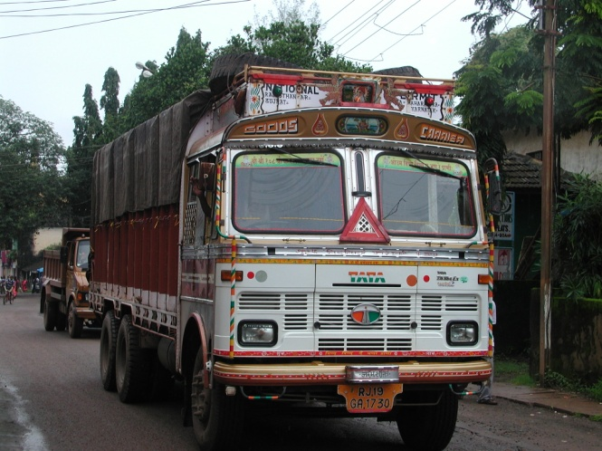
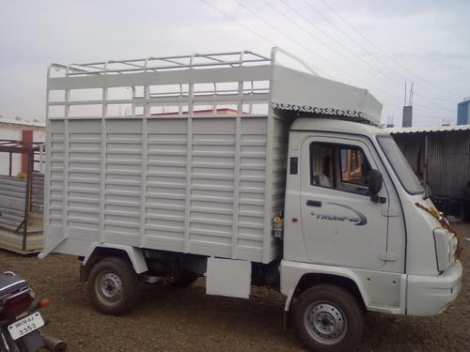
6. System for transportation of drugs

Slide 17
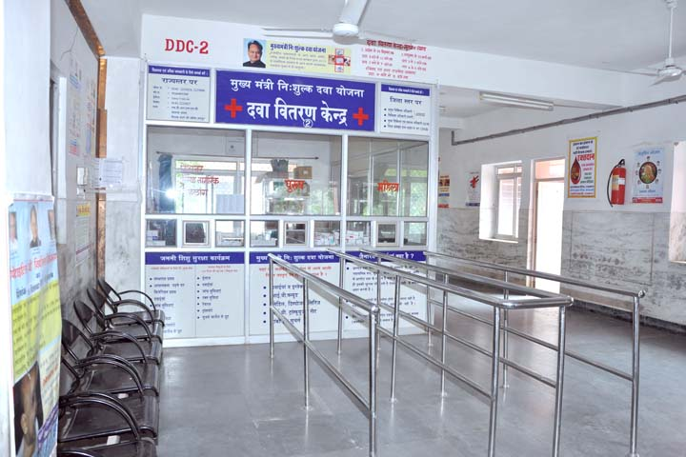
7. System for storage and distribution of drugs in all hospitals

Slide 18
8. e-Aushadhi Software for Inventory management
Computerized inventory management through e-Ausahdhi Software.
Drugs are issued using passbook system.

Slide 19
9. Transparent and prompt payment system.
Payment either through CBS (Core banking solution, anywhere
banking), or NEFT (National Electronic Fund Transfer) up to
1.00 Lac or RTGS (Real Time Gross Settlement) if more than
1.00 Lac.
e- Processing of suppliers payment through e- Aushdhi
Software.
Physical Cheques are not issued to any suppliers.
Centralized payment to all stakeholders viz suppliers,
H.Q./DDWs staffers.
TDS and other statutory dues etc through e-payment.

Slide 20
10. Sufficient funds.
FY 2011-12 - Rs.200 Cr.
FY 2012-13 - Rs.300 Cr.
FY 2013-14 - Rs.300 Cr.

Slide 21
COMPONENT-2
STEPS TO CHANGE PRESCRIPTION BEHAVIOUR OF DOCTORS.

Slide 22
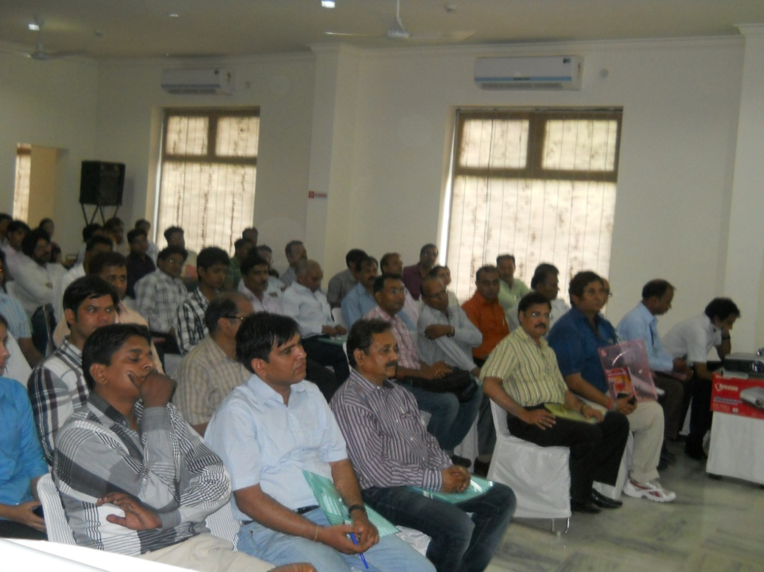
1. Sensitization about the poor and orientation of Doctors about rational use of drugs (RUD).
Seminars,
Conferences
&
Review meetings

Slide 23
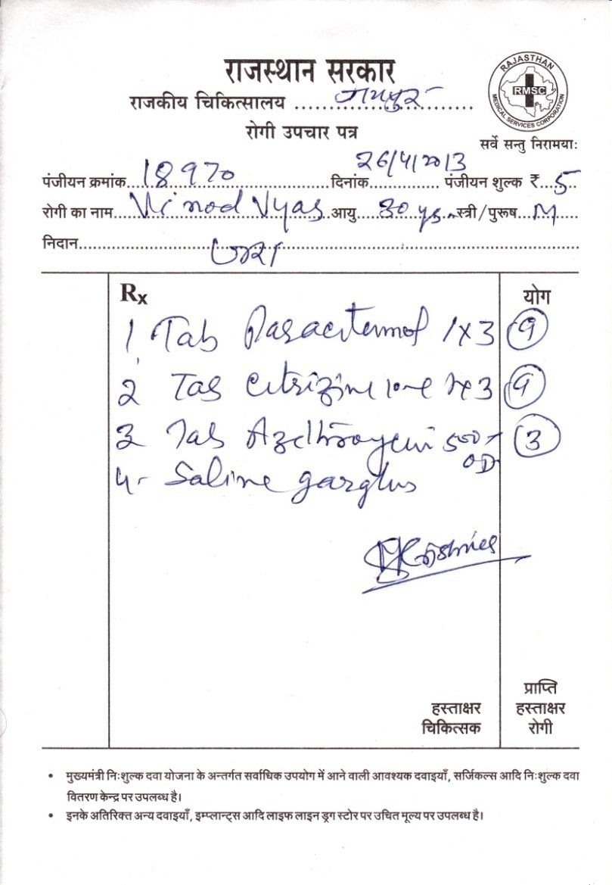
2. Write prescription on self carbonated double prescription slip.
3. Diagnosis must be written

Slide 24
4. Write Generic / Salt names.

Slide 25
5. Use out of Essential Drug List.
6. Follow Standard Treatment Guidelines.

Slide 26
7.
Constitution of Drug and Therapeutics Committee.
8.
Prescription Audit.

Slide 27
9. Computerized drug dispensing up to PHCs
10. Patient counselling

Slide 28
DRUG AVAILABILITY
WHAT DO WE GIVE CURRENTLY ?
Institutes | Drug Items | Surgicals | Suture items
Medical College Hospitals | 410 | 70 | 72
District / Sub-dist / Satellite Hospitals | 375 | 60 | 62
CHCs | 150-225 | 50 | 50
PHCs/Dispensaries | 75-150 | 25 | 25
Sub Centers | 20-30 | 0 | 0
Along with 71 National Program Drugs supplied by GoI

Slide 29
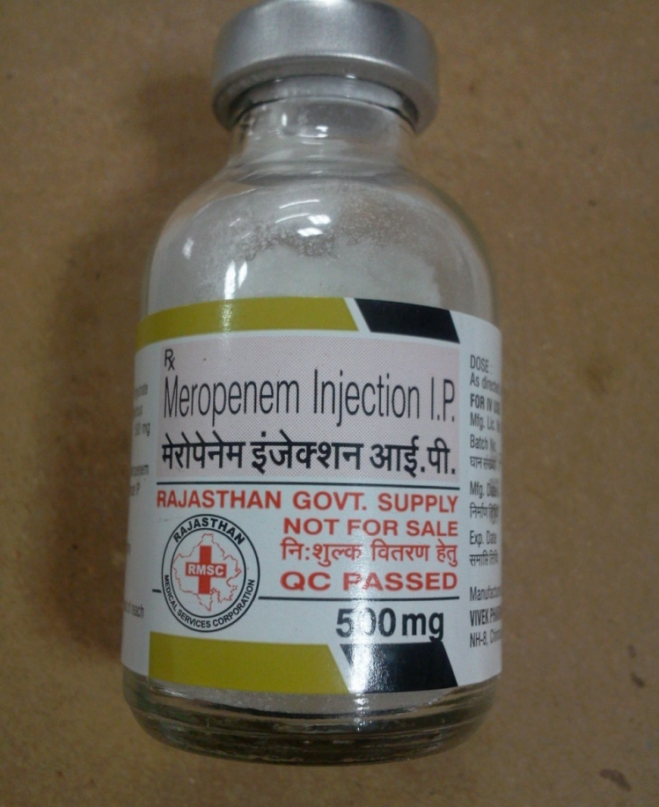
30 types of ANTIBIOTICS
Tab. Azithromycin 500 mg (10 Tabs)
Price Rs.58.80
Inj. Meropenam 500 mg (1 vial)
Price Rs.113.74

Slide 30
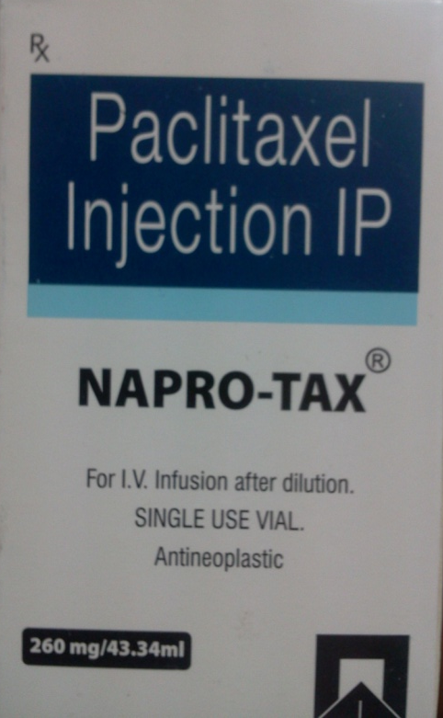
25 ANTICANCER DRUGS
Name of Drug | Price (in Rs.)
Cap. Cyclosporin 25 mg (1 pack) | 602.18
Inj. L-Asparginase (1 vial) | 712.98
Inj. Paclitaxel 260 mg (1 vial)
Price Rs. 714.40

Slide 31
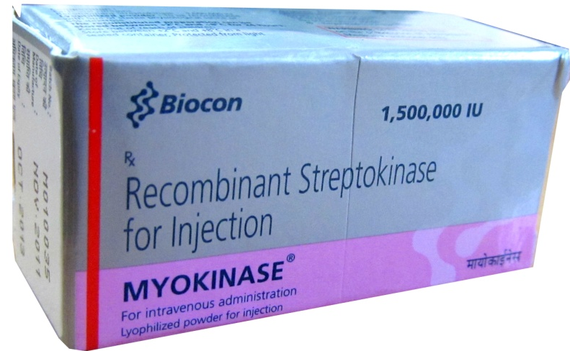
35 DRUGS FOR HEART DISEASE
Name of Drug | Price (in Rs.)
Inj. Streptokinase 15 Lac units (1 vial) | 470
Inj. RH-Erythropoetin 10000 IU (1 vial) | 447.76
Inj. Human Albumin 20% (1 bottle) | 2000

Slide 32
DIABETES
Inj. Biphasic Insulin 30/70
(10 ml vial)
Price Rs. 46.5
Inj. Insulin regular
(10 ml vial)
Price 46.93

Slide 33
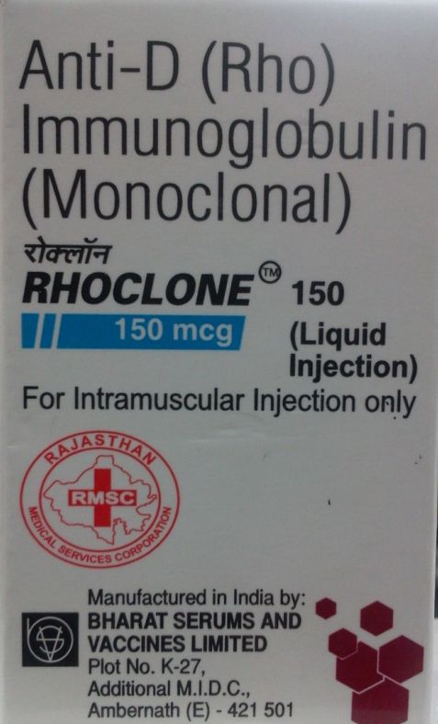
For PREGNANT WOMEN
Dinoprostone Gel 0.5 mg
(in syringe)
Price Rs.173.25
Inj. Human Anti D Immunoglobulin
150 mg
Price Rs.1207.50

Slide 34
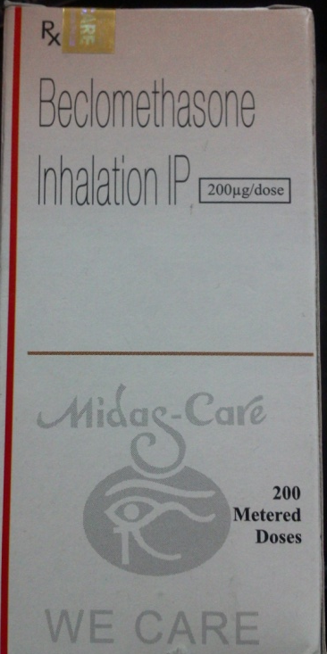
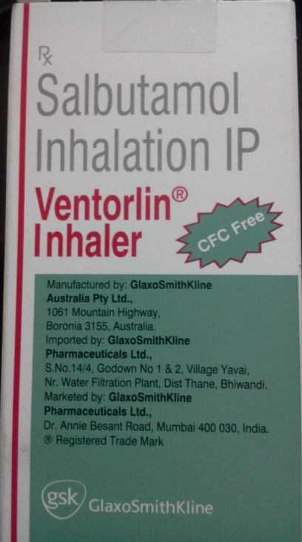
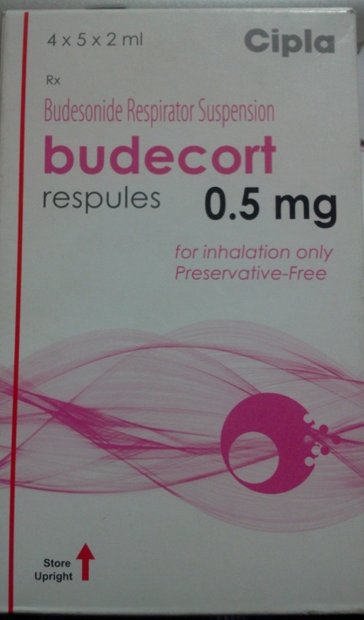
12 drugs for RESPIRATORY DISEASE & ASTHAMA
Beclomethasone Inhaler (200 doses)
Price Rs. 129.95
Salbutamol Inhaler (200 doses)
Price Rs. 52.34
Budesonide Nebulizer
Suspension (2 ml amp)
Price Rs. 11

Slide 35
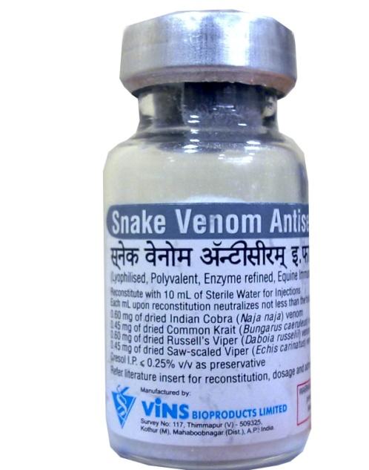
ANTI RABIES & ANTI SNAKE VENOM Injections
Name of Drug | Price (in Rs.)
Rabies Vaccine Human 2.5 IU (1 ml vial) | 185.64
Rabies Antiserum IP (Equine) (5 ml vial) | 303.45
Human Anti rabies Immunoglobulin Inj. 150 IU (2 ml vial) | 4640
Anti Snake Venom (10 ml vial) | 207.90

Slide 36
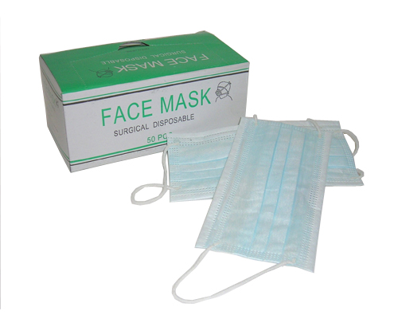
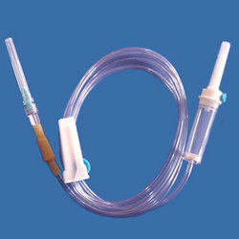
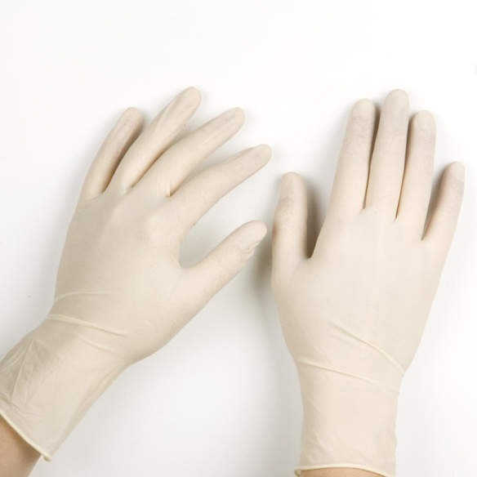
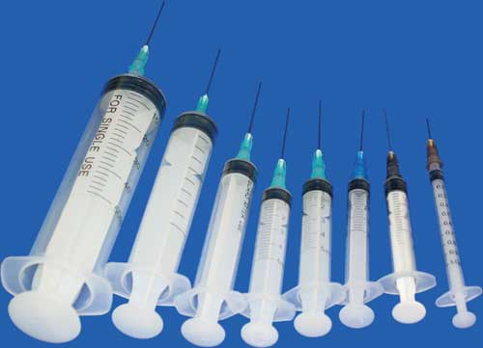
SURGICALS & SUTURE ITEMS
Disposable Syringe
IV Set
Surgical Cap
Gloves
Disposable Syringe

Slide 37
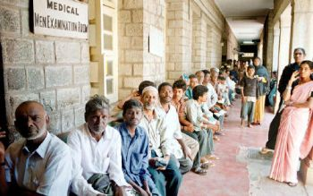
IMPACT
1. INCREASE IN NUMBER OF PATIENTS IN GOVT. INSTITUTES
From 2nd Oct 2011 to 31st March 2012
Before | After MNDY
44 Lac patients per month | 62 Lac patients per month

Slide 38
IMPACT
2. DECREASE IN OUT OF POCKET EXPENDITURE
Everyday we are giving drugs to more than 2 Lac patients
The average cost per patient is around Rs.12 - 30
Otherwise the cost of drugs purchased from the market use to cost around Rs.300 - 500.

Slide 39
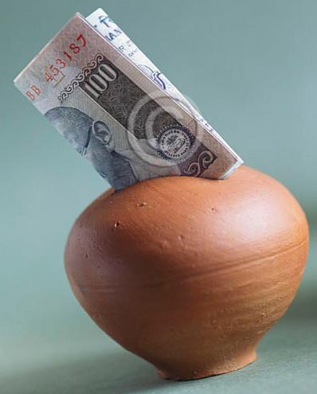
IMPACT
3. OUT OF POCKET EXPENDITURE SAVINGS
RMSC cost Rs. 507 crore
Market cost Rs. Over 3000 crore
Savings to the Govt. Approx Rs. 2500 crore
Due to procurement by generic name

Slide 40
IMPACT
4. Comparison of costs of treatment using generic v/s branded drugs. (in Rs) Contd…
Disease | Branded drugs | Generic Drugs
OPD treatment of 30 days
Depression /Mixed anxiety disorder | 799.00 | 45.59
Schizophrenia | 1093.80 | 100.77
Mania | 1962.30 | 227.49
Hypertension | 435.60 | 29.28
Diabetes mellitus | 481.20 | 17.19
OPD treatment of 3 days
Diarrhoea and vomiting | 190.81 | 17.73
ARI | 118.19 | 12.39

Slide 41
IMPACT
4. Comparison of costs of treatment using generic v/s branded drugs (in Rs)
Disease | Branded drugs | Generic Drugs
Indoor medical/non surgical cases
Myocardial Infarction | 9381.78 | 2195.73
Enteric fever | 2953.40 | 426.50
Pneumonia | 2102.77 | 381.09
Stroke/ CVA | 3636.29 | 635.32
Diabetic ketoacidosis | 3192.41 | 502.83

Slide 42
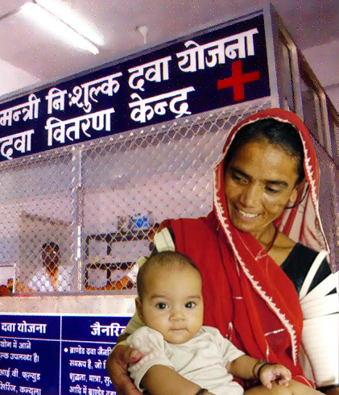
IMPACT
5. SMILING PATIENTS & THOUSANDS OF LIVES SAVED

Slide 43
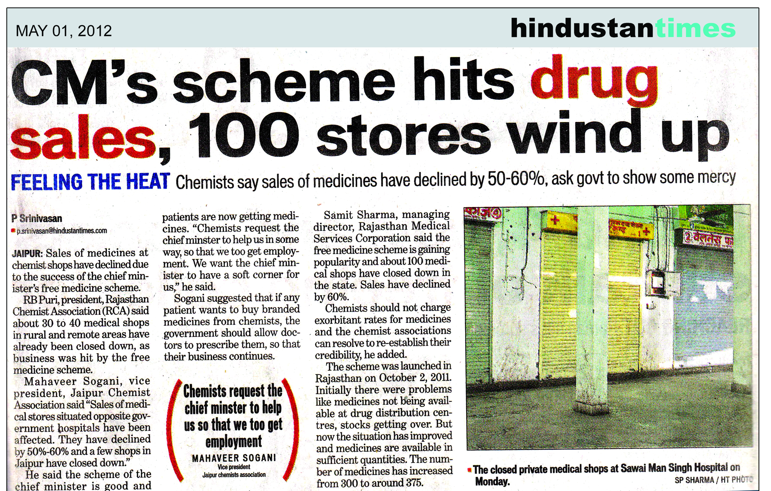
SIDE EFFECT

Slide 44
SIDE EFFECT

Slide 45
MUKHYAMANTRI NISHULK JANCH YOJNA
Scheme for Free Basic Diagnostic Services
at Public Health Institutions

Slide 46
ESSENTIAL COMPONENTS OF HEALTH SERVICES
Component of health service | Provision
Hospital infrastructure | provided free
Consultation by a doctor & nursing care | provided free
Surgical and sutures items | provided free
Diagnostic Services | Paid
Services available at the token money for registration at OPD for
Rs.2/- or Rs.5/- and in IPD for Rs. 10/-.
Patients pay only for tests whereas other components are provided
free of cost.

Slide 47
GROUPING OF DIAGNOSTIC TESTS.
BASIC TESTS (FREE) Required for diagnosis of common illnesses by >90% of patients at Primary & Secondary care hospitals. | SPECIALISED TESTS (PAID) Required for <10% of patients at Tertiary care hospitals
Pathology – Blood for HB, TLC, DLC, TEC, T-RBC, ESR, PBF, Malaria AG, Platelet Count, BT, CT, PCV, CBC, etc . | CT Scan
Bio-Chemistry –B Sugar, Creatinine, Urea, Uric Acid, S-phosphorus, Calcium, Total Protein, Bilirubine, SGOT, SGPT, S alk-phosphatase, LDHCPK,CPKMB, GGT, Amylase, Lipase, Total lipid Profile, S. Electrolyte. | MRI
Microbiology – Widal test, VDRL, ASLO Titre, CRP, RF, Pregnancy Test, HBS – AG, etc. | ECHO Cardiography
Urine Complete, stool examination, CSF, Pleural fluid etc. | EEG
X-Ray
ECG

Slide 48
PACKAGE OF FREE TESTS AT VARIOUS LEVEL OF HEALTH CARE.
S.No. | Level of care | Medical Institutions | No. of free test proposed | Start Date
1 | Primary | PHC(1507) Dispensaries (198) | 15 | 15-Aug-13
2 | Secondary | CHC (431) | 28 | 01-July-13
 |  | DH/SDH/SH (52) | 44 | 07-April-13
3 | Tertiary | MCH (28) | 57 | 07-April-13

Slide 49
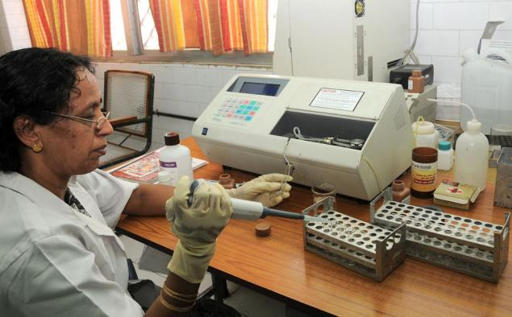
BASIC COMPONENTS FOR STRENGTHENING AND MODERNIZATION OF LABORATORIES
Infrastructure
Manpower
Equipment & instruments
Supply of essential reagents and consumables.

Slide 50
1. CIVIL WORK
S.No. | Civil work
1 | Repairs & renovation of existing laboratories.
2 | Need based additional civil work/space at DH/MCH
3 | Construction of shelves & cabinets to store reagents
4 | Platform, Basin ,sink and other sanitary fittings
5 | Counters for sample collection and report dispatch
6 | Equipment installation work
7 | Office furniture – chair, table, rack, almirah etc.
8 | Electric fitting and appliances - Refrigerator, Incubator, ups etc.

Slide 51
2. MANPOWER
S.No. | Manpower
1 | Utilization of existing staff after sensitization & training (MOs and LTs).
2 | New recruitment (need based) & training.
3 | Contractual recruitment through RMRS.
4 | Computer operators as per FD circular through RMRS one at CHC lab and three at SH/SDH/DH for data collection recording and reporting.
5 | Technical staff GNM for SC, LT for others and trained nurses for radiology and ECG Supervisory & Monitoring staff SS/JS/MOPG or Six months trained pathologist, microbiologist/ radiologist/biochemist etc.
6 | Training of other cadres like ANMs, MOs and LTs

Slide 52
3. EQUIPMENTS & INSTRUMENTS. – Contd..
S.No. | Equipment & instruments.
1 | Utilization of existing equipments after one time repair
2 | EPM cell will execute annual R/C for equipments and Other regularly required materials
3 | Gap analysis and procurement of new equipments
4 | Equipment maintenance and repair centers
5 | Repair and maintenance management through EMRC Of RMSC

Slide 53
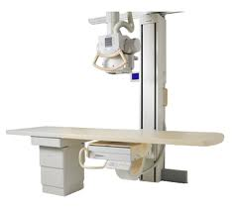
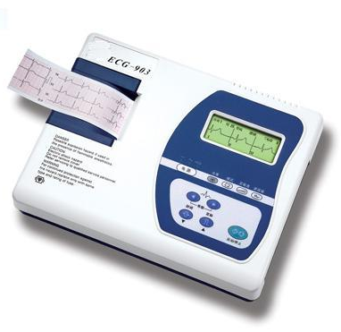
3. EQUIPMENTS & INSTRUMENTS. - Contd..
226 X-Ray Machines
352 ECG Machines

Slide 54
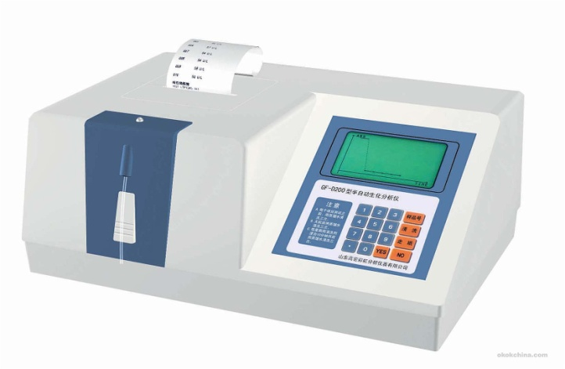
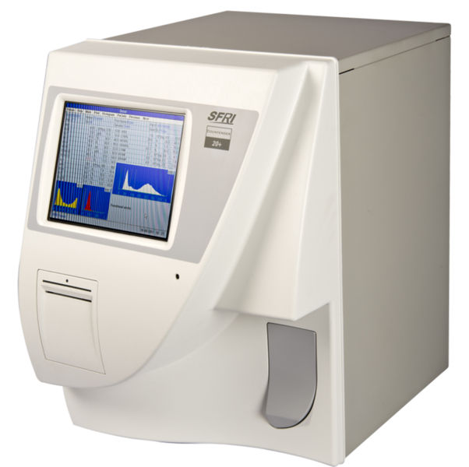
3. EQUIPMENTS & INSTRUMENTS.- Contd..
223 Semi Auto Analyzer
454 Three part hematology
Analyzer (CBC)

Slide 55
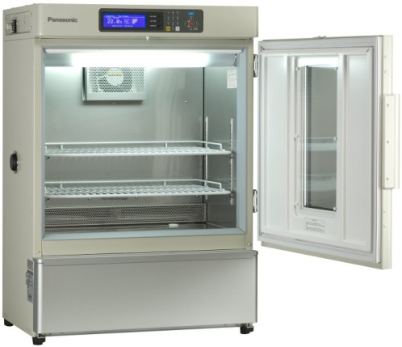
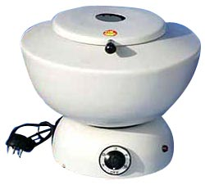
3. EQUIPMENTS & INSTRUMENTS. - Contd..
Incubator
Centrifuge machine

Slide 56
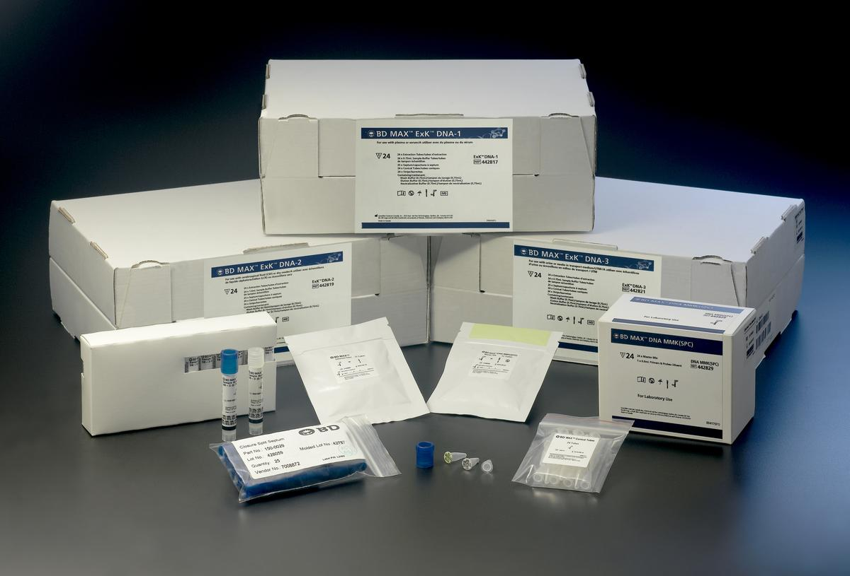
4. REAGENTS & CONSUMABLES

Slide 57
OTHER ACTIVITIES
TRAINING & CAPACITY BUILDING
PRINTING OF STATIONARY
LABORATORY SAFETY PROGRAM
LABORATORY BIO-WASTE MANAGEMENT
QUALITY ASSURANCE

Slide 58
E-AUSHADHI - BIO MEDICAL EQUIPMENT MANAGEMENT SOFTWARE
WEB BASED APPLICATION
Equipment inventory module.
Equipment maintenance module.
No. of investigations reporting module.

Slide 59
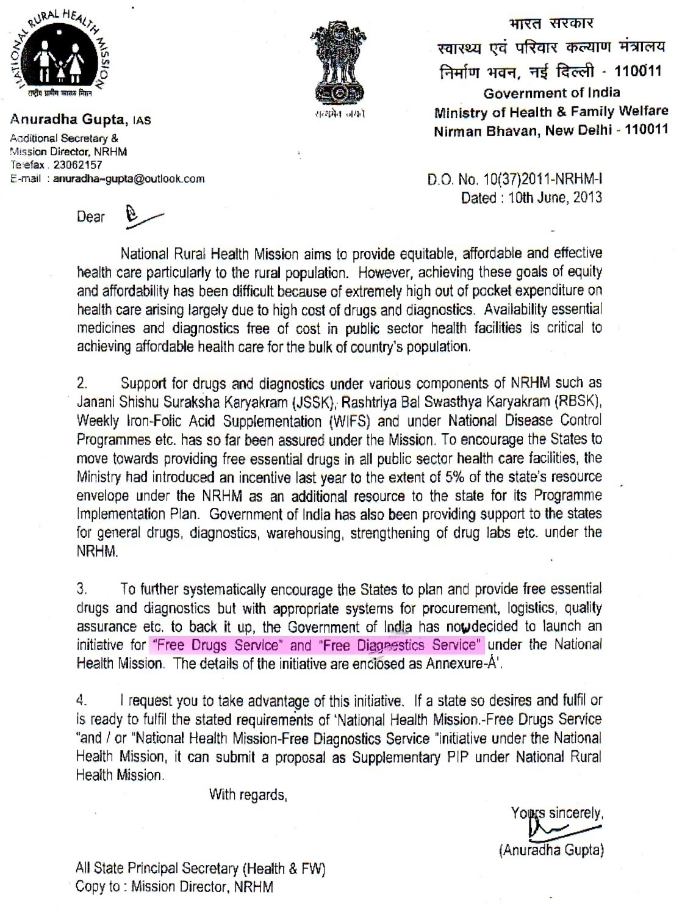
RECENT DEVELOPMENTS AT GOVERNMENT OF INDIA LEVEL
Scheme for support of “Free Medicines & Free investigations
for All” in Public Health
Facilities

Slide 60
THANK YOU ajayaswal2002@yahoo.com 0141-2228059, 09413332400
RMSC motto
All essential medicines and
Basic diagnostic tests.
At all public health institutions
At all times
so that
No human being dies for want of treatment

