Slide 1
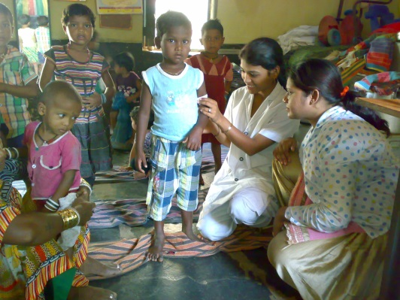
Rashtriya Bal Swasthya Karyakram
Maharashtra
Vikas Kharage (IAS)
Commissioner & MD(NRHM)
Maharashtra

Slide 2
School Health
School Health Check up Program started in Maharashtra in 2008 in coordination with Sarva Shiksha Abhiyan (SSA).
Per year 120 lakh students from 84000 schools are covered
Health education and counseling to children along with check-up.
SHSRC conducted evaluation of school health program in 33 schools which showed reduction in Morbidities and in turn improvement in School attendance.

Slide 3
6617 Heart surgeries performed from 2008 to 2013
School Health Performance
27,582 Other surgeries conducted from 2008 to 2013
Students with minor ailments are treated in school(20%) and with Surgical and other problems are referred to higher centers(10%)

Slide 4
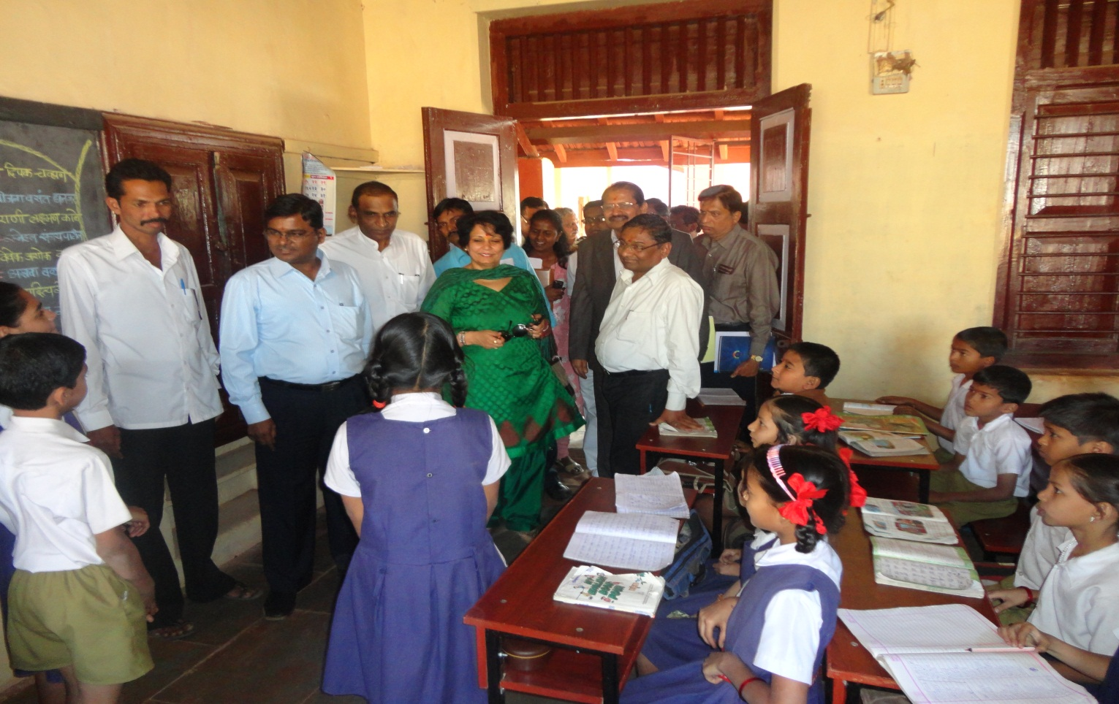
Visit of Hon. Smt. Anuradha Gupta, Mission Director, Health Ministry & FW, GOI to Zilla Parishad School, Thane dist.

Slide 5
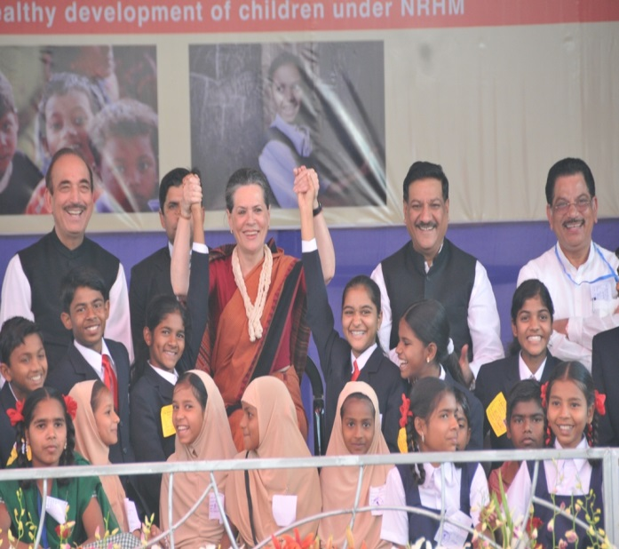
Towards Comprehensive Child Health Care National Launch of RBSK
Declining Trend in IMR and Better survival outcomes of newborns in SNCUs
Need of an Hour is to render QUALITY CARE.
Thus , School Health expanded to include 0-6 yrs.
With success of School Health Program and guidance from GoI, Maharashtra made a move to RBSK…
Thus, Nationally launched in Thane district of Maharashtra on 6th Feb 2013.

Slide 6
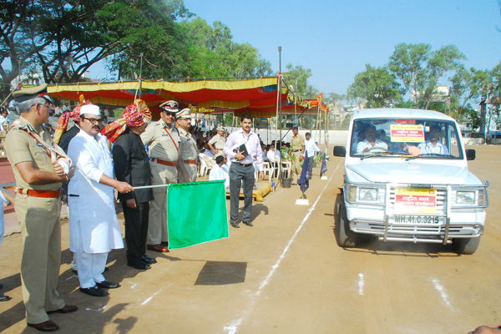
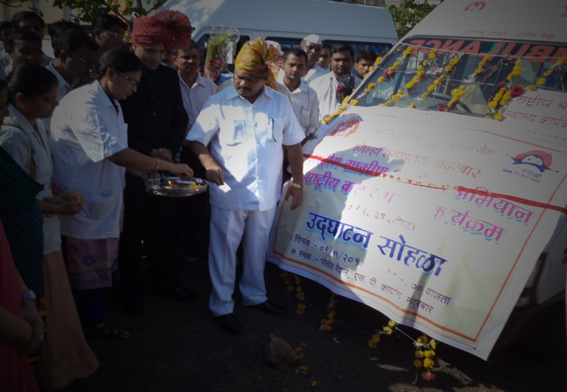
District Launch of RBSK...
Formal launching done by Hon Guardian Minister in ALL Districts on 1st May 2013.
1130 teams appointed consisting of 2 Mos ( One Male & One Female),1 Pharmacist and 1 ANM.
All schools will be screened ONCE, Anganwadi Centers TWICE and Ashram Schools QUARTERLY in a year.
Approximately 200 lakhs children will be screened in 2013-14.

Slide 7
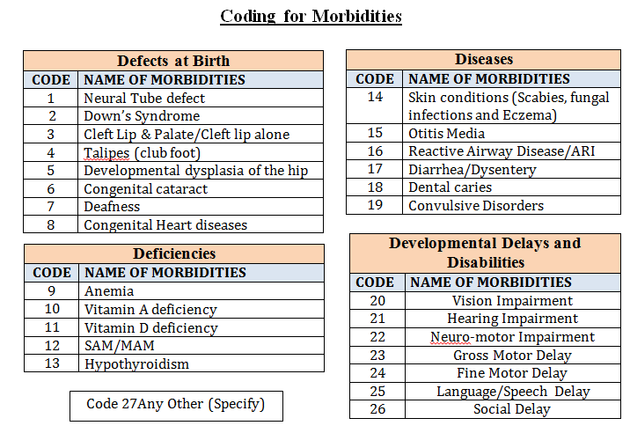
Screening of 4 D’s
Screening of children with respect to 4 “D” namely Birth Defects, Diseases, Deficiencies, Developmental delays and Disabilities.

Slide 8
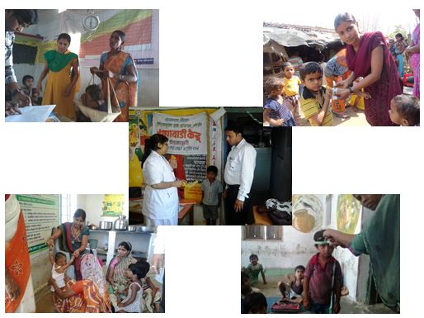
Screening under RBSK

Slide 9
Recruitment Process
Recruitment was done as follows –
Advertisement issued from State level on 17 February 2013.
Guidelines about the recruitment procedure were issued to the districts and also advertised in newspaper.
Information about recruitment also given to districts through V.C on 21 February 2013.
Walk-in-Interviews conducted at district during 25th February to 28th February 2013 for all post simultaneously in all districts.
Selected candidates were provided specialized training in the month of March and the teams started working on 1st April 2013.

Slide 10
Recruitment Process
The transparency in the process of recruitment was ensured by -
The complete process of recruitment was monitored from state level.
Guidelines for recruitment were published in public domain.
At the time of interview 90% of the marks were objective and only 10% for the interview.
The results were declared on the same day in all the districts.
Results also declared on NRHM website along with marks obtained.

Slide 11
Training
Training manual was prepared under the guidance of National experts like Dr. Arun Singh.
Simultaneously, the medicines for 0-6 yrs and 6-18 yrs along with equipment's were finalized by experts
5 TOT batches were conducted at the state wherein 2 Pediatricians, 1 Dist. Training Head,1 Resident Medical officer were trained.
Training at districts for 3 days by the Master trainers.

Slide 12
Micro-planning For Screening
Women and Child Department, Rural Development Department, Education (Primary and Secondary) Department, Tribal Department are involved in planning.
Village wise action plan was prepared for screening
Each Block is equally divided amongst the teams
On an average one team caters to 25000 child population with 125 children per day are screened by each team.
Approx. 200 days available for screening after considering school holidays, exams and referrals etc.

Slide 13
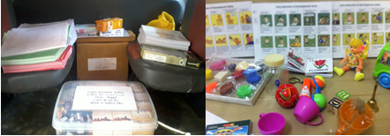
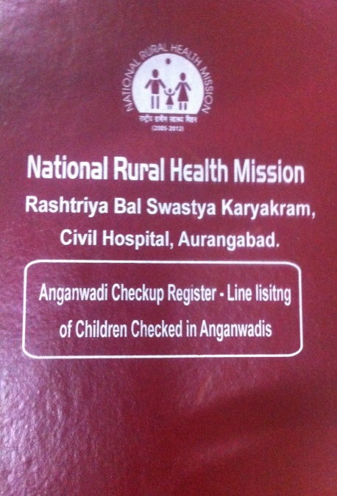
Program Implementation…
Allocation of team is done from district level.
Headquarter of team is Rural Hospital.
Mobility support given to the team by way of hired vehicle.
Team is provided with Registers, Medicines and Equipment including Developmental Kit.
Health card for each child is provided to the teams.

Slide 14
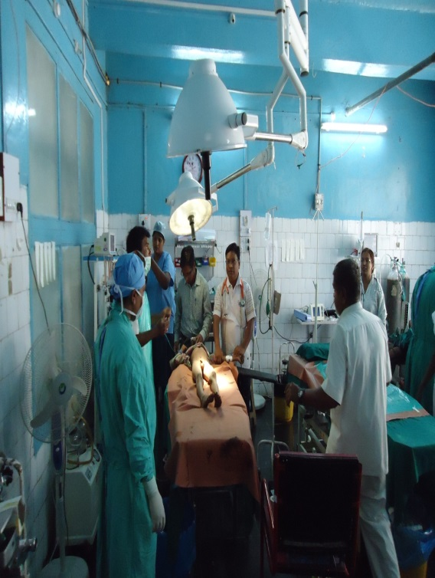
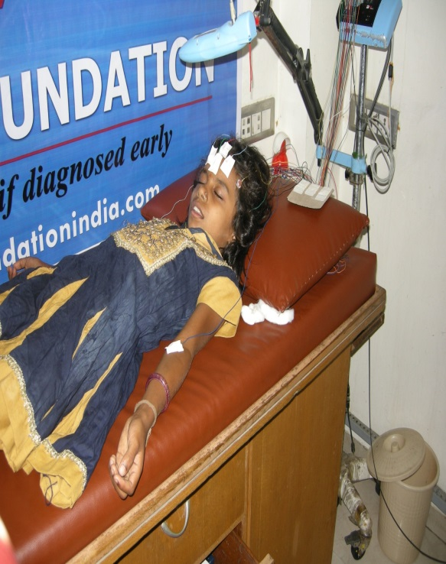
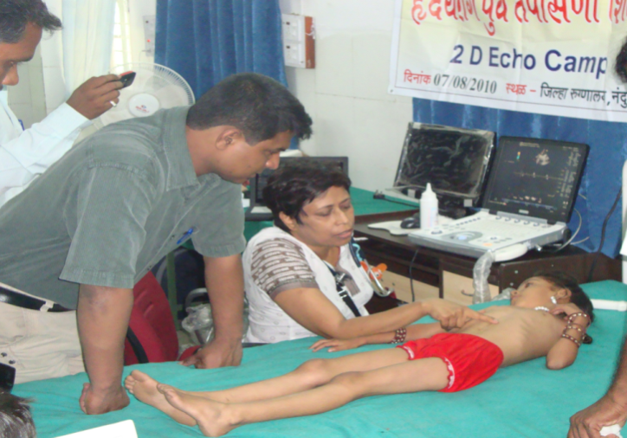
Referrals…
Referrals camps are arranged at RH/SDH (CHC) the first fortnight of the month.
Children requiring specialized investigations and treatment are referred to District Hospital or Medical Collage.

Slide 15
Referrals…
Liasioning with -
Rajiv Gandhi Jeevendayee Yojna for Tertiary care and Sarva Shiksha Abhiyan
NGOs like Cure Club Foot, Smile train providing free services
Institutes like Ali Vavar Jung for deafness and Sane Guruji for Blindness
Skill up-gradation of Regular staff like Occupational therapist, ophthalmologist for screening ROP is being planned in Institutes like KEM Pune, All India Institute of Physical Medicine and Rehabilitation (AIIPMR)

Slide 16
District Early Intervention Cell (DEIC)
First Consultation with GOI Officials for DEIC done at KEM Hospital Pune - State of Art Early intervention center.
DEIC planned to establish in 8 Regional centers initially.
Instructions given to all districts to have early interventions with available resources under other National programs like Deafness control ,RGJAY.
Newborn screening for SNCU Admissions for Oto Acoustic Emission (OAE) under deafness control Programme made mandatory.

Slide 17
RBSK Performance in Anganwadis April-May 2013
Details | Target | Absolute Number | %
Total Anganwadis covered | 59,302 | 53,785 | 91%
Total Children screened | 41,48,544 | 25,72,839 | 62%
Total Children treated (w.r.t. screened) | ---- | 2,49,579 | 10%
Total Children referred (w.r.t. screened) | ---- | 99016 | 3.84%

Slide 18
Morbidity Profile of Children covered in RBSK (April-May 2013)

Slide 19
Way Forward…
Better Inter-sectoral and inter department Coordination for planning and implementation of screening and referral
Early detection and management of conditions comprehensively in all age groups to give quality care
Mobilization of 0-6 yrs children in particular 0-3 yrs age group.
Incentives to ASHA
Referrals generated for Defects like Congenital Heart Diseases, requires long waiting period.
Increasing tertiary level institutes through PPP model
Analysis of Huge Data
Under RBSK for which Software is planned.

Slide 20
To conclude…
RBSK has led to…
National Launch in Maharashtra by high dignitaries-political commitment gives positive direction
Health education to children, ASHA, teachers and AWW leading to mass awareness in community
Early diagnosis and treatment leading to improved quality of life

Slide 21
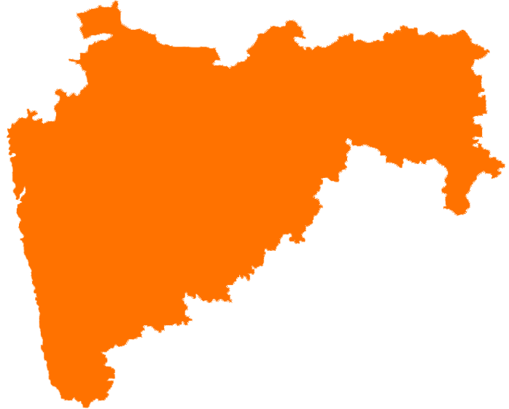
Thank you

