Slide 1




National summit on best practices & innovations in public healthcare systems
3-6 July 2013
SKICC Srinagar
TEMPERATURE DATA LOGGERS:
Piloting in DISTRICT Kurukshtra (Haryana)
AFFORDABLE HEALTH TECHNOLOGIES (PHFI) & IMMUNIZATION TECHNICAL SUPPORT UNIT (ITSU)- MOHFW, GOI
Dr Suresh Dalpath
DDCH/SEPIO
Government of Haryana

Slide 2
Background
Universal Immunization Programme (UIP) was launched in 1985 and has completed 2.5 decades of successful implementation
Each Year, >12 crore children and 4 crore pregnant mothers in India are targeted for vaccination with various antigens including 20 lakh children in Haryana
As per CES-2009, 71.6 % children in Haryana & 61% children Nationally are fully immunized
India has introduced Pentavalent vaccine in 8 states including Haryana and many other potential vaccines are currently available.

Slide 3
Background…2
Under national immunization programme BCG, DPT, Hepatitis B, Polio, Measles and TT vaccines are universally provided
In addition, JE and Pentavalent vaccines are provided in limited geographical areas
All vaccines under Immunization Programme are temperature sensitive ( both high and low) and need to be stored at +2 to + 8 deg C or -20 deg C depending upon type of vaccine and storage level

Slide 4
Background…3
Cold chain needs to be maintained from Manufacture up to Session site
Variety of active (ILR, DF, WIC, WIF) and passive cold chain equipment (Cold boxes, Vaccine Carriers) have been provided in the system to store and maintain vaccines at recommended temperature
  All vaccines vials are provided with VVM ( Vaccine vial monitor) for monitoring heat exposure to vaccines.
Violation of temperature range leads to
  loss of potency of vaccine
  Probability of an Adverse Effect
Cardinal principal of immunization: “Don’t Harm”

Slide 5
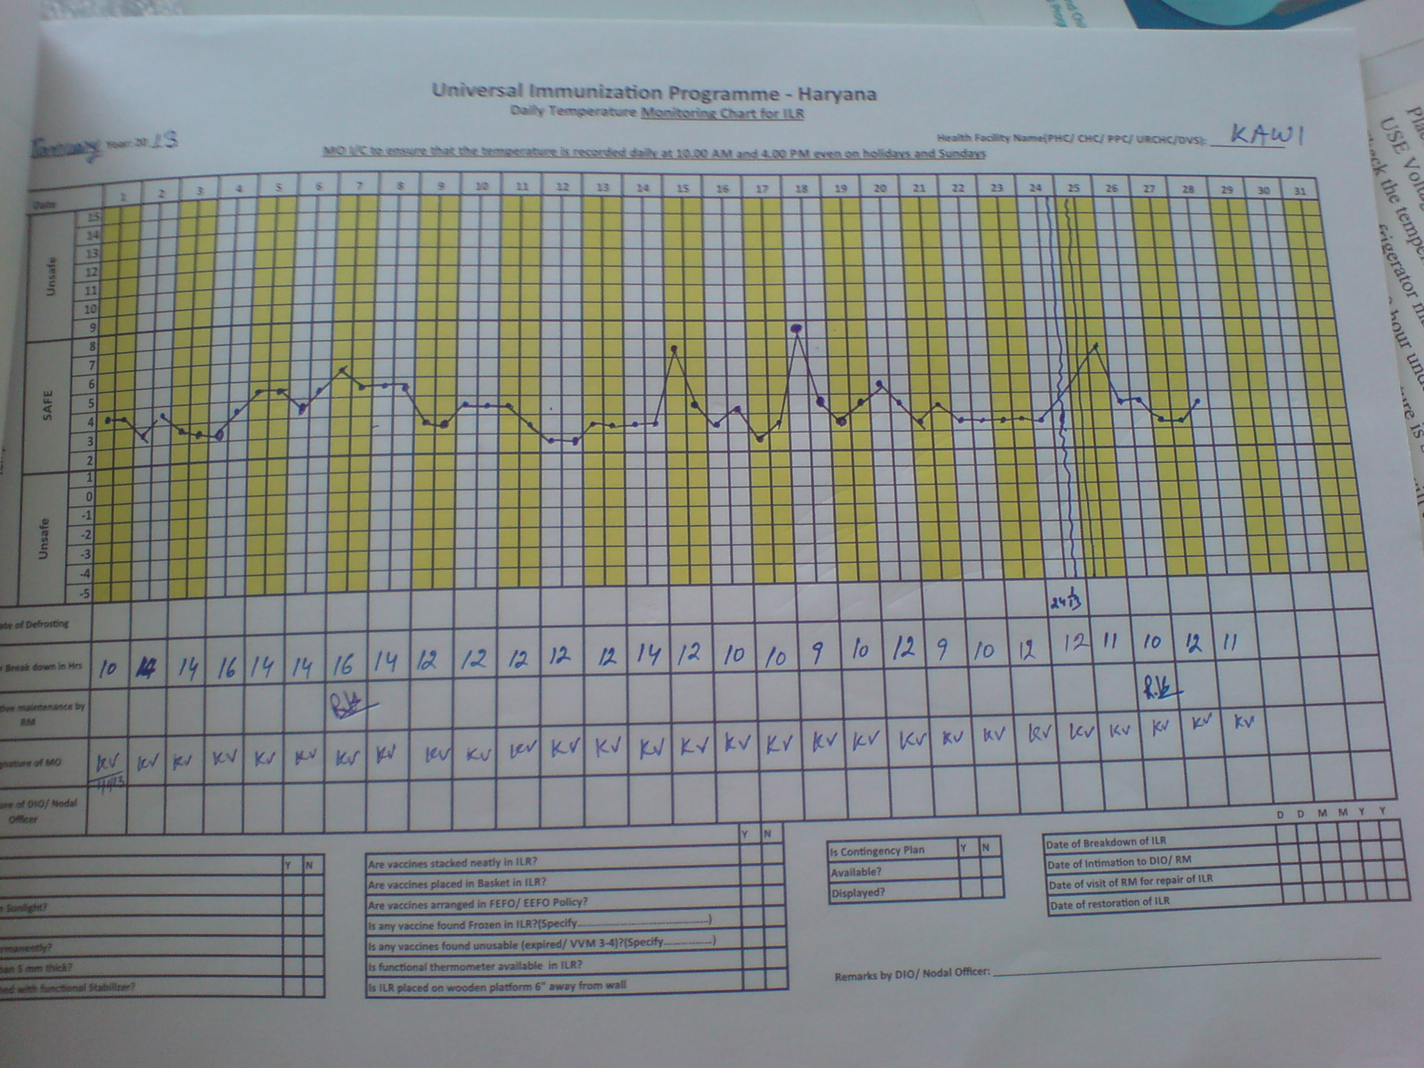
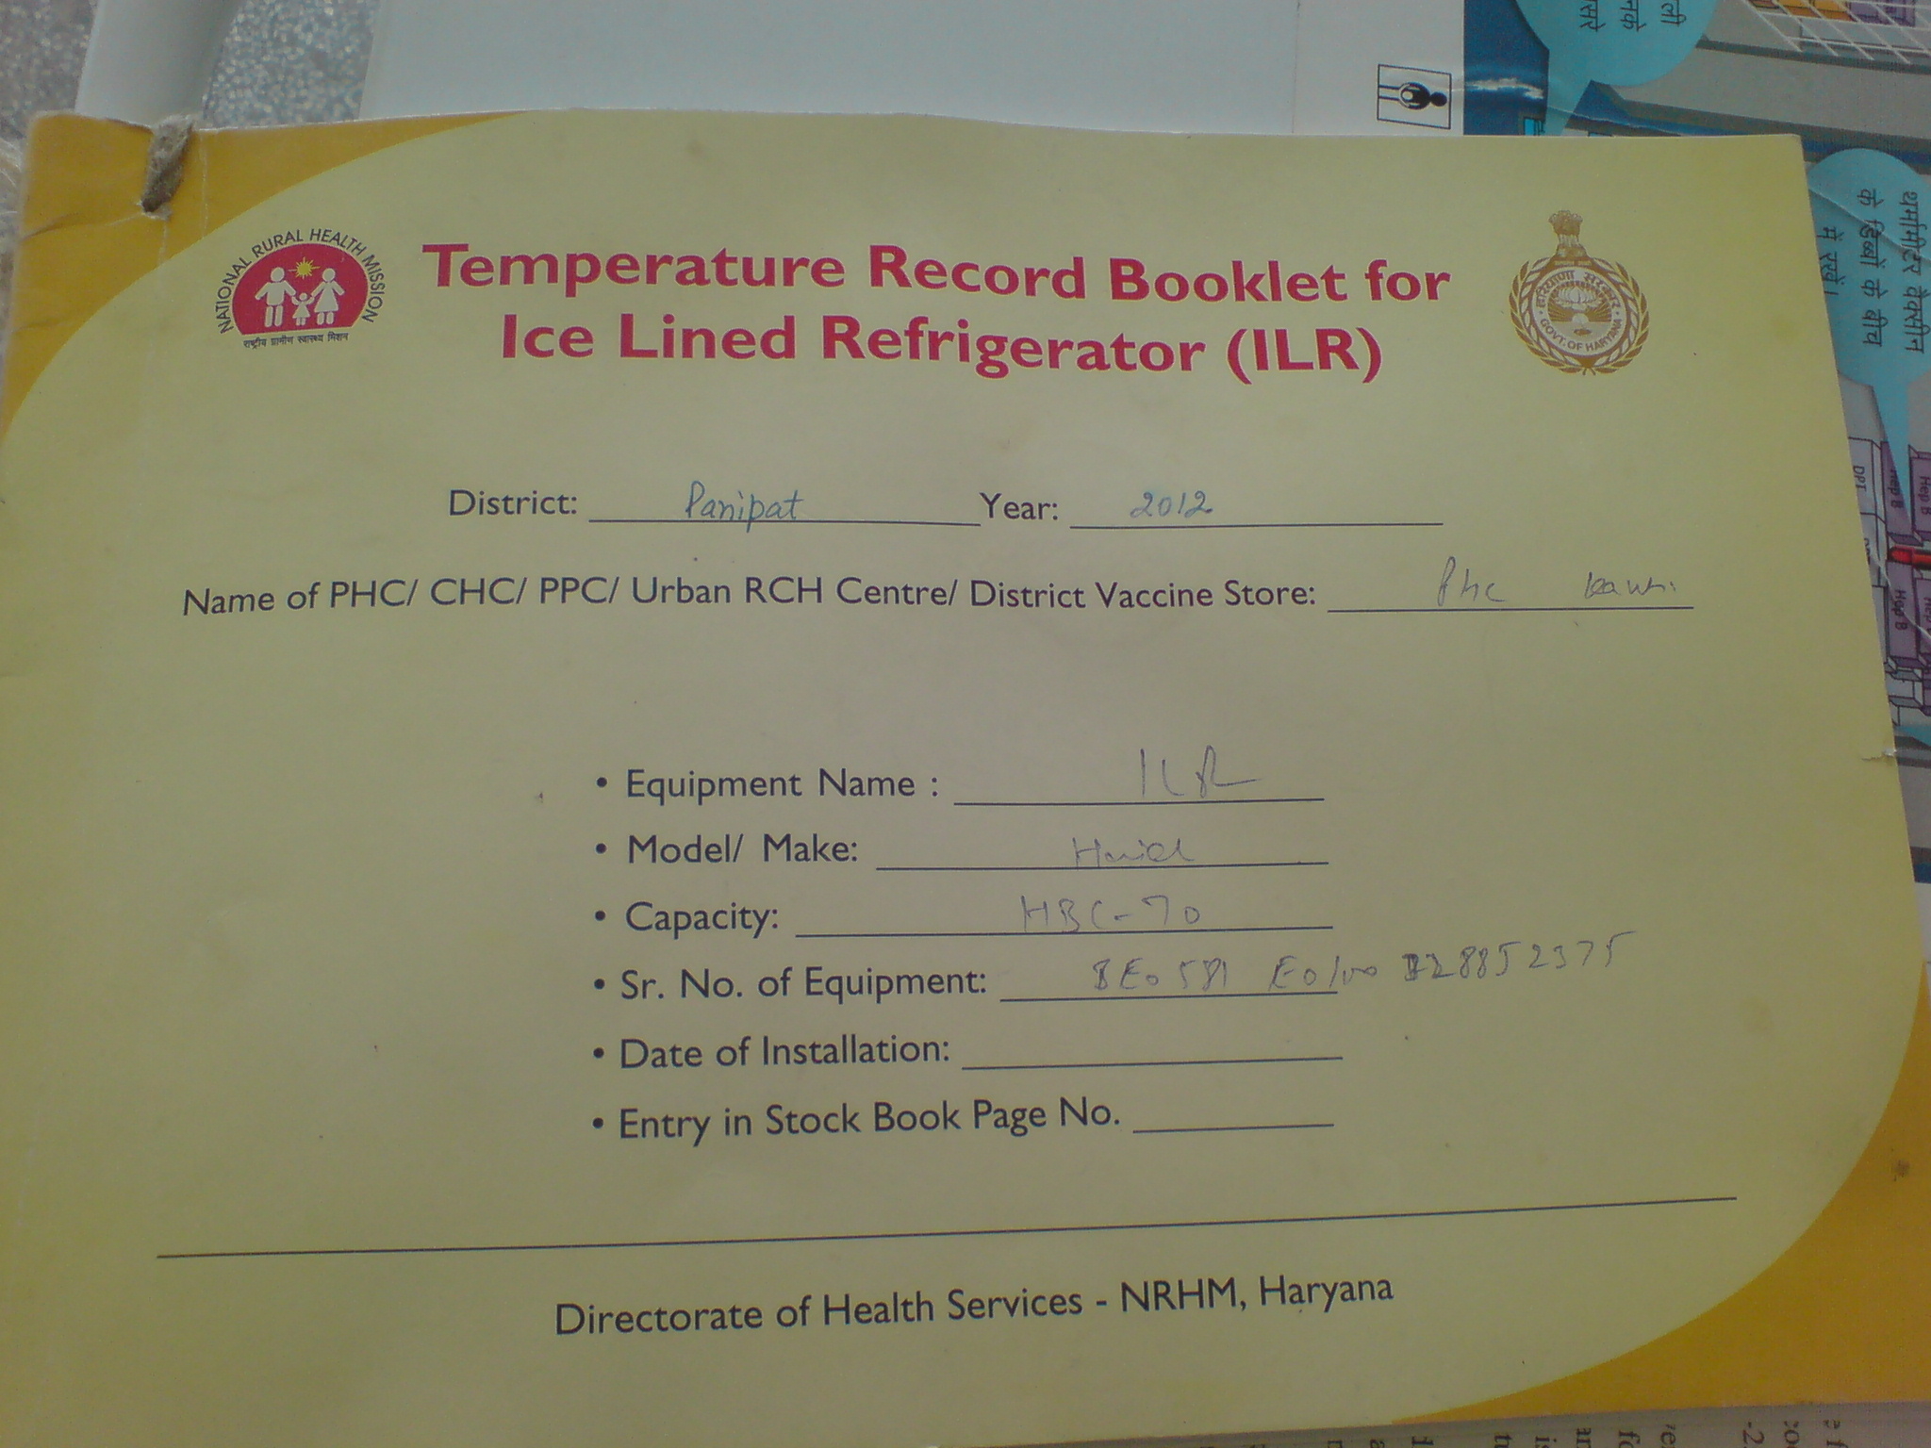
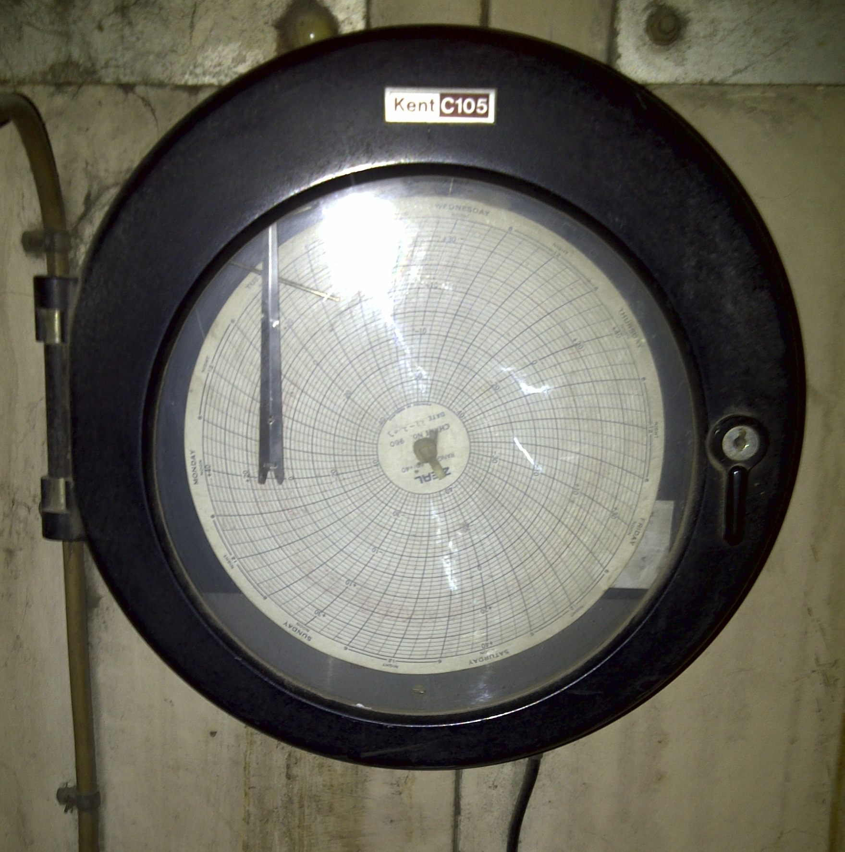
Temperature Recording: Current Practices
As per guidelines, temperature of each cold chain equipment should be recorded minimum twice a day including Sundays & holidays
Cold chain handlers need to record temp., monitoring by MO, DIO, CMO
Manual Recording
In temperature Log books using thermometers
Automated/Semi-Automated
WIC/WIF are provided with 7 or 30 day temperature graph recorder and hooter
Few WIC/WIF also equipped with wireless data loggers

Slide 6
Limitation of Current Temperature Monitoring
Manual Recording: Compliance issues
Failure to record temperature twice daily
Non-recording of temperature on Holidays
Details of power failure rarely documented
Differential interpretation of thermometer readings by cold chain handlers
Not a real time data and historic records cannot be verified
Inadequate sensitization of health staff
Automated/Semi-Automated
Larger setup required/high investment cost
Dependent of electricity supply and/or internet availability
Non-availability of usable parts ( ink of graph recorder)
ALL temperature monitoring is currently localized with No dynamic system to monitor cold chain performance

Slide 7
Cold Chain Maintenance:
Studies and Field Visits Observations

Slide 8
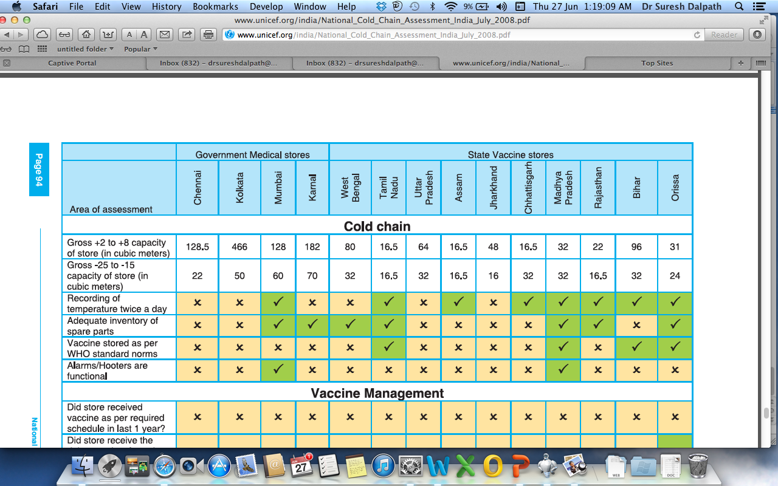
Unicef: Cold chain evaluation report 2008
≈

Slide 9
Observations of RAPID Visit
≈
≈
≈
≈
≈

Slide 10
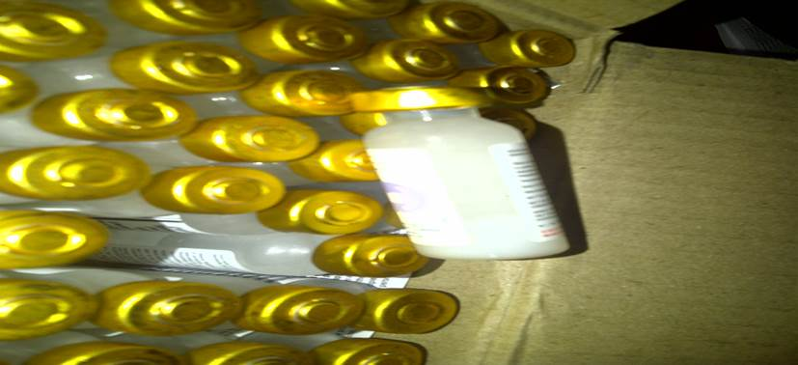
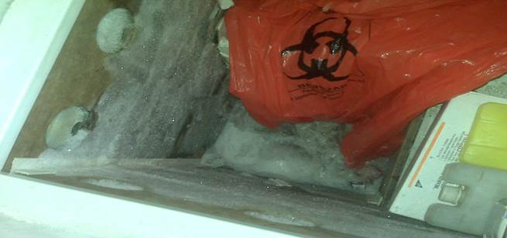
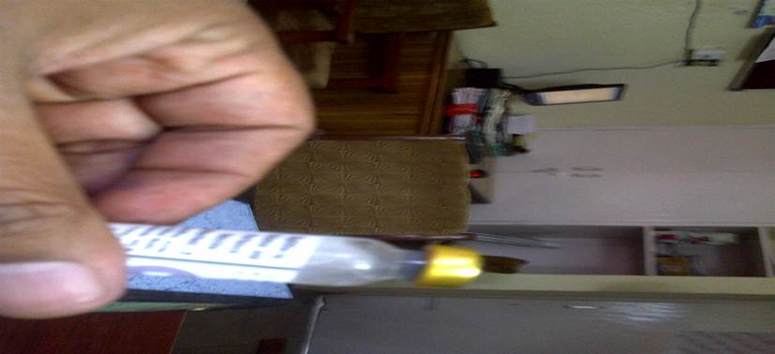
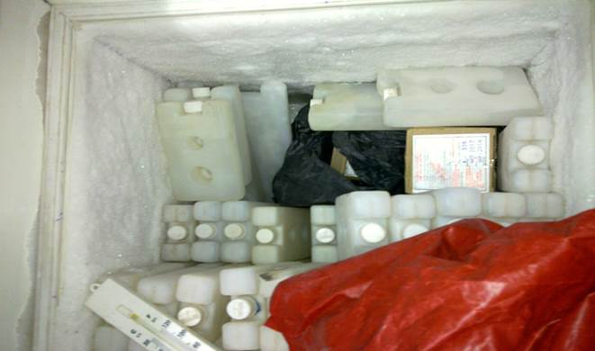
Some observations during field visits

Slide 11
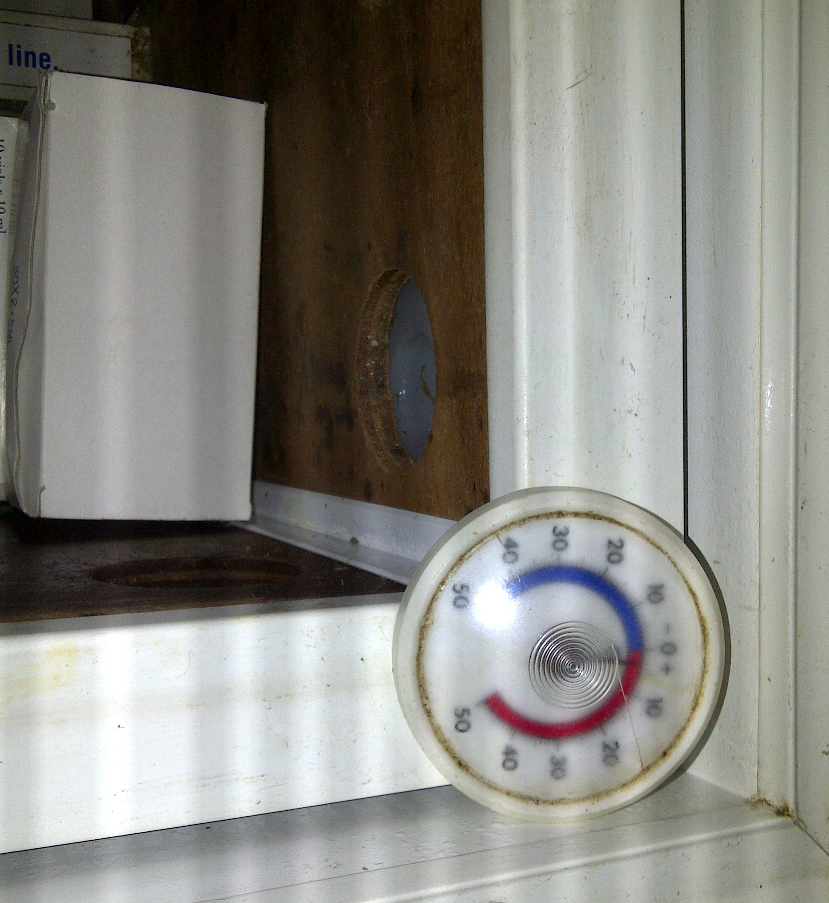
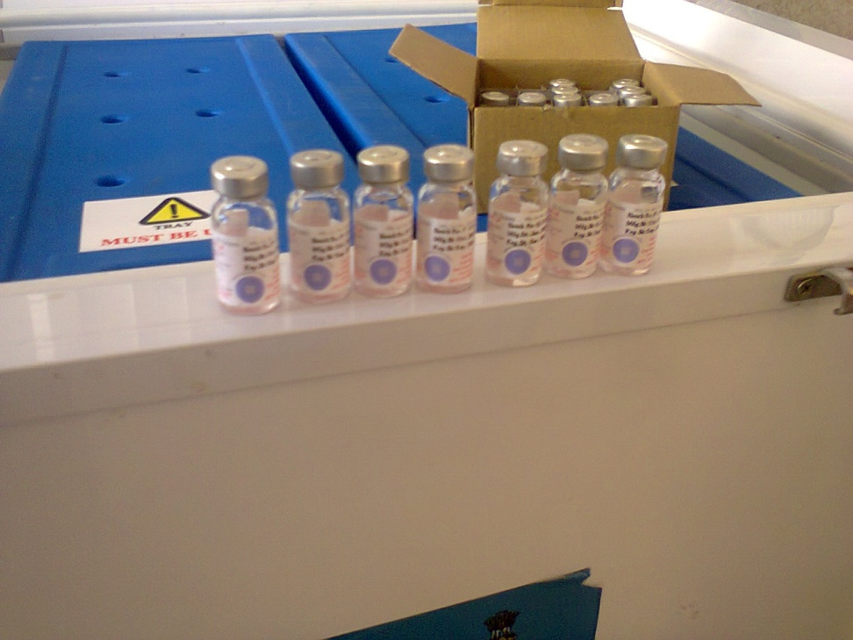
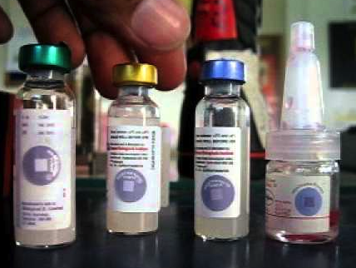
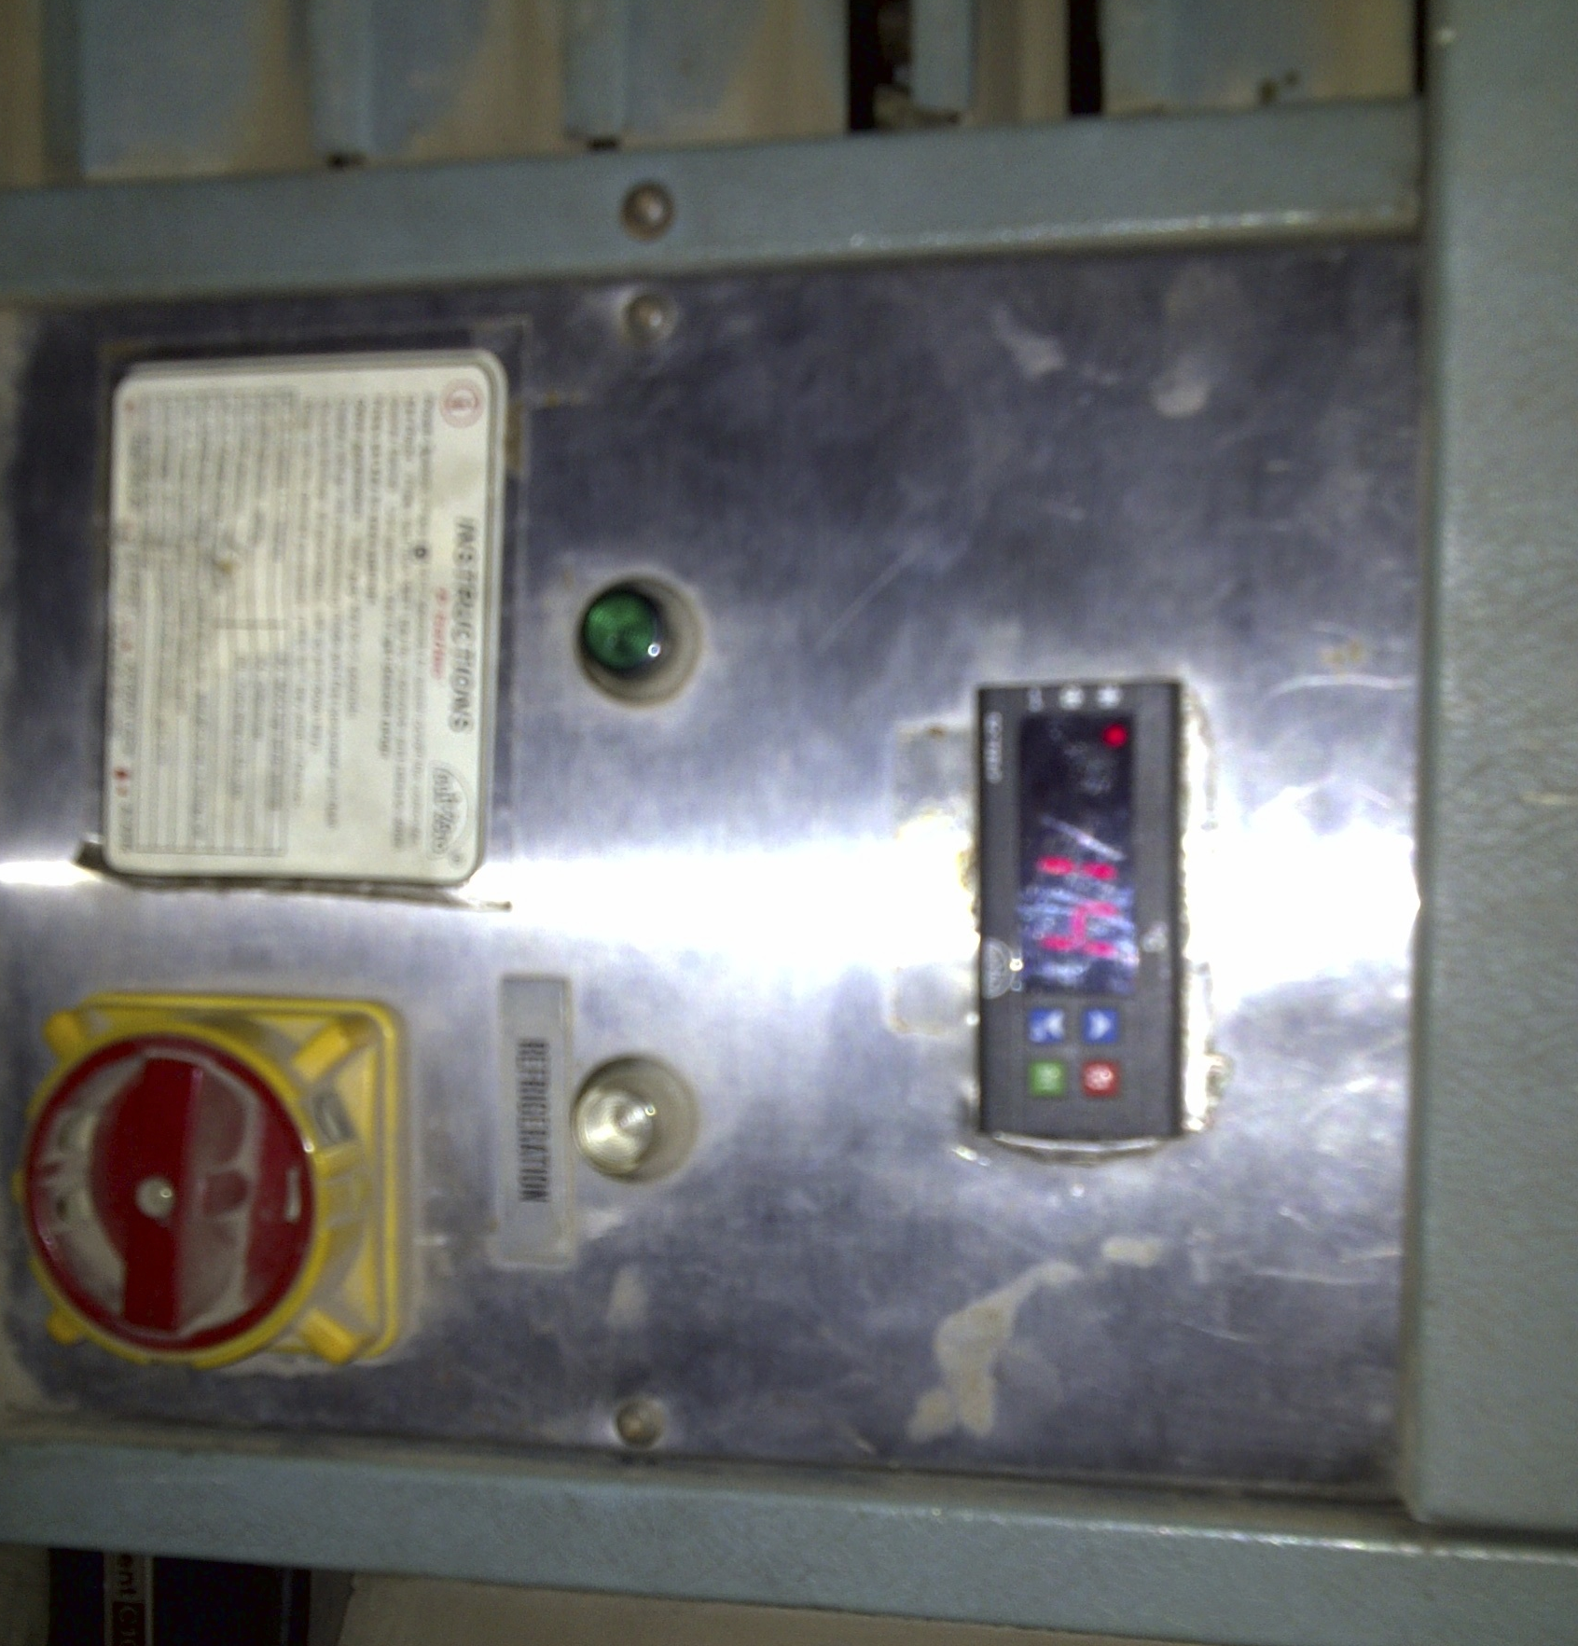
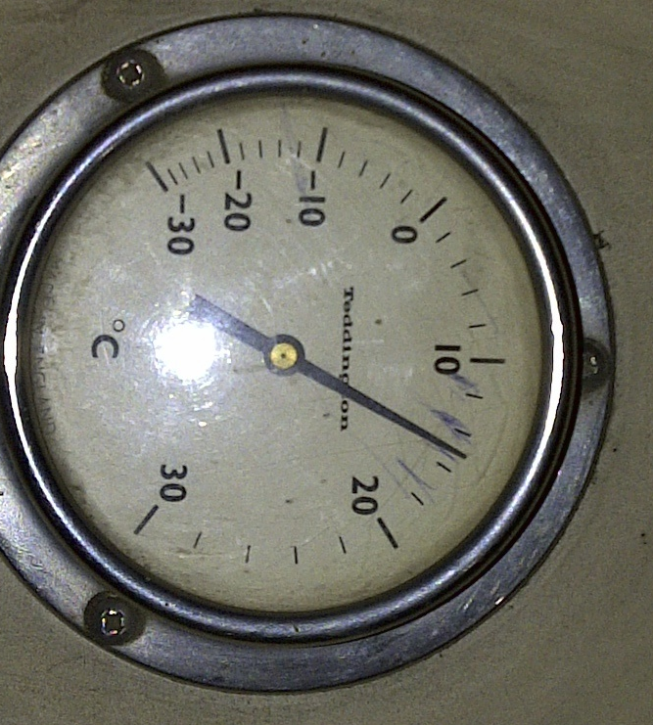

Some observations during field visits

Slide 12
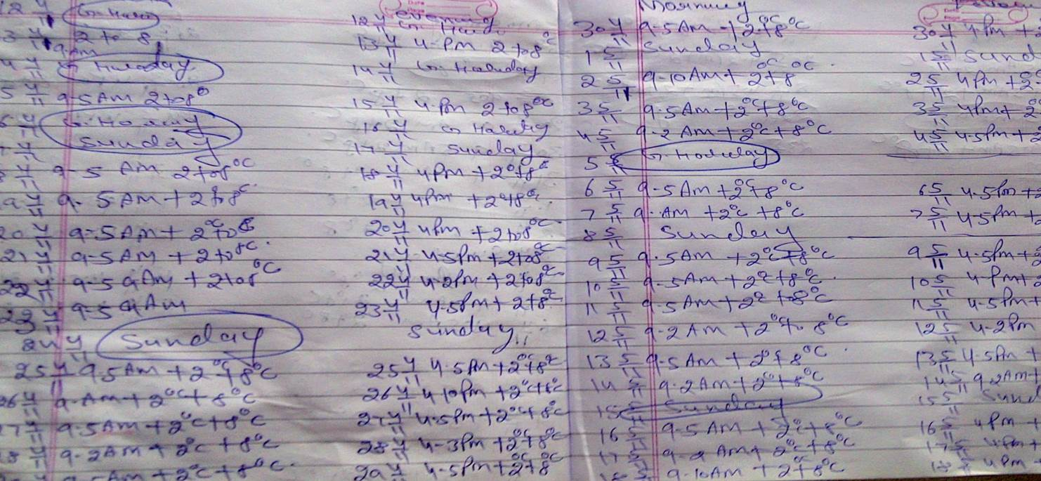
Some observations during field visits cntd..
How can we be sure that vaccines given to beneficiaries in immunization programme is of good quality?

Slide 13
Use of SIM enabled temperature data logger:
An innovative yet simple technique

Slide 14
OBJECTIVE OF USE
Real time visibility of Temperature at cold chain equipment
Use of information for timely response
Accountable and vigilant system with proper trail.
Functional in limited resource setting
The Ultimate objective is
“ Safe and Potent Vaccine For Each Child”

Slide 15

Temperature Data Logger: The Device
Control
Buttons
A special electronic device designed by PHFI
Developed to monitor temperature of cold chain equipment
Has an In-built SIM to send out real time temperature readings and alerts at calibrated time interval
Monitor
Screen

Slide 16
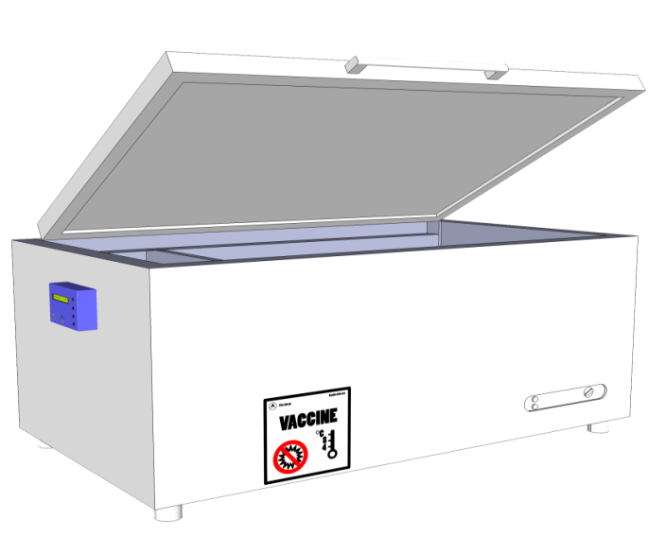
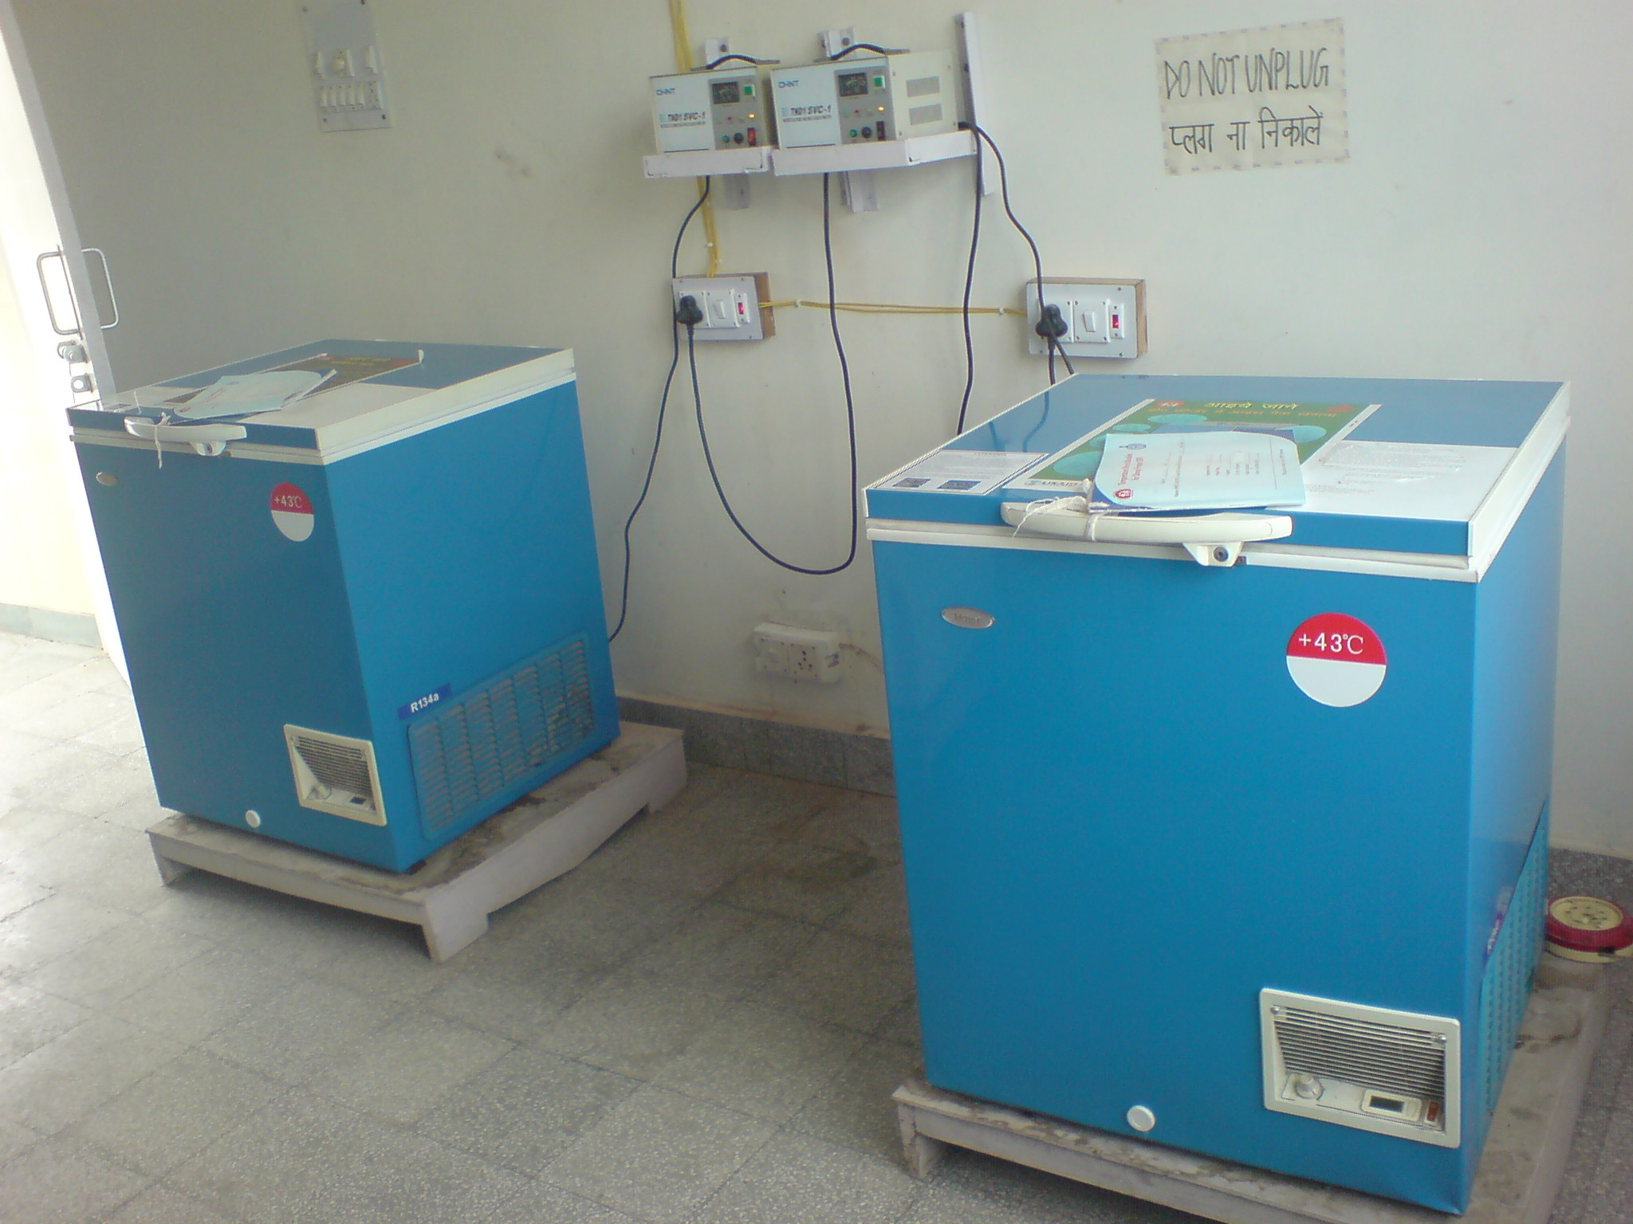
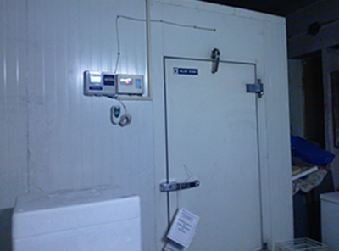
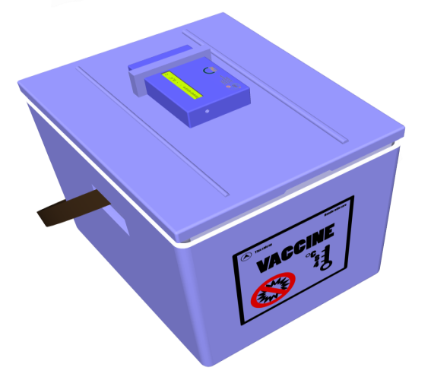

Temperature Data Logger: Where it can be used
Deep Freezer
ILR Type
WIC
Box Type
Walk in Cooler
Walk in Freezer
Ice Lined Refrigerator
Deep Freezer
Cold Boxes
Vaccine carriers

Slide 17
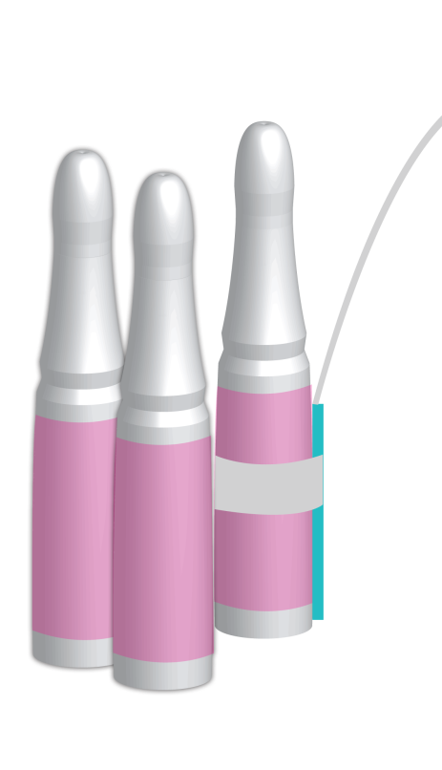
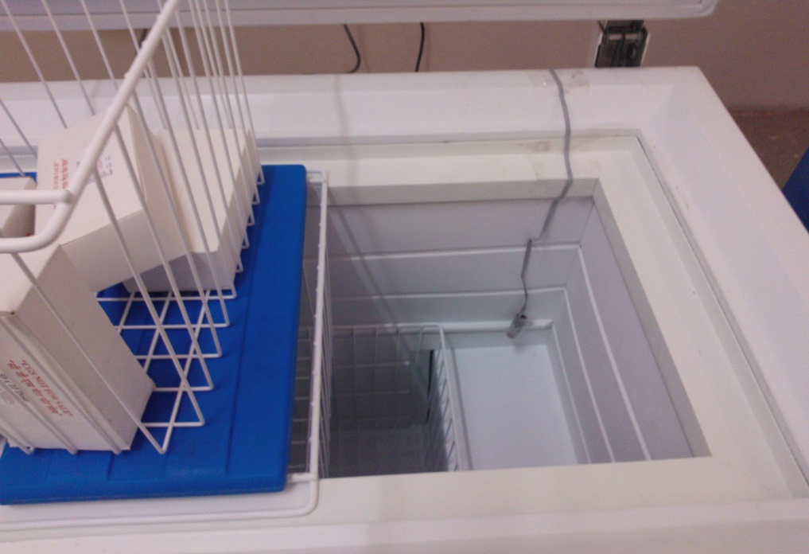

Temperature Data Logger: How it cn be used
Sensor are placed with vaccine and attached to a vaccine vial
Wire of sensor is very thin and can enter the equipment without effecting closing and opening of door
The temperature sensor is attached to vial itself for accurate measurements

Slide 18
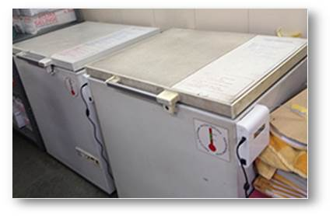
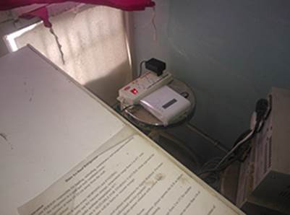
Temperature Data Logger: In ILR & DF

Slide 19
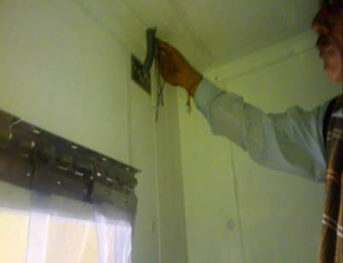
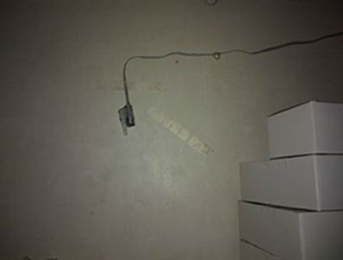
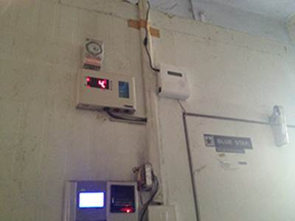
Temperature Data Logger: In WIC & WIF
2-3 sensors inside the WIC & WIF are placed to measure temperature of different corners

Slide 20
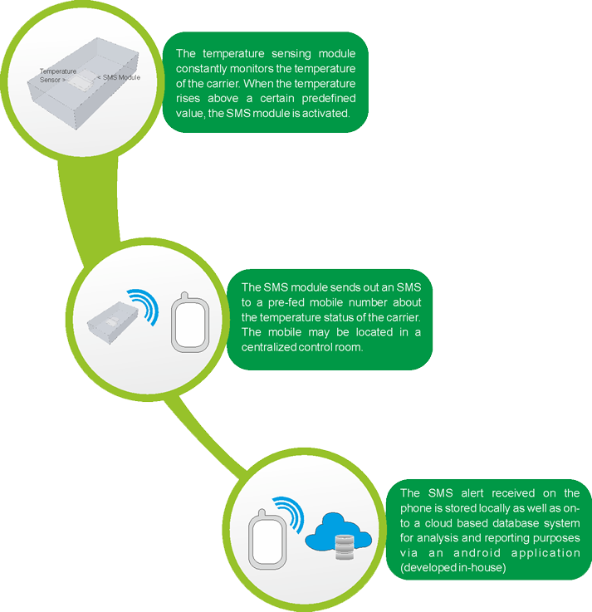
Temperature Data Logger: How the system works
SENSOR MODULE
The temperature sensing module constantly monitors the temperature of the CC equipment. When the temperature goes beyond recommended range, the SMS module is activated.
SMS MODULE
The SMS module sends out an SMS to a pre-fed mobile number about the temperature status of the CC Equipmenty

Slide 21

The Temprature logger Pilot : Haryana
Haryana initiated the pilot project throughout the compete Cold Chain system i.e. from State Vaccine Store upto last cold chain point in Kurukshetra district
Supported by PHFI/ITSU-GOI
The Pilot was launched in April 2013.
31 Temperature Loggers installed,
  2 In State Vaccine Store at Panchkula,
  4 at regional vaccine store KKR
  25 in PHC/ CHC cold chain points of KKR dist.
Initial troubleshooting and stabilization of devices going on.
Contingency and Response Plan developed for responding to temperature failures

Slide 22
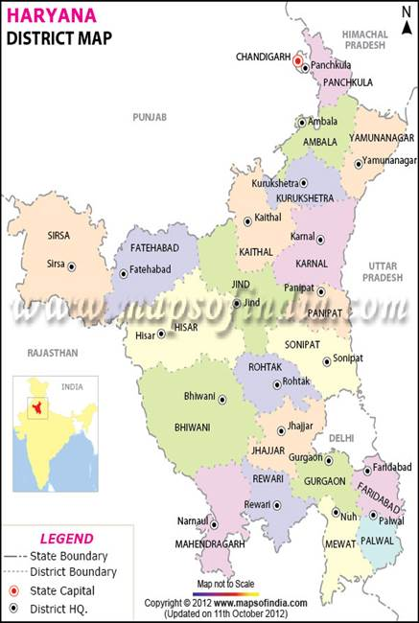
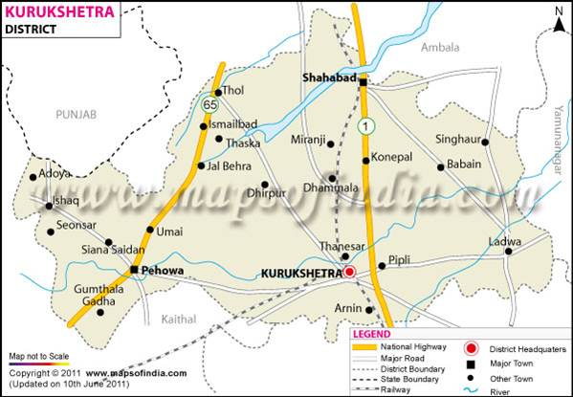
The Temprature Logger Pilot : Haryana
State Vaccine store

Slide 23
The Temprature logger Pilot : Haryana Contd..
State Level orientation on response plan competed
Conducted an inspection drill exercise for all machines initially reporting faulty temperature
Caliberation issues resolves and troubleshooting done
Identified nodal person for each cold chain point
Nodal person will receive an SMS alert whenever there is a temperature violation
District level orientation scheduled in July 2013.

Slide 24
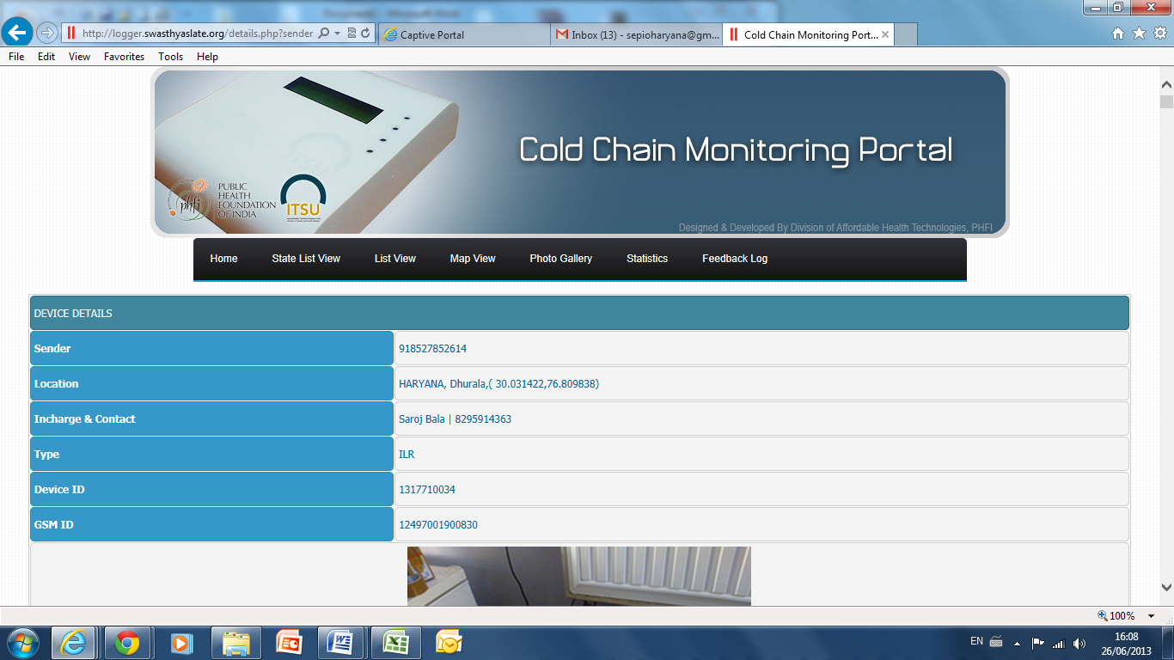
Temperature Data Logger: Monitoring Portal
Temperature Loggers installed are mapped on a central monitoring portal
Monitoring Portal have details about the logger device like
  GPS Location,
  Centre In charge,
  Contact Details,
  History of carrier temperature data,
  graphical representation etc..
Centre In Charges are given access to the portal so that they can monitor the carrier temperature.

Slide 25
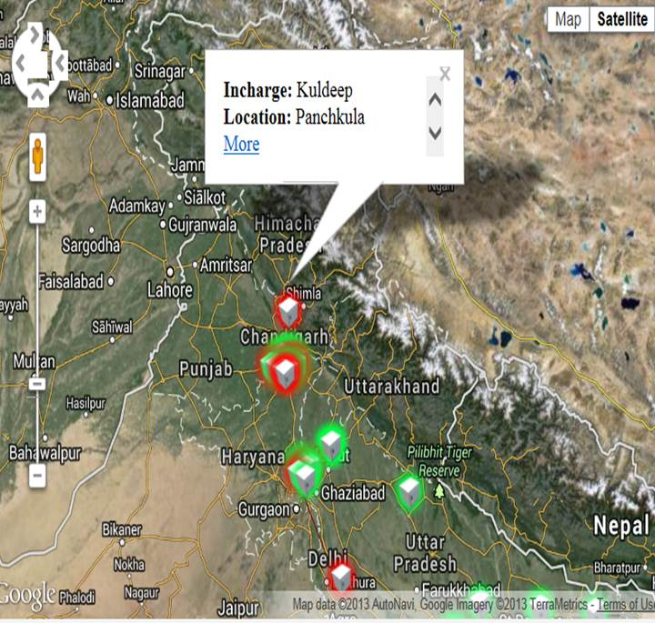
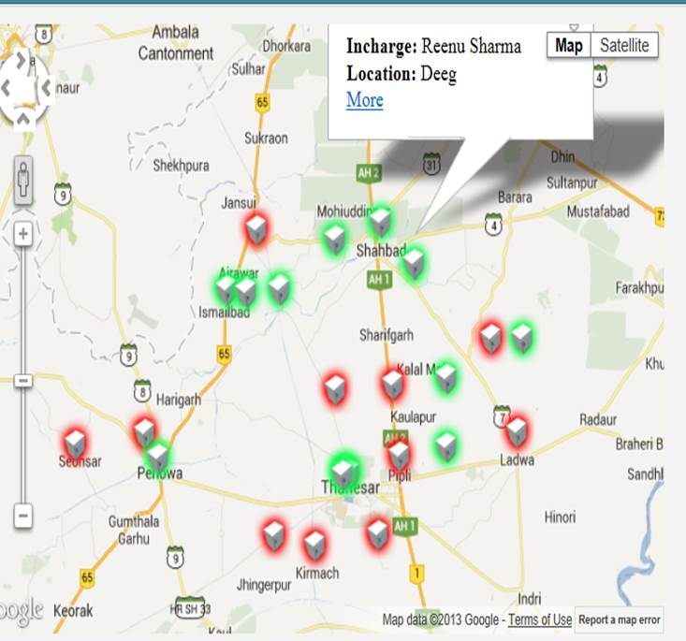
Temperature Data Logger: Monitoring Portal

Slide 26
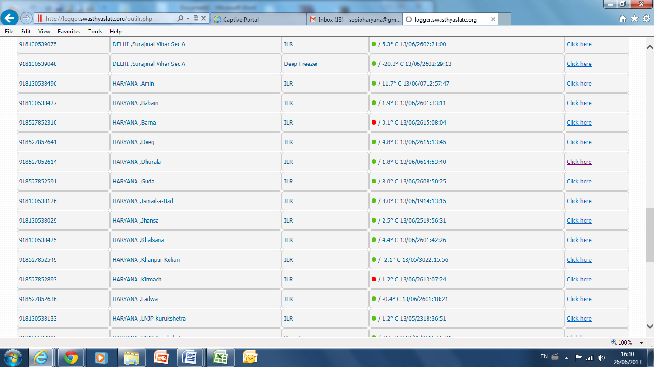
Temperature Data Logger: Monitoring Portal

Slide 27
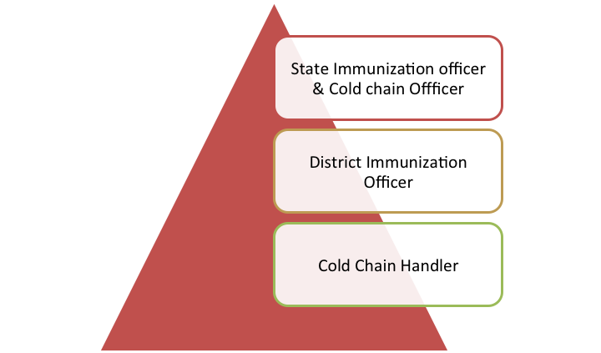
Monitoring & Feedback Mechanism
Monitoring
Intervention

Slide 28
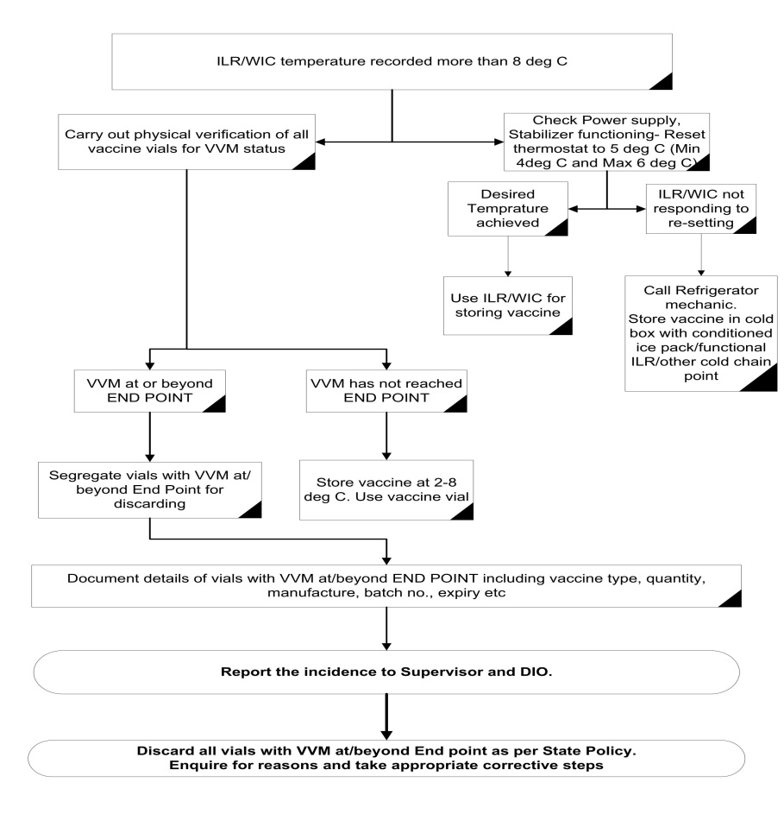
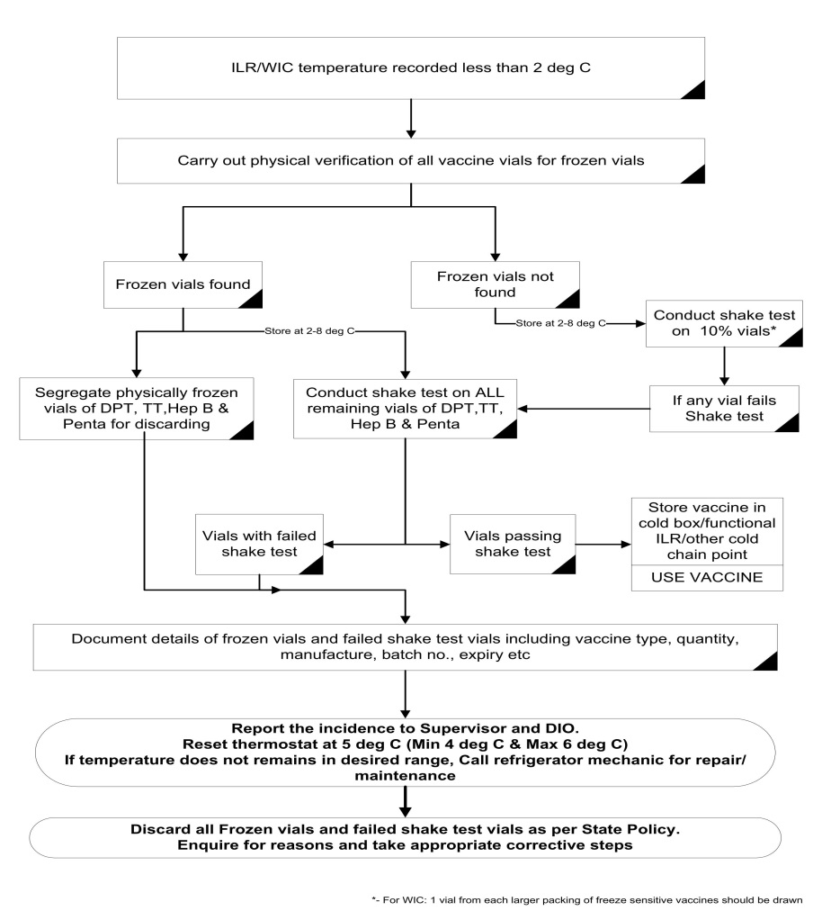
Response Plan in event of Temp Failure
Temp less than recommended
Temp more than recommended

Slide 29
SMS Alerts
SMS Alert Protocol
Level | Equipment | Condition | Alert to be Sent to
PHC/Other Sub District Cold Chain Points | ILR | 2 Degree and below 8 Degree and above | Cold Chain Handler MO In-charge
 | If no correction at local level for 12 hour (or > 2 outlier readings in 24 hrs), alert for individual equipment will be sent to- |  | District Cold Chain Technician Dist. CC Handler DIO
District Cold Chain Points | ILR | 2 Degree and below 8 Degree and above | District Cold Chain Technician Dist. CC Handler DIO
 | DF | > ( - 15) Degree
Regional Cold Chain Point | WIC | 2 Degree and below 8 Degree and above | Reg. CC Handler DIO Dist. CC Technician State CCO State CC Tech SIO
 | WIF | > - 15 Degree
State Cold Chain Point | WIC | 2 Degree and below 8 Degree and above | State CCO State CC Tech SIO
 | WIF | > - 15 Degree

Slide 30

Conclusion
Temprature monitoring is very important to ensure delivery of safe vaccine to beneficiary
System has started recording the temperature for the cold chain equipment and transmitting in real time to the website
It helped in sensitising the health staff for prompt action.
Initial response has been very encouraging
Scaling up appears to be very much feasible as well as utterly desirable.

Slide 31
Way forward
This Pilot has been recently launched with installation of Temperature monitoring devices
A full scale monitoring and response will start in July 2013 in pilot areas.
Contingency plan is to be implemented with mechanism of prompt response to cold chain break down & temperature failure
Improved system performance from the pilot is expected only after 6 -12 months with scope of scale up to other areas.

Slide 32

Thanks
Team Haryana

