Slide 1
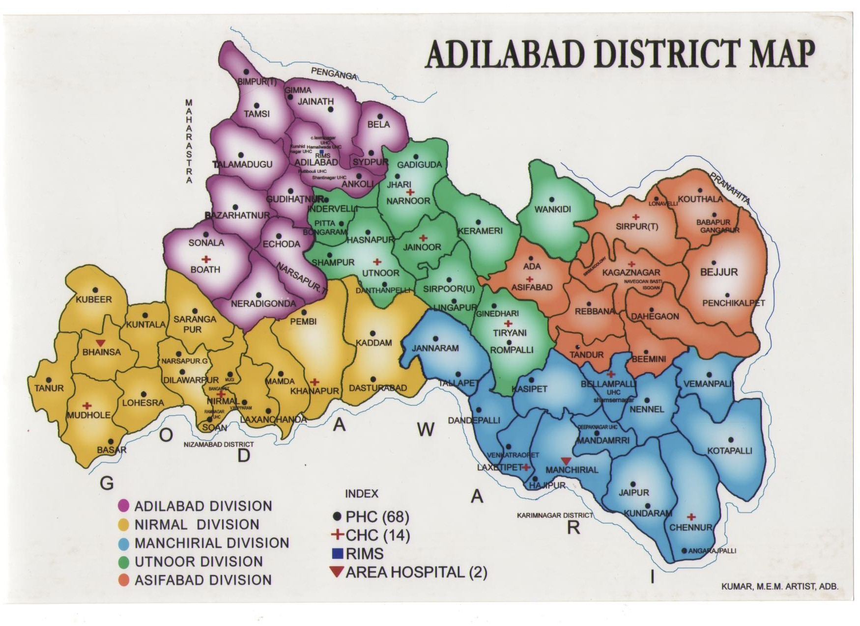
District Map for existing locations of MCH facilities
S/C
PHC
CHC
AH
DH
TH
Pvt.
L0: L1: L2: L3

